Slide 1
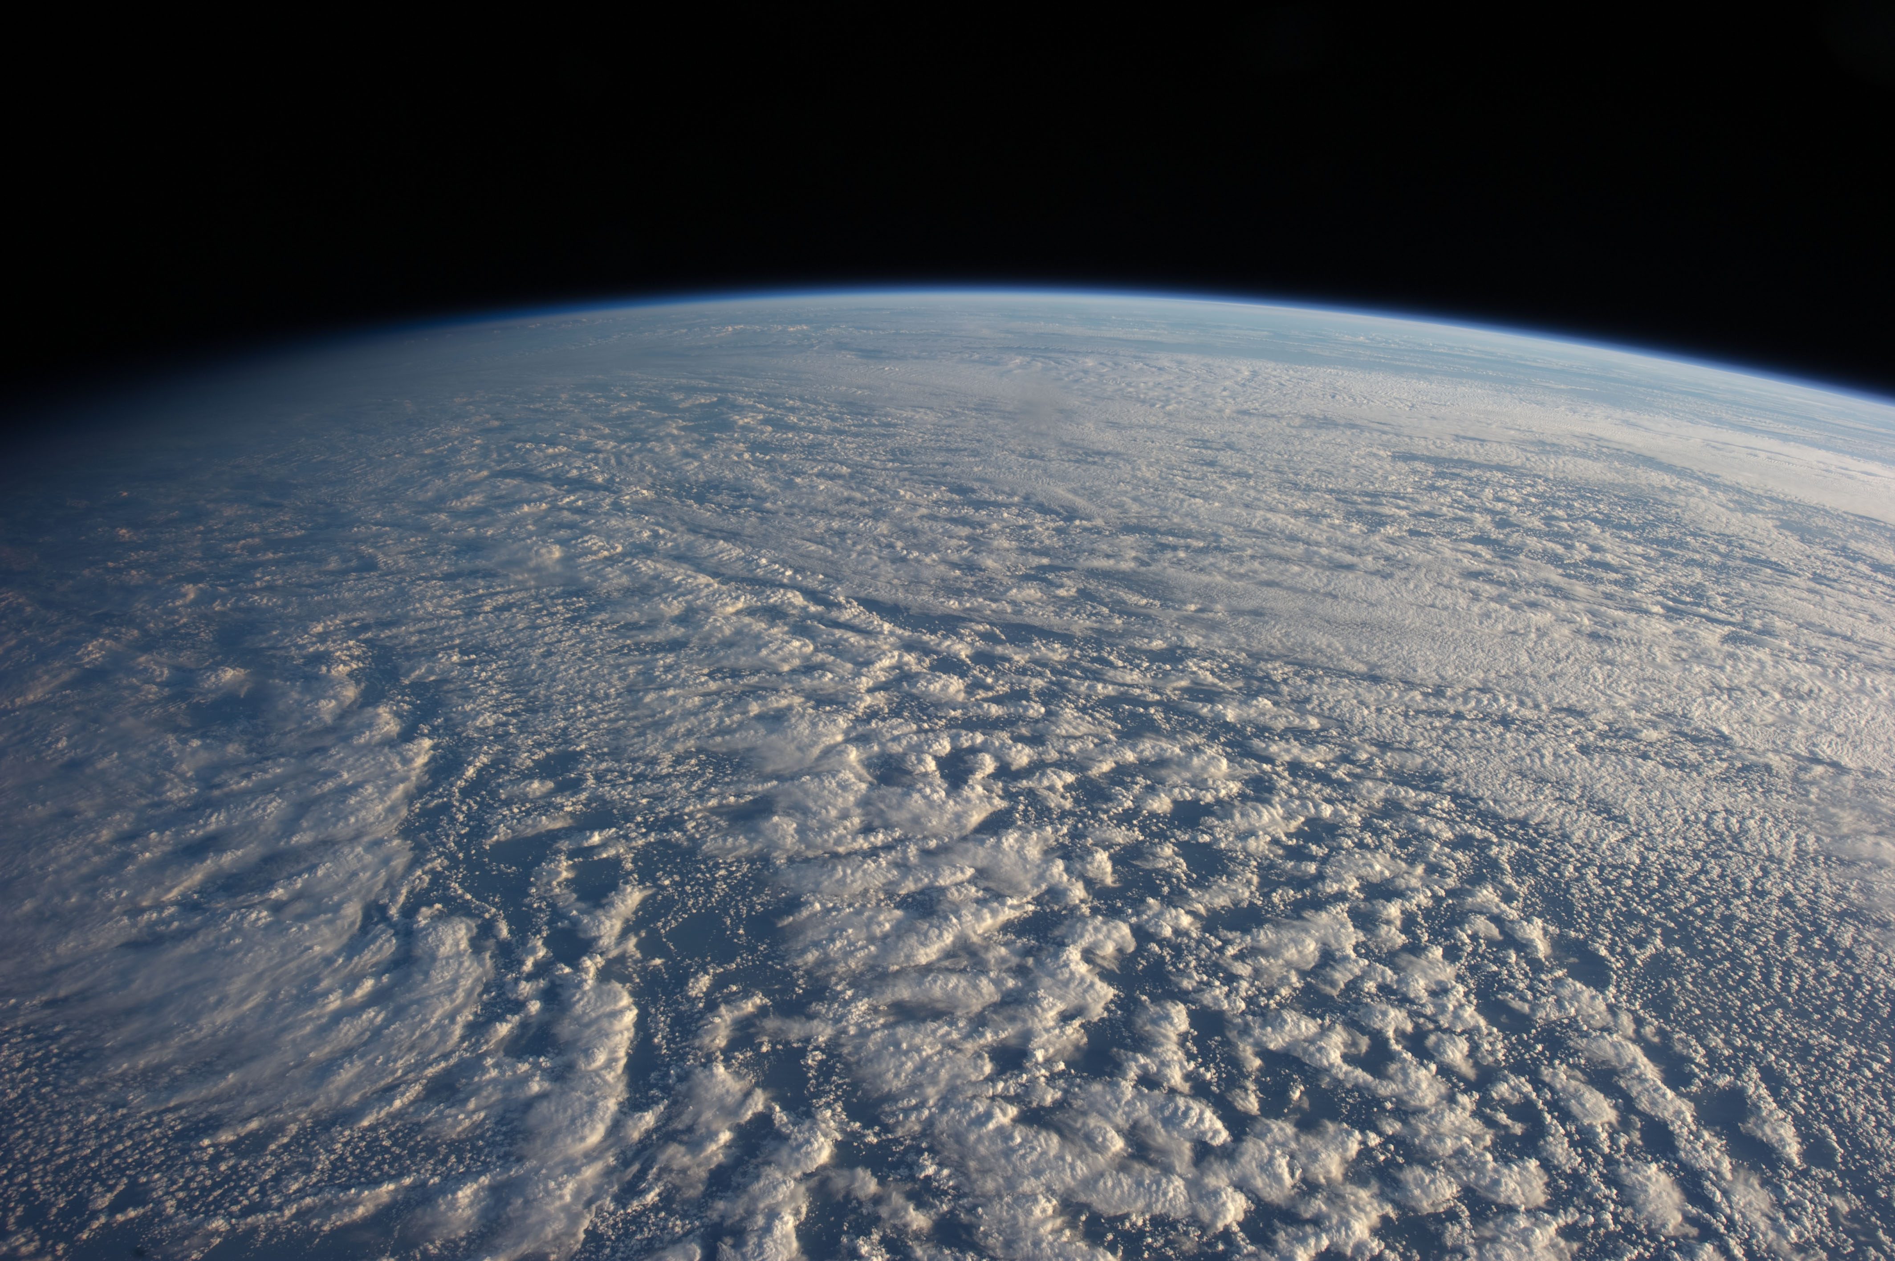

A global search for aerosol-cloud interaction signals using Cloud Regimes
Lazaros Oreopoulos
Climate and Radiation Laboratory
NASA-GSFC
Acknowledgements: Nayeong Cho and Dongmin Lee

Slide 2
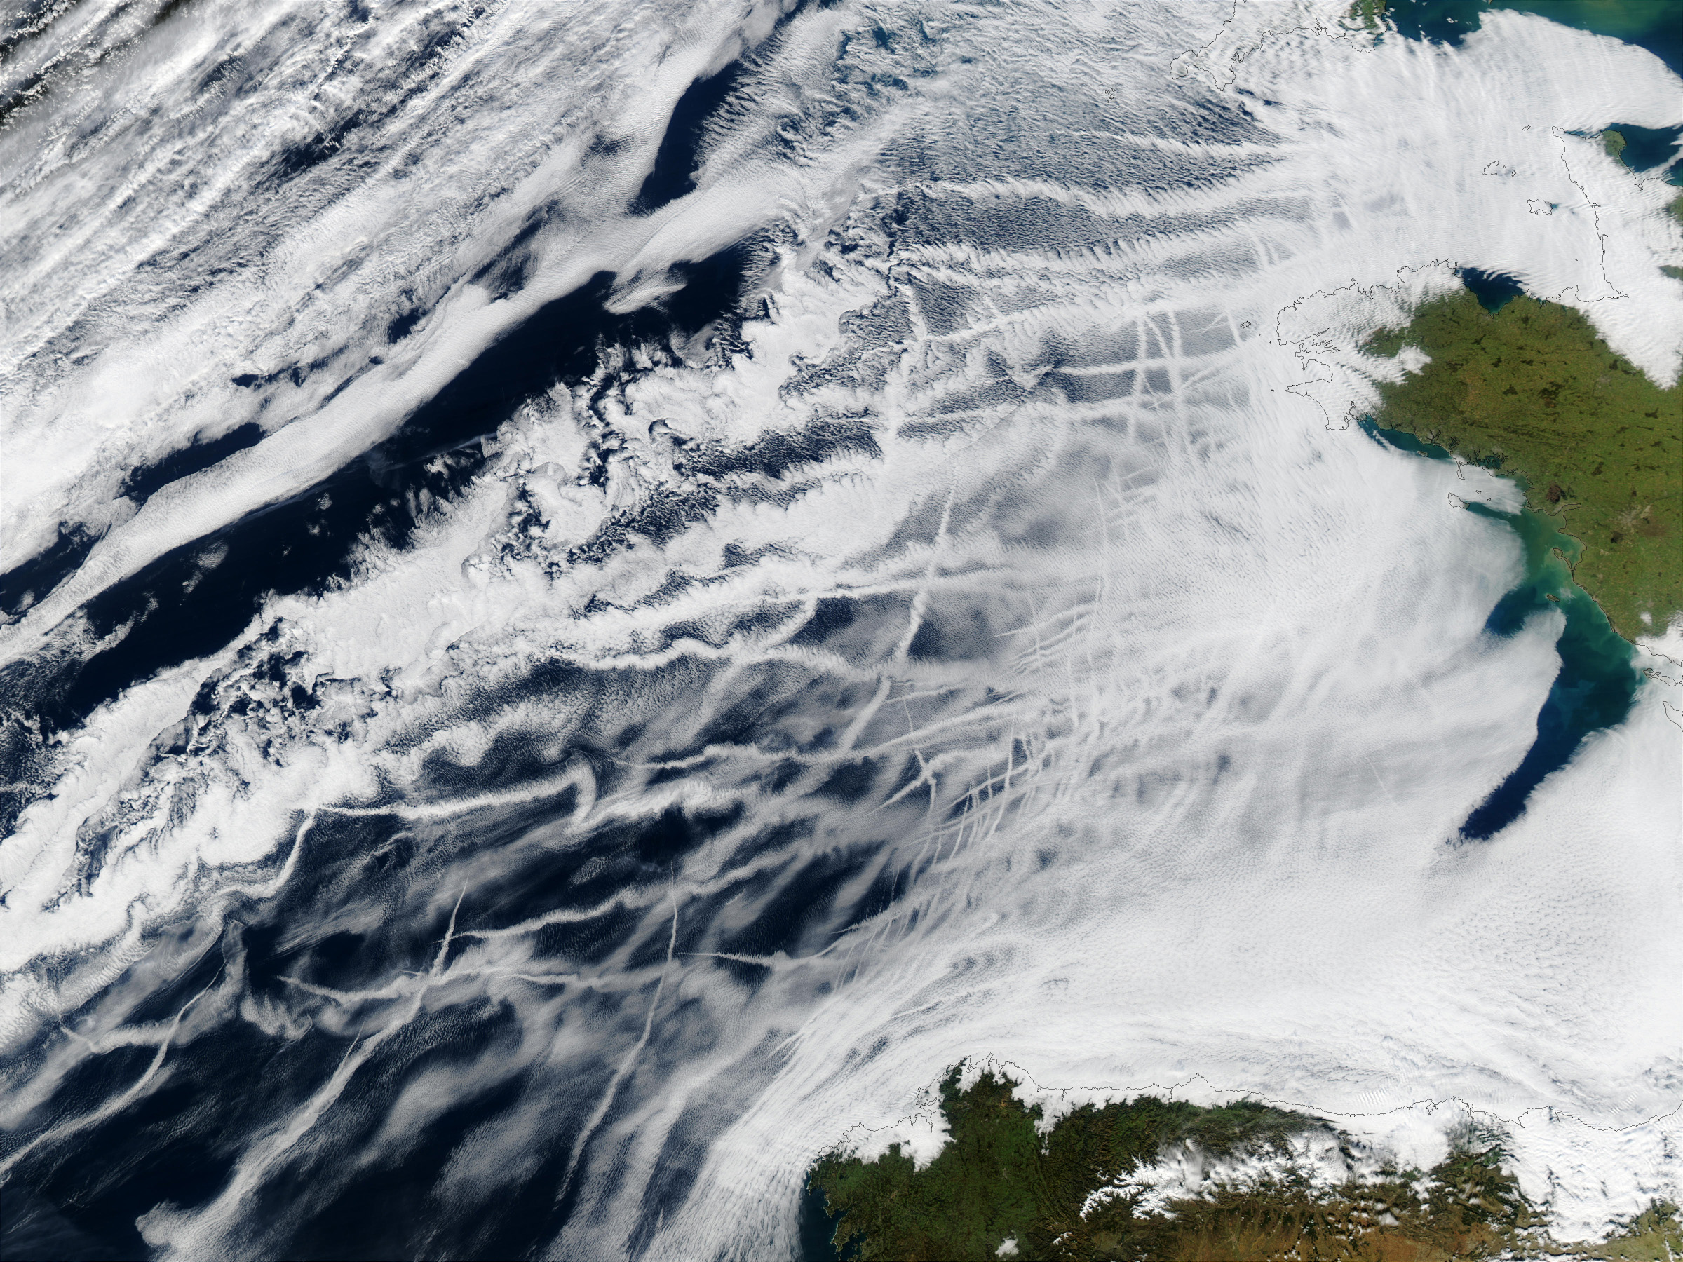
Motivation and approach
Interpretation of aerosol-cloud interactions from space is difficult.
How to separate aerosol from all other effects on clouds?
Nevertheless, apparent systematic relationships can perhaps be diagnosed at near-global scales
Breakdown by “cloud regime” (CR), a cloud class representative of similar cloud conditions, may help streamline the analysis
How can regimes be defined?
  We have previously used CRs from passive observations (MODIS) defined as having alike CTP-COT histograms
  Should pose some constraint on meteorological conditions

Slide 3
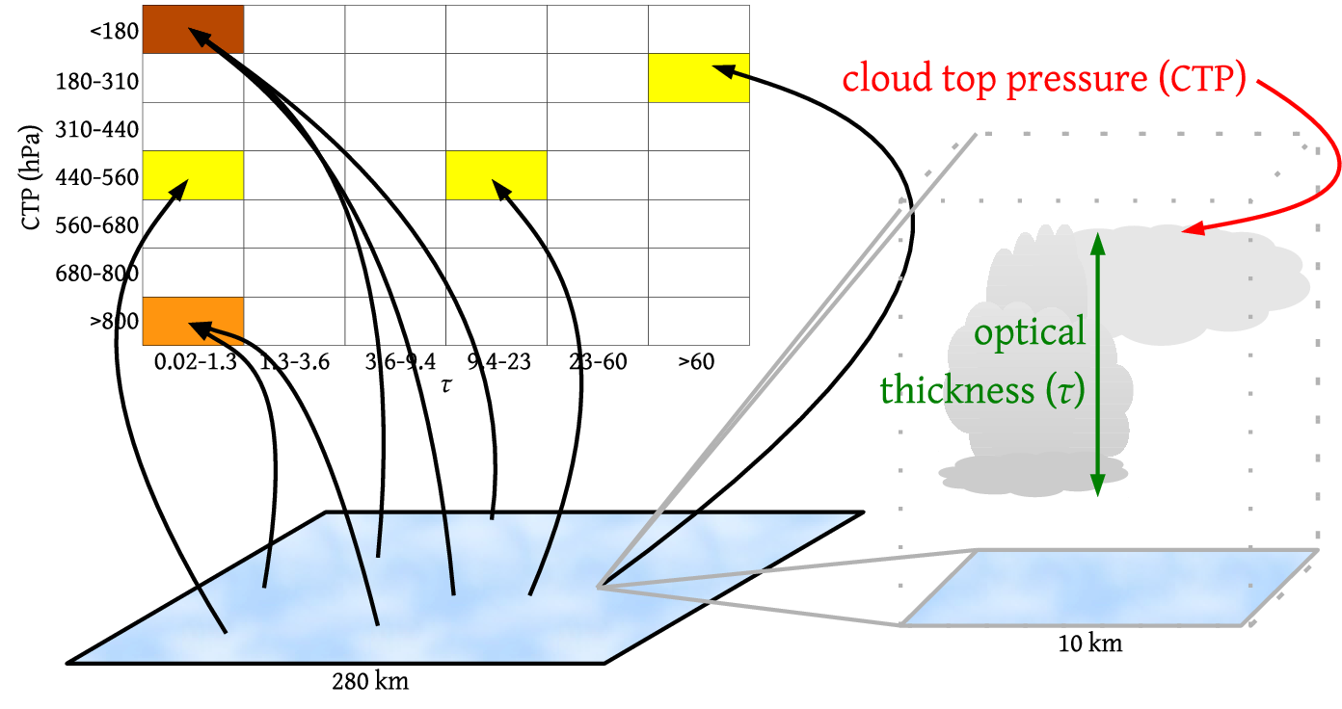
MODIS Joint CTP-COT histograms
1 km
1 degree
Courtesy of Jackson Tan

Slide 4
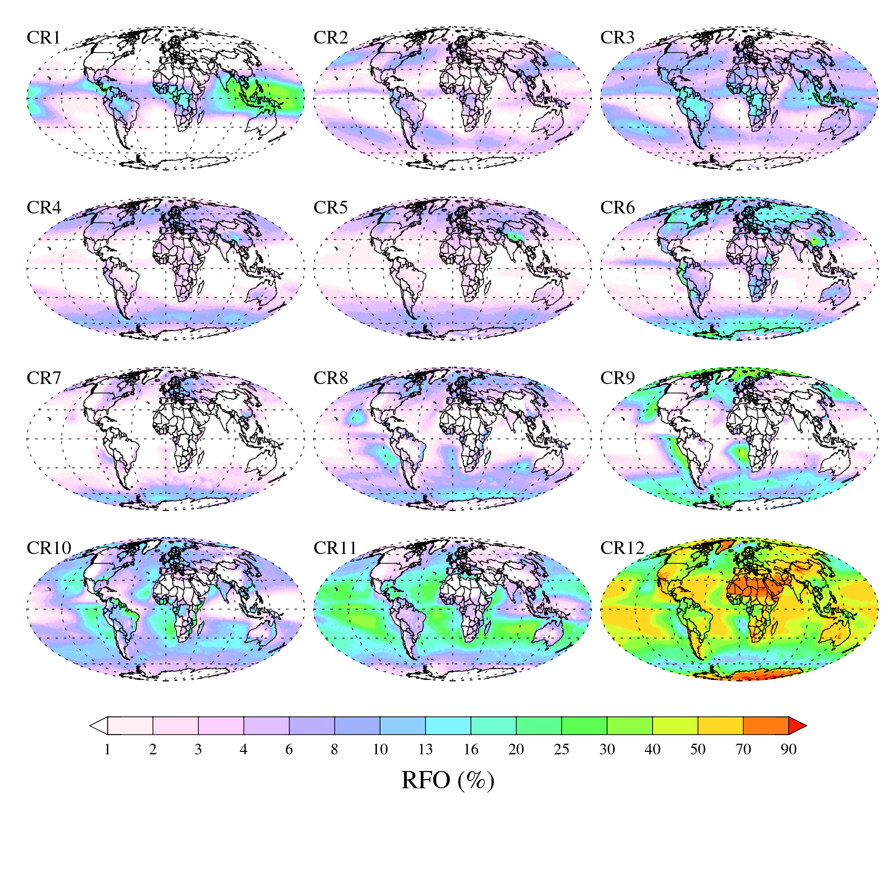
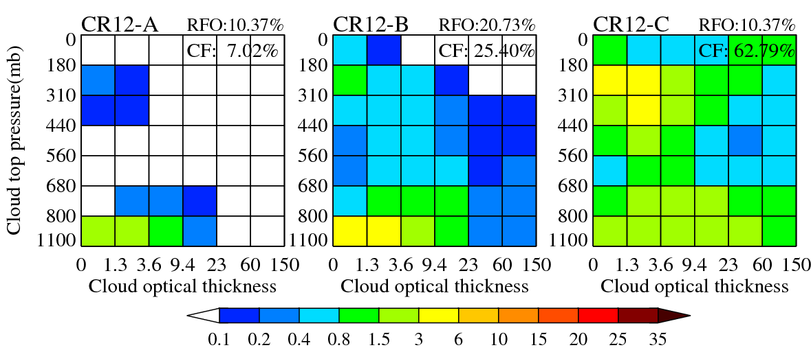
MODIS Collection 6 Cloud Regimes (CRs)

Slide 5
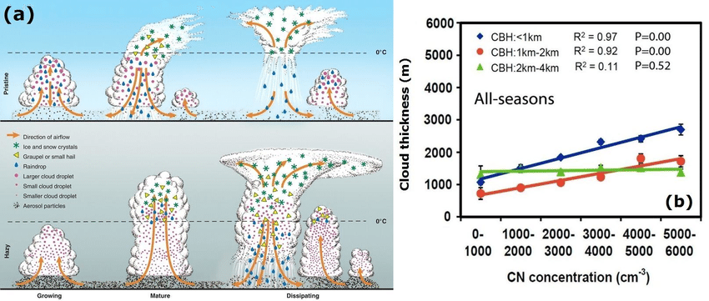
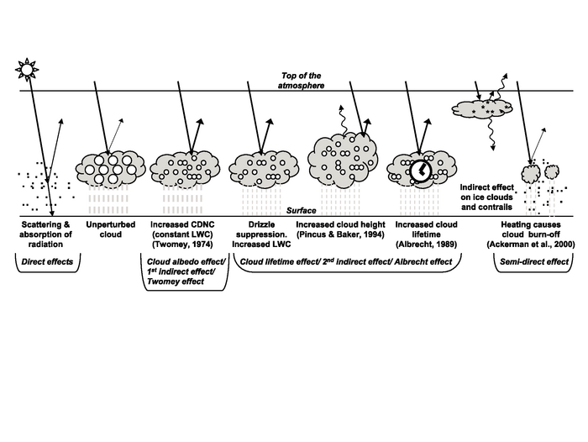
Radiation/Precipitation signals we are searching for as AOD increases
(Classic Paradigms)
Invigoration (ice and mixed CRs, CR1-CR5, CR12) | First indirect effect (FIE) (liquid CRs, CR6-CR11) | Second indirect effect (SIE) (liquid CRs, CR6-CR11)
“Conventional” paradigms (have been under scrutiny)
CF increases CTP decreases (CTH increases) COT increases CRE_SW and CRE_LW increase PR and POP increases | LWP constant CER decreases COT increases CRE_SW increases | PR and POP decrease CF increases LWP increases COT increases CRE_SW and CRE_LW increase
“Twomey”
“Lifetime”
Old IPCC report
Rosenfeld et al. (2008)
Notes:
Evolution of deep convective clouds developing in the pristine (top) and polluted (bottom) atmosphere. Cloud droplets coalesce into raindrops that rain out from the pristine clouds. The smaller drops in the polluted air do not precipitate before reaching the supercooled levels, where they freeze onto ice precipitation that falls and melts at lower levels. The additional release of latent heat of freezing aloft and reabsorbed heat at lower levels by the melting ice implies greater upward heat transport for the same amount of surface precipitation in the more polluted atmosphere. This means consumption of more instability for the same amount of rainfall. The inevitable result is invigoration of the convective clouds and additional rainfall, despite the slower conversion of cloud droplets to raindrops

Slide 6
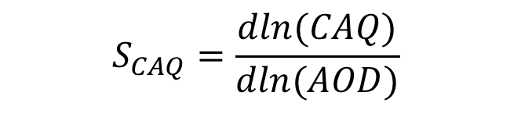

Local sensitivities, methodology
For each grid cell calculate the sensitivity ($S_{CAQ})$ of an afternoon cloud-affected quantity ($CAQ$) to morning AOD:
Slope of linear regression of $lnCAQ vs. lnAOD$ separately for each group (”ice”, ”mixed”, “liquid”) of morning CRs (separate regression for each CR12 subregime)
Each point in the scatterplot represents a distinct morning CR occurrence.
We do not care what afternoon CR the CAQ corresponds to
$$S_{CAQ}=\frac{dln(CAQ)}{dln(AOD)}$$

Slide 7
Caveats
Is AOD appropriate?
  AI=AOD×AE is not always available (MERRA2 and MODIS-land)
  Strictly speaking, CCN(z)/IN(z) are most appropriate
Aerosol in the neighborhood of clouds problematic
  Sampling issue for MODIS
Time delay between Terra and Aqua vs timescale of interaction
Meteorological influences
  How much do CRs constrain?
  Have looked into this, will not show today

Slide 8
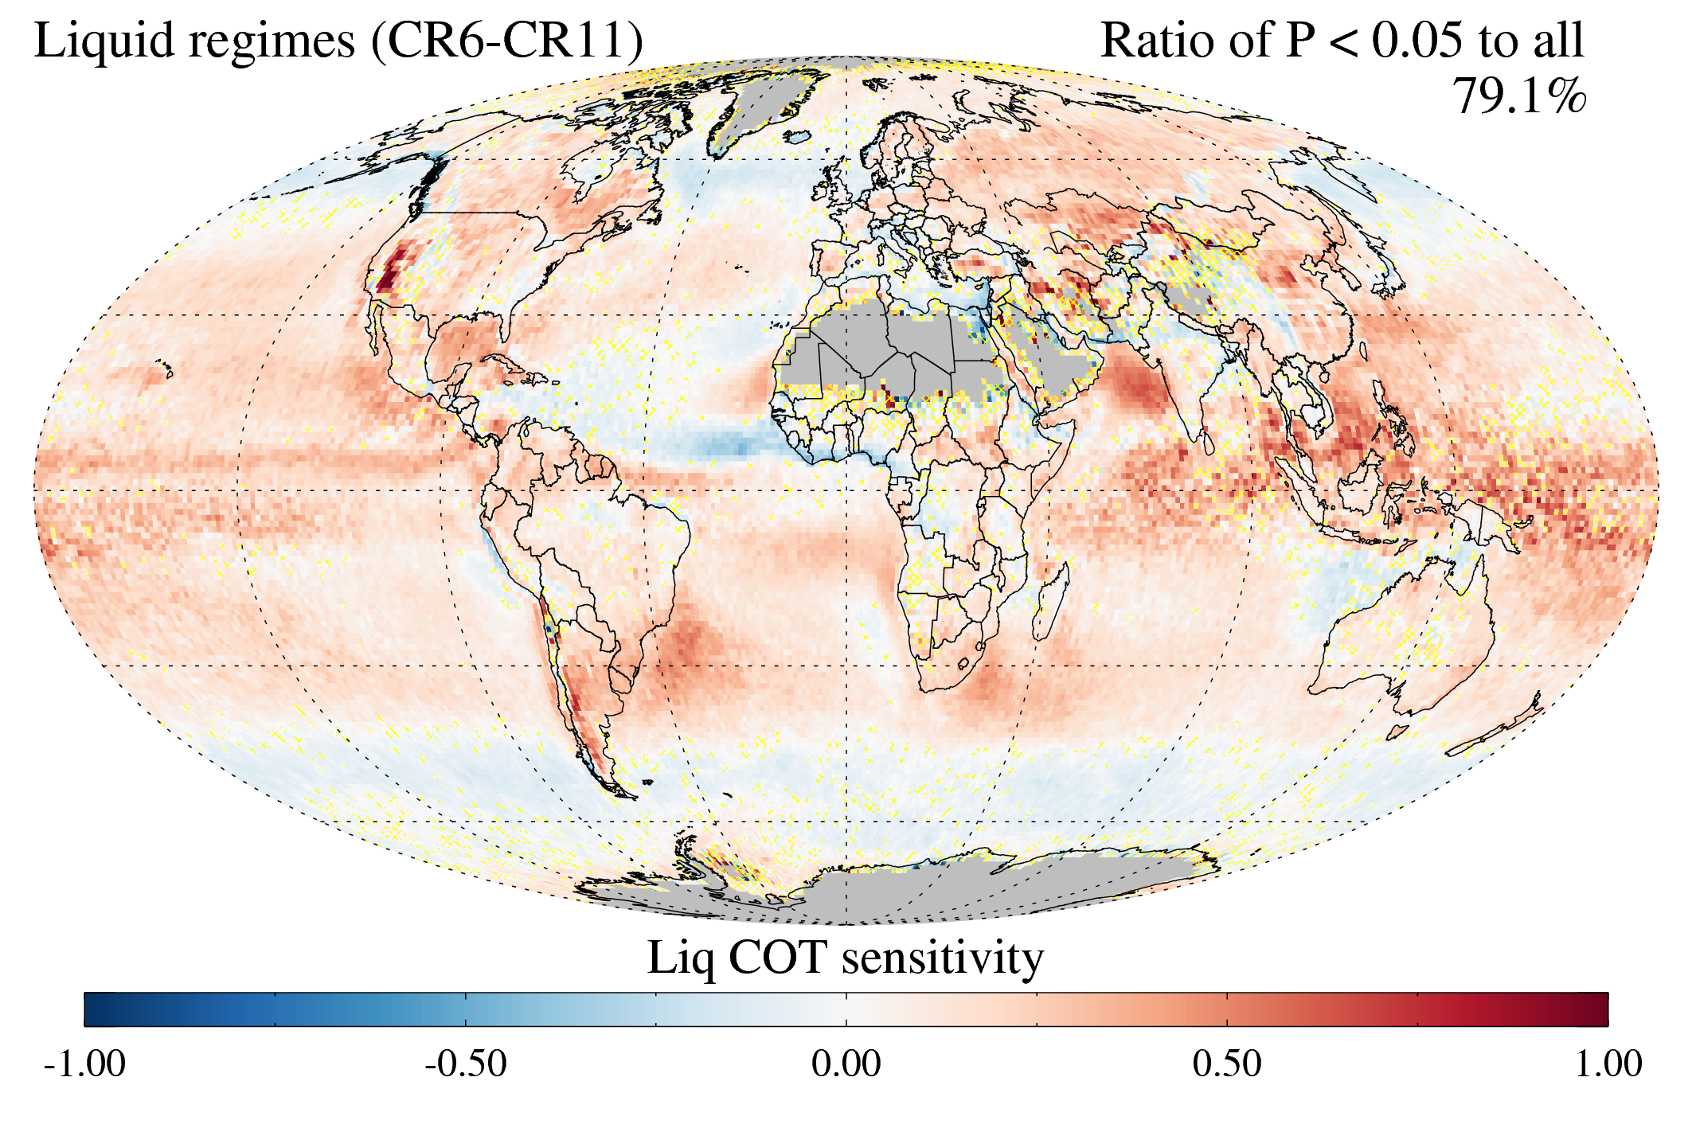
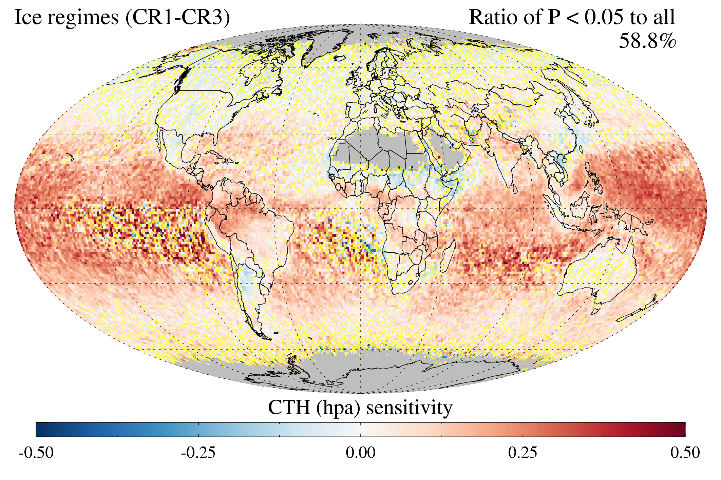
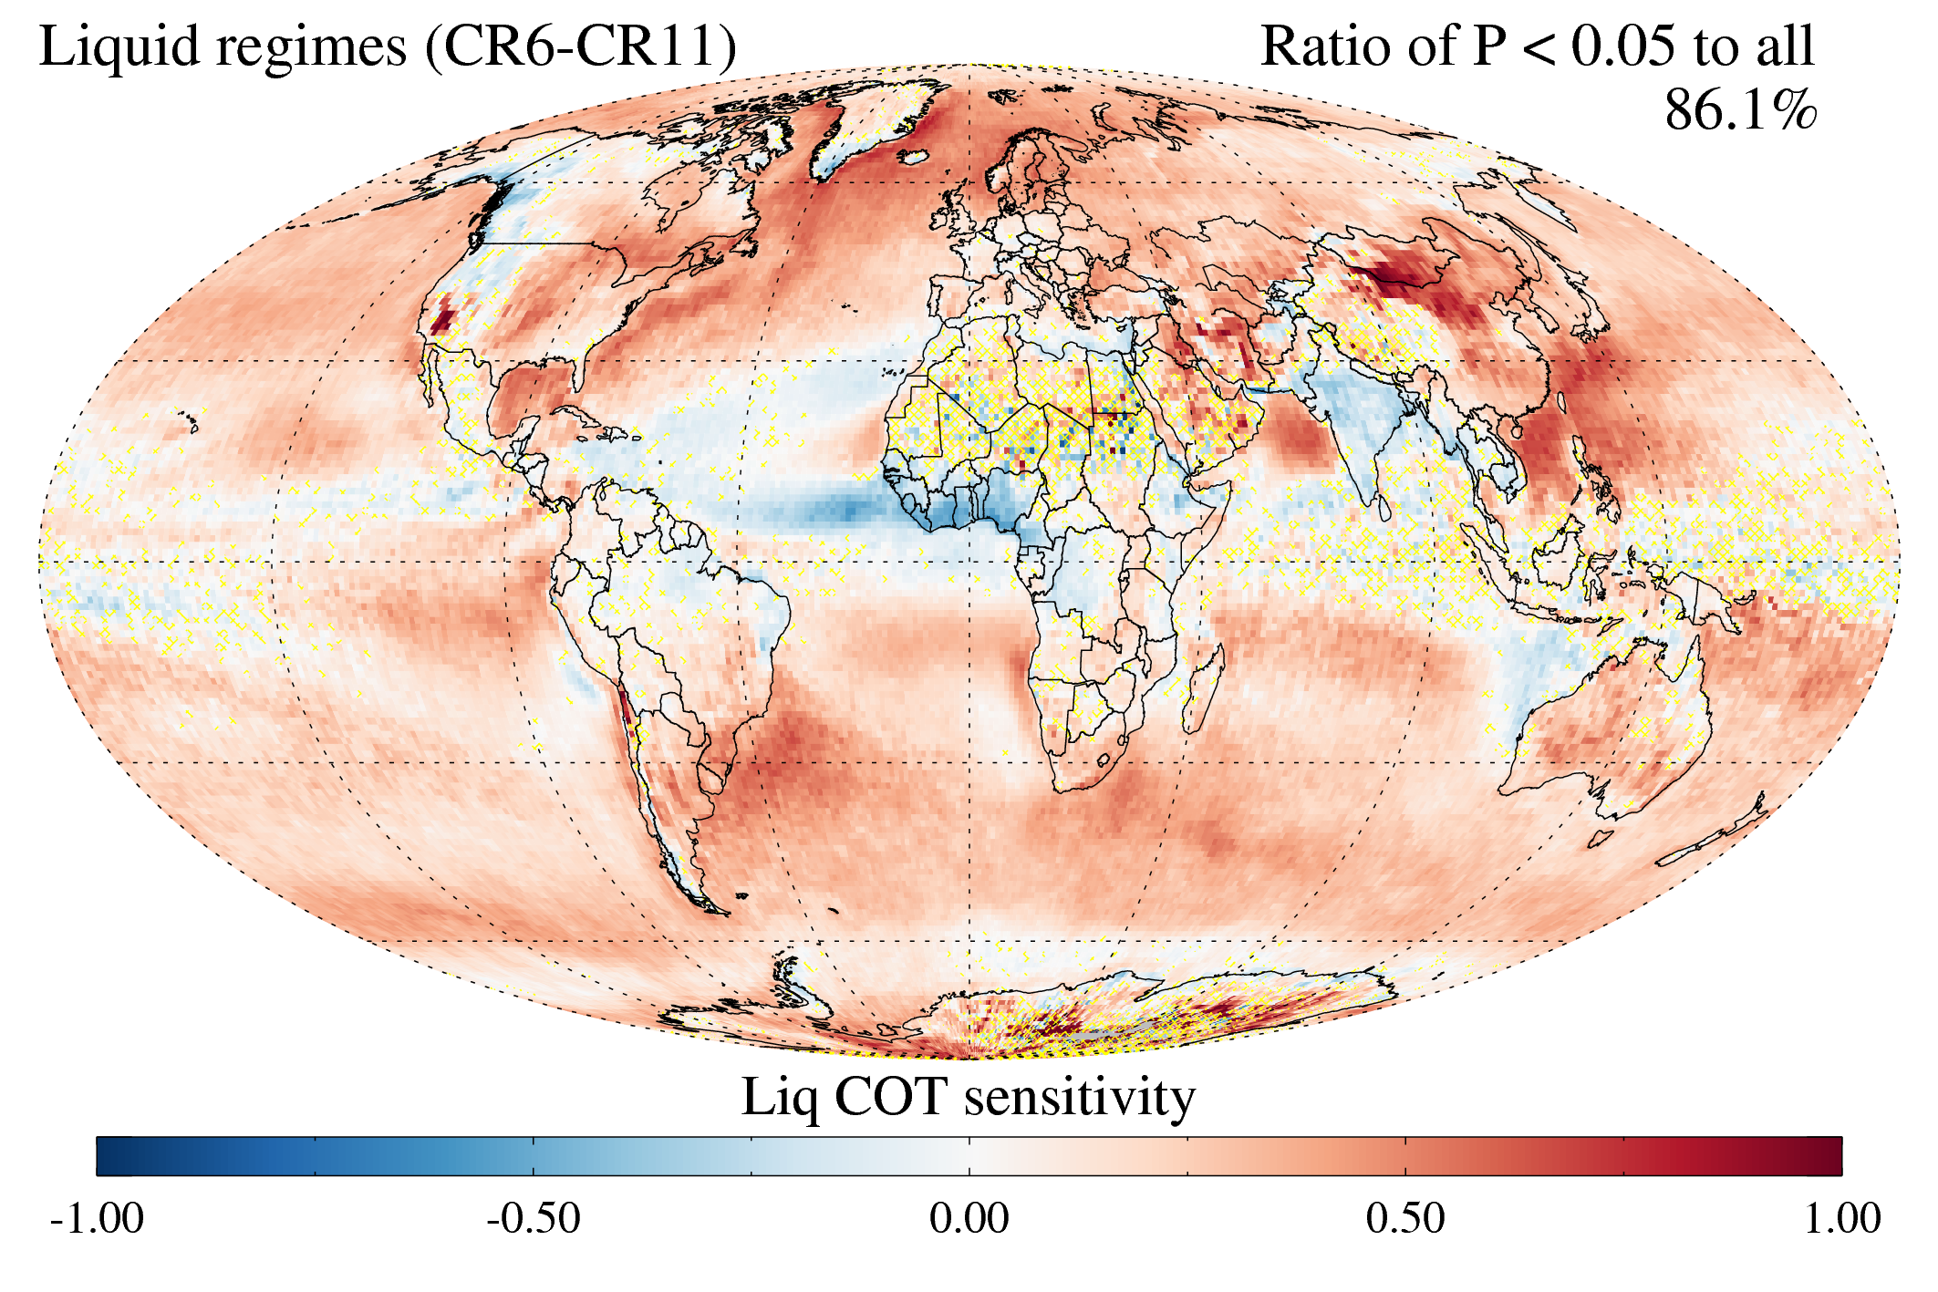
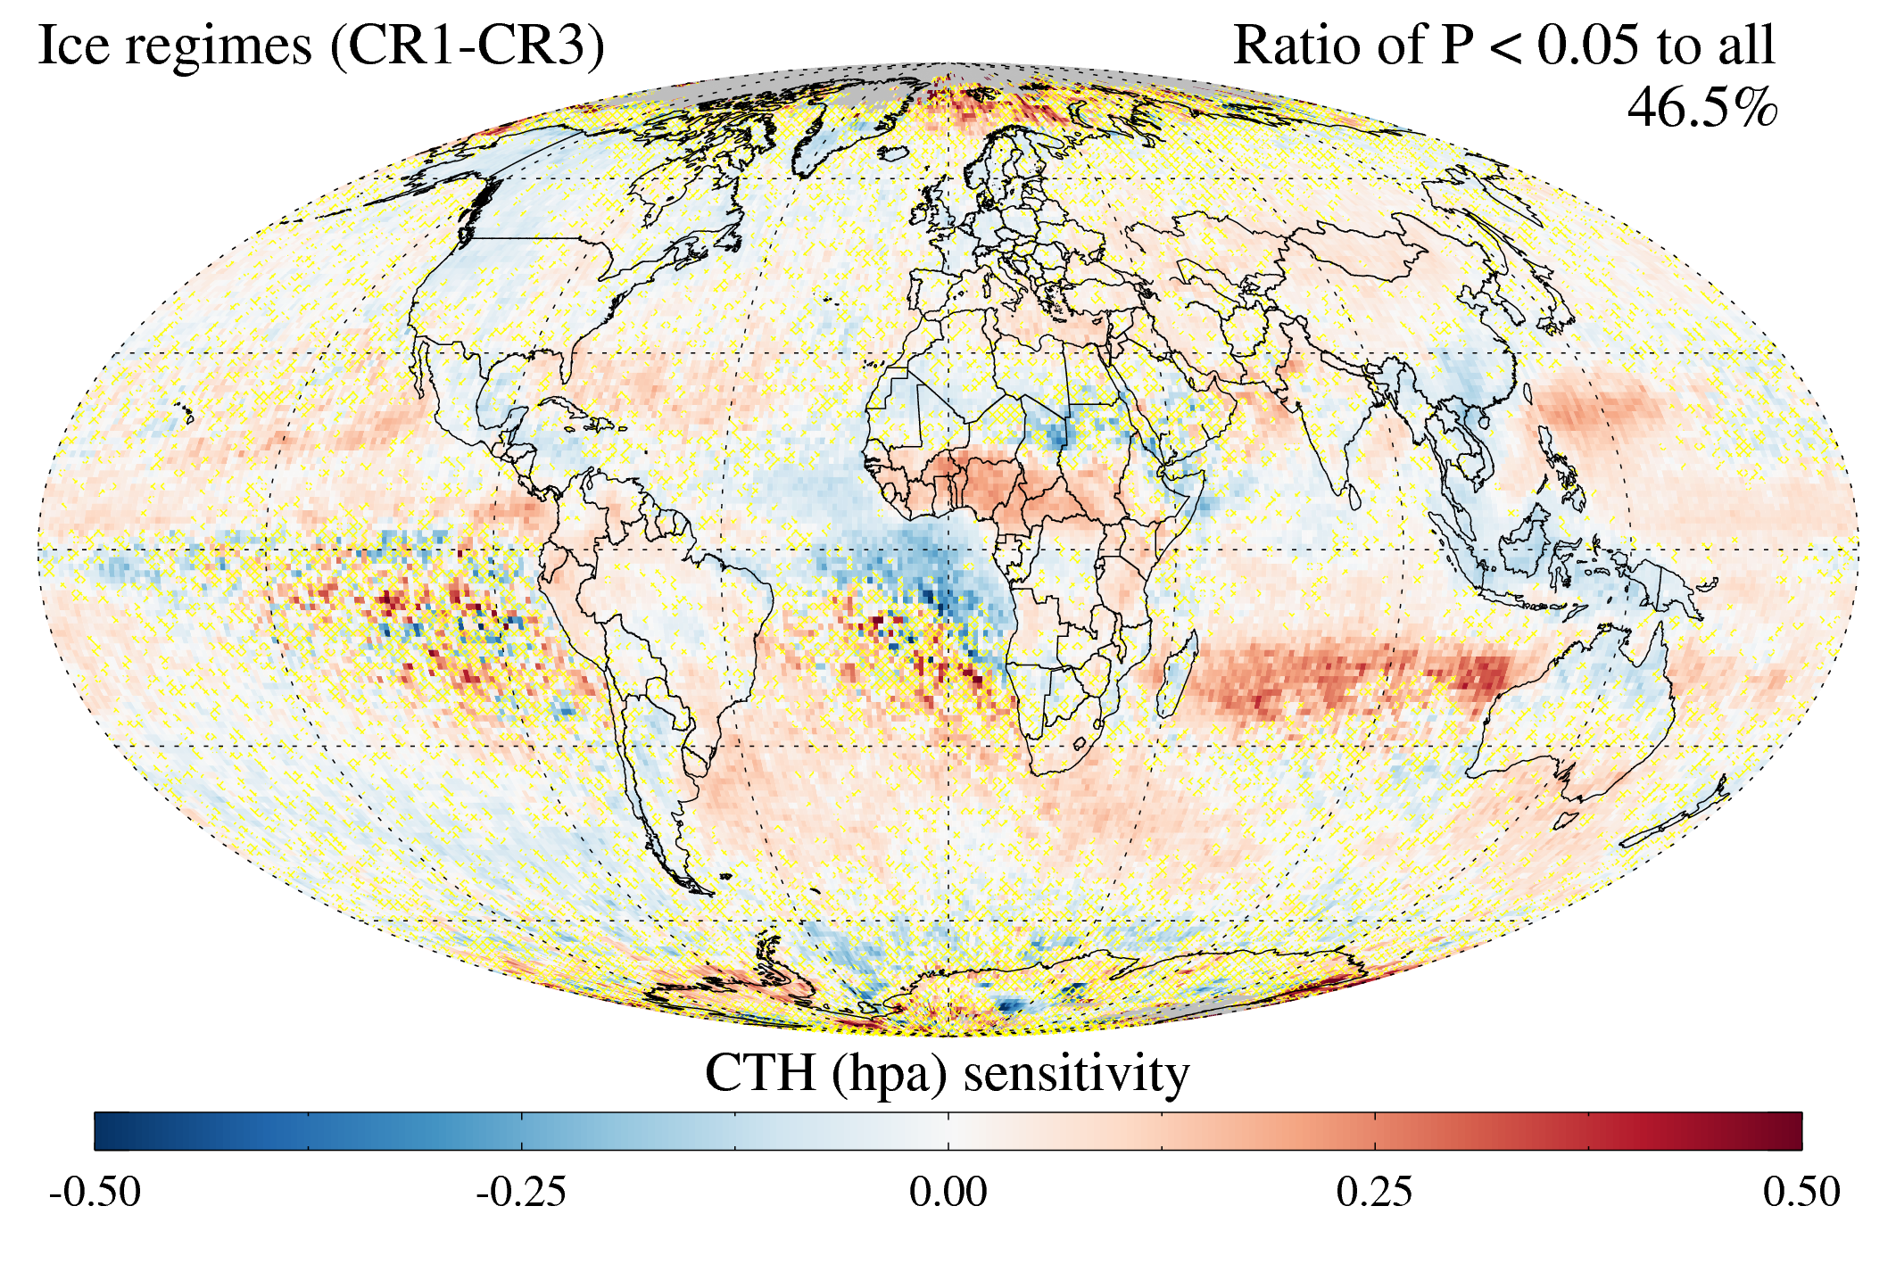
Some examples
MODIS AOD
MERRA2 AOD
Gray: Fewer than 5 points available
Yellow shading: Failed F-test for goodness of fit at 95% confidence level.

Slide 9
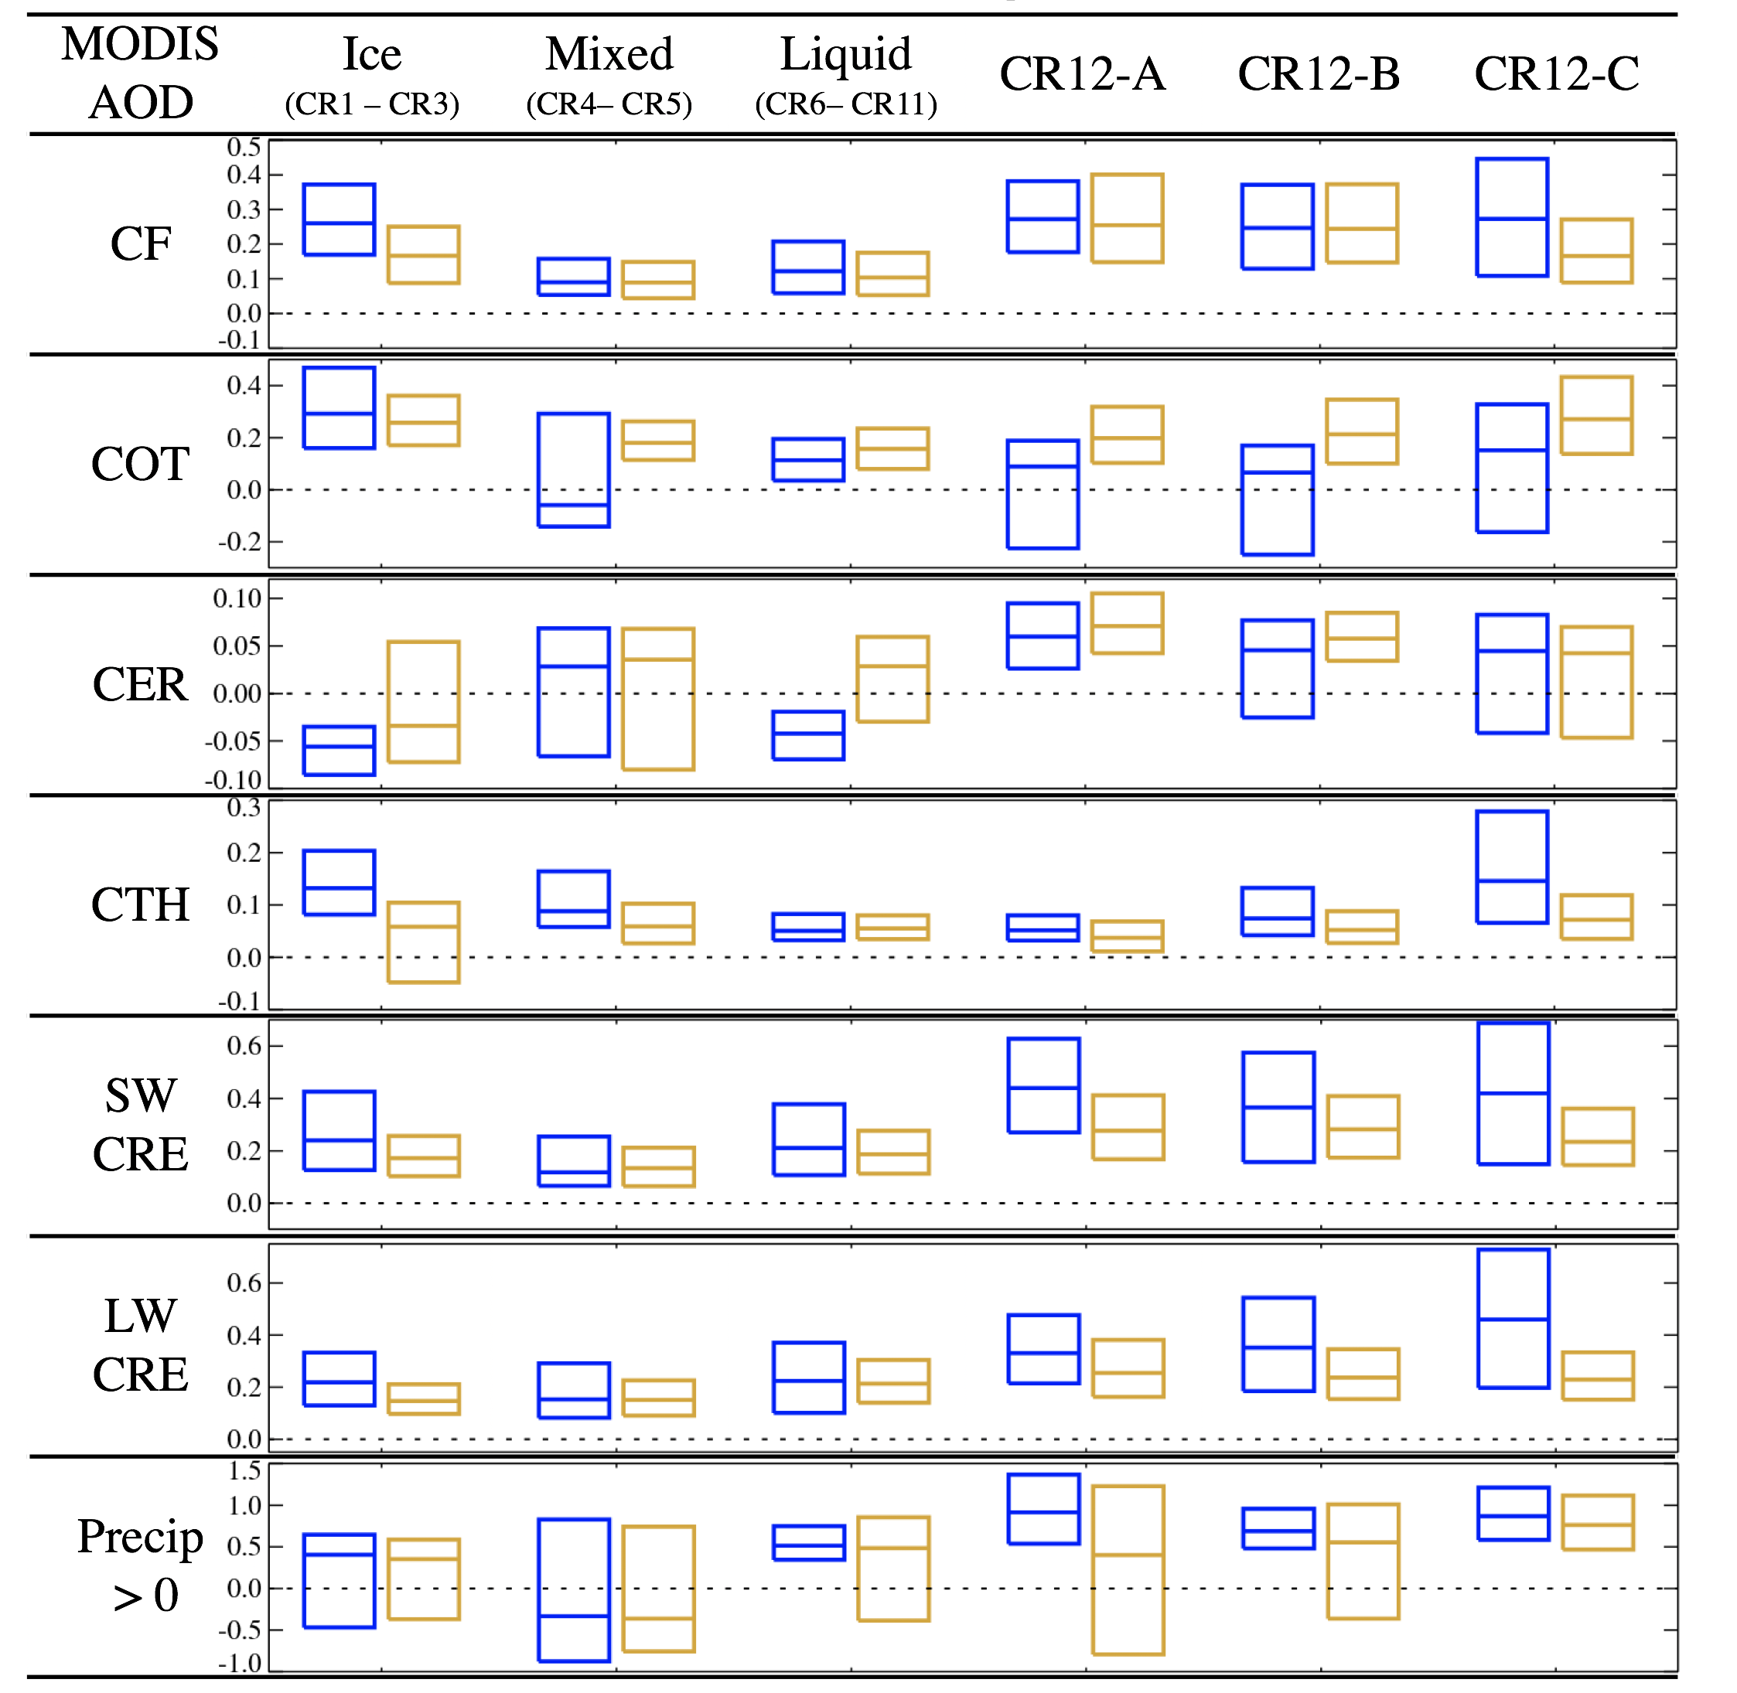
Sensitivity boxplots, MODIS AOD

Slide 10
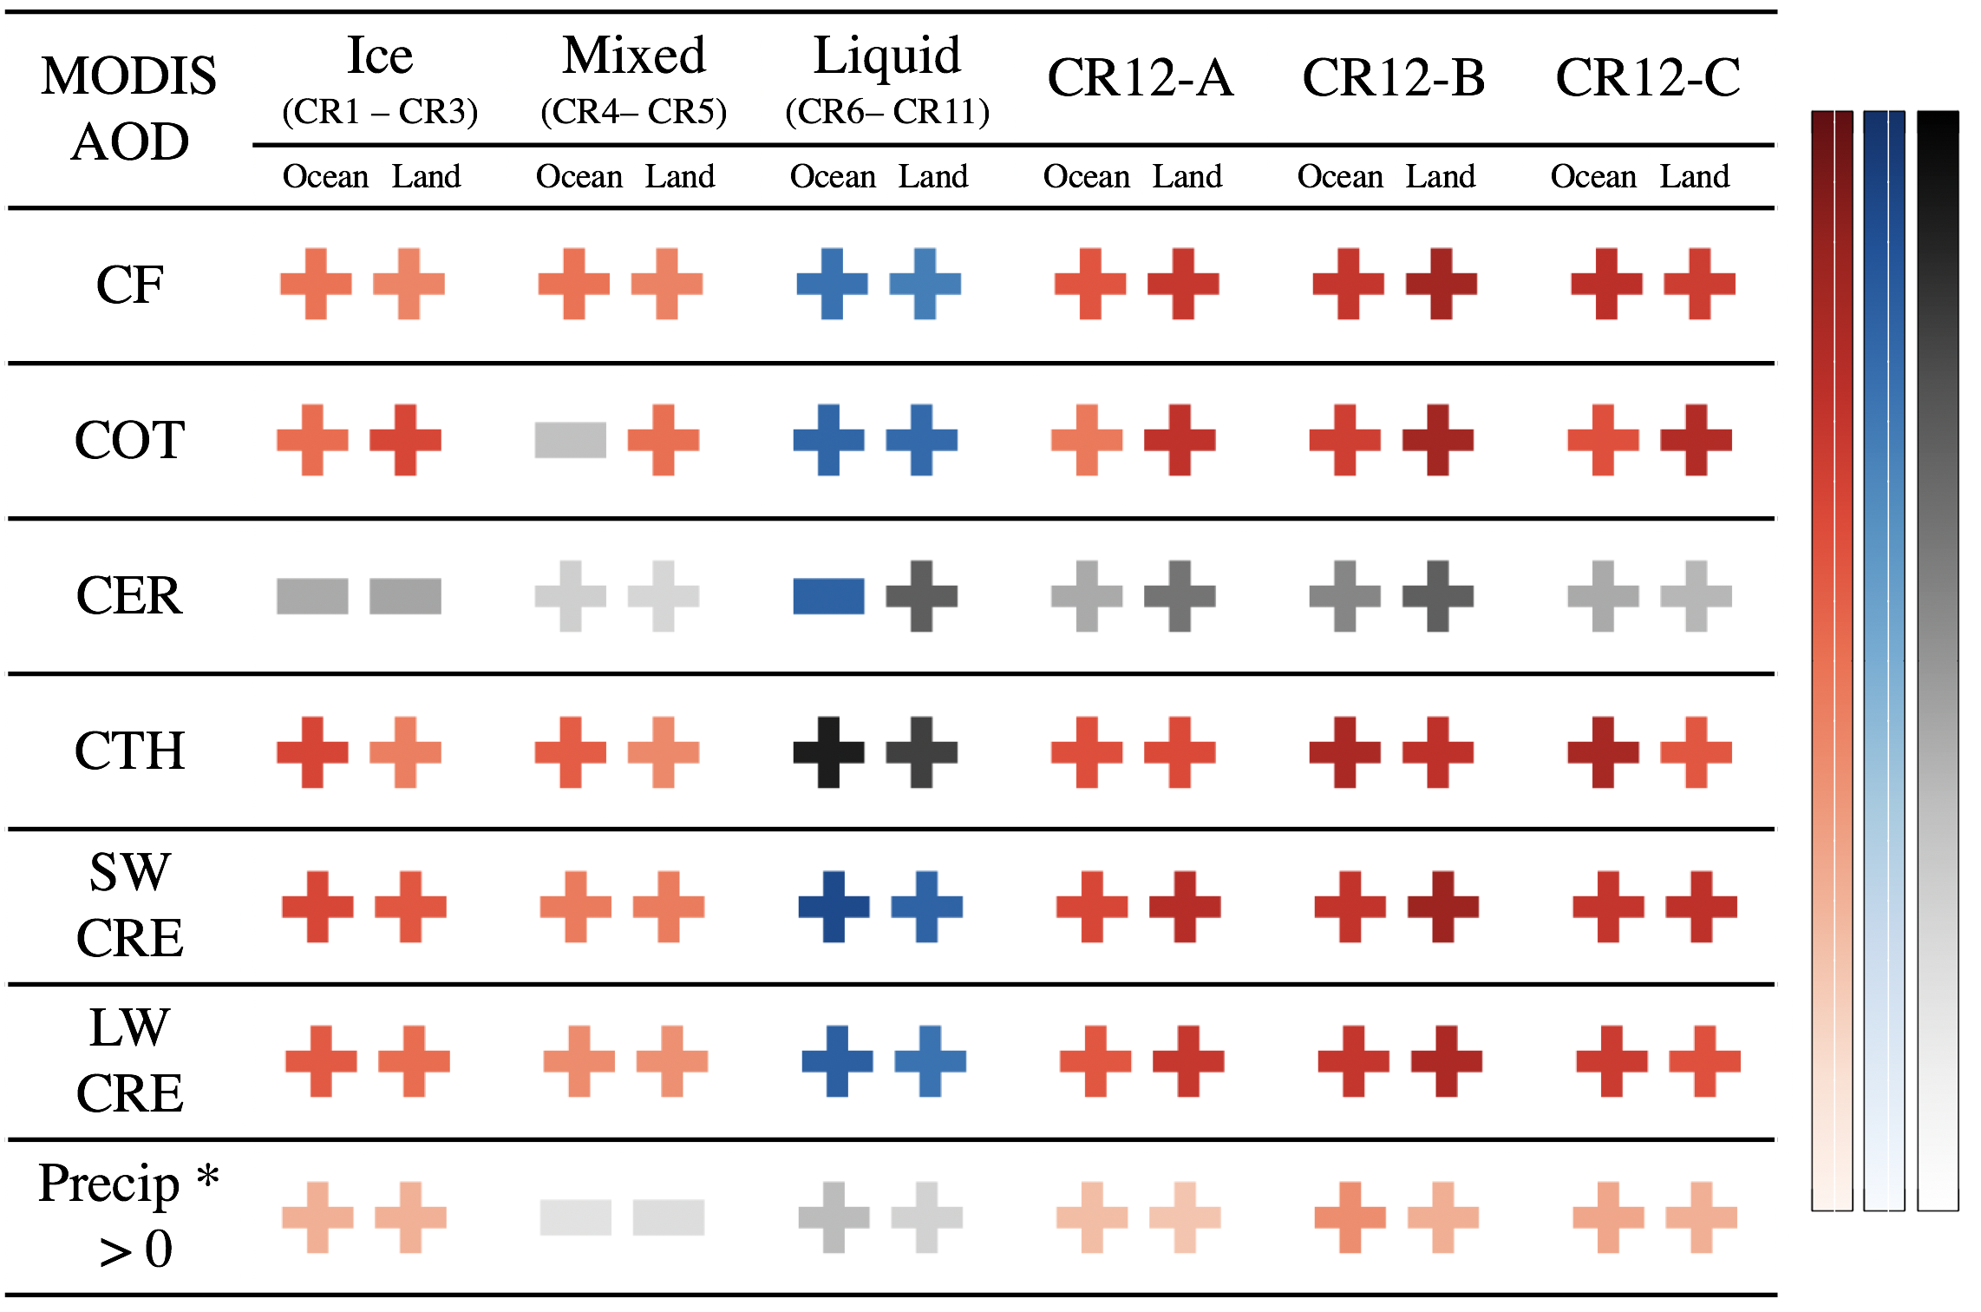

Sensitivity signs, MODIS and MERRA-2 AOD
Shades or red: Consistent with invigoration
Shades of blue: Consistent with FIE/SIE
Lighter shades indicate poorer sampling

Slide 11
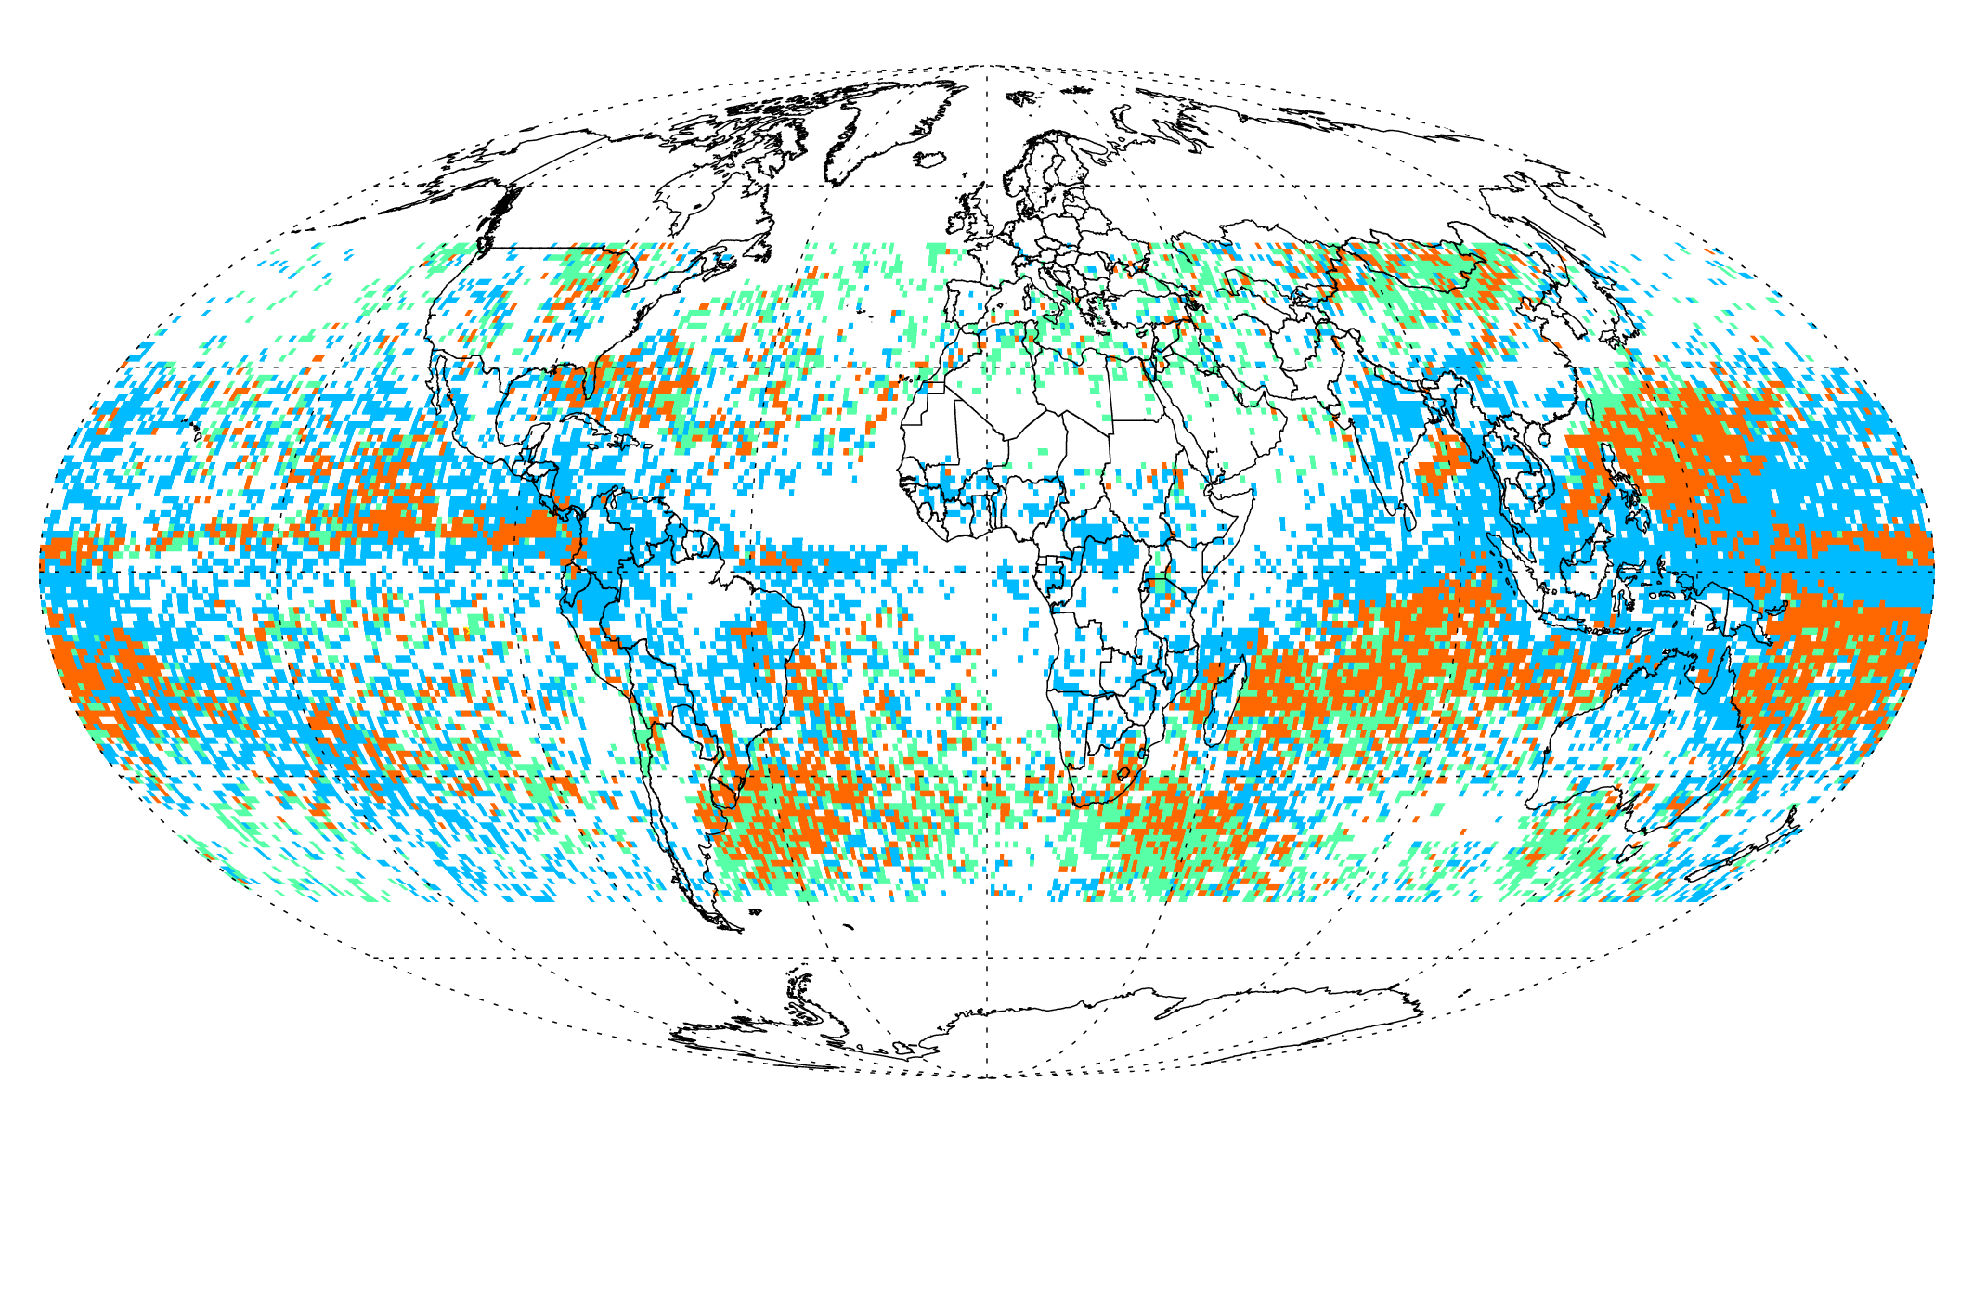
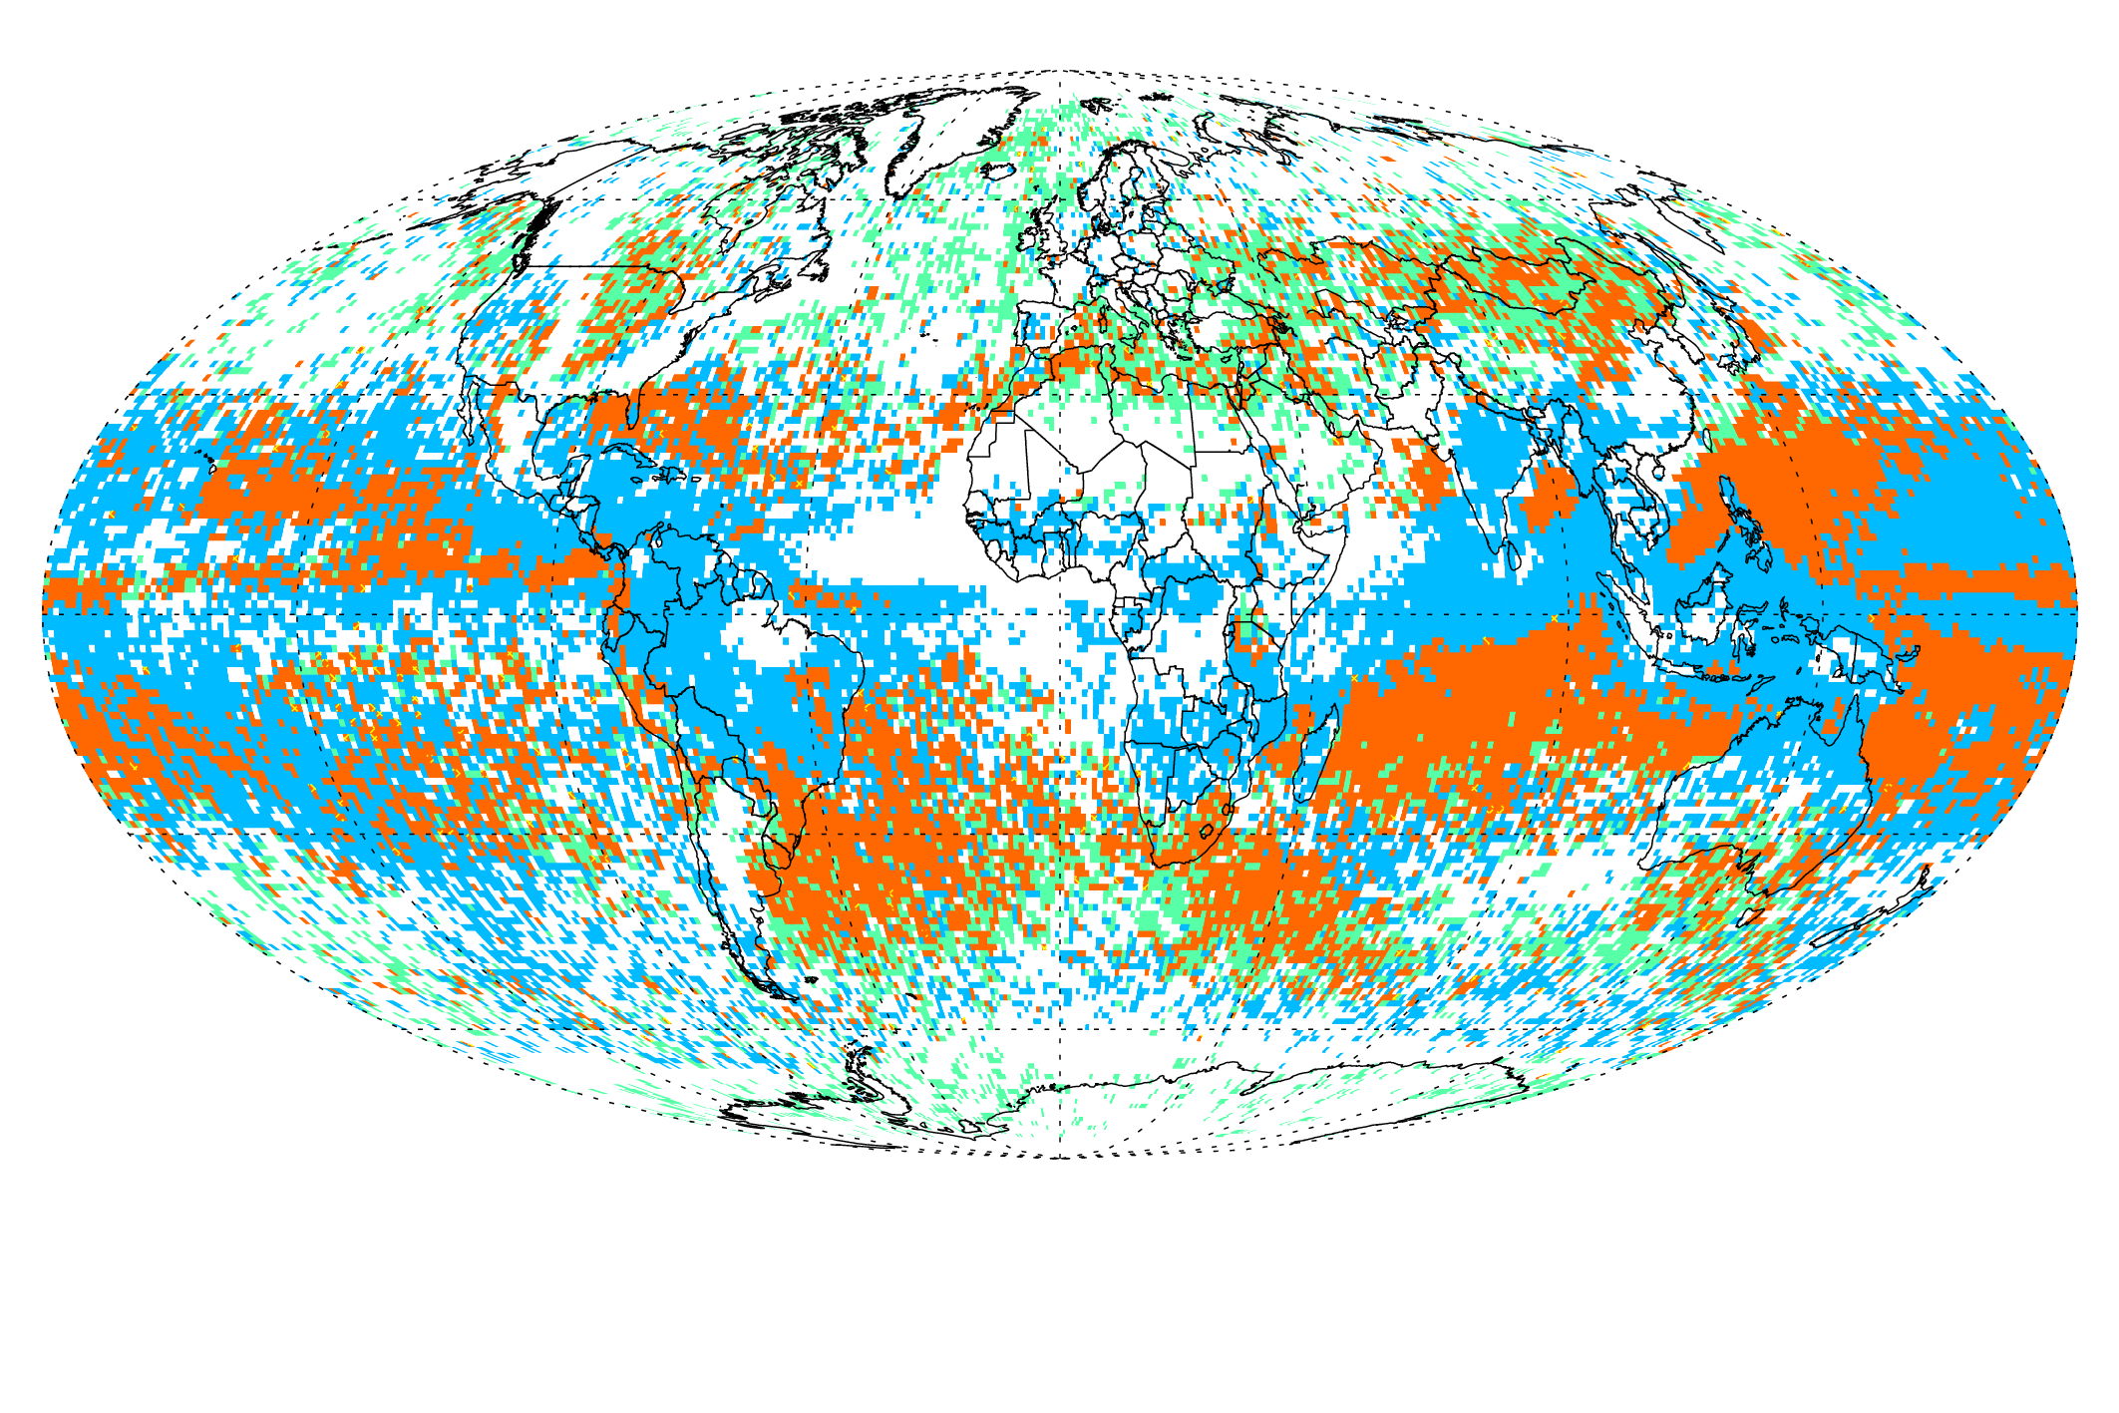
Invigoration (Ice CRs)
S_{PR} > 0 & S_{CF} > 0 & S_{CTH}> 0 & S_{COT} > 0 & S_{CRE} > 0
S_{CF} > 0 & S_{CTH}> 0 & S_{COT} > 0 & S_{CRE} > 0

Slide 12
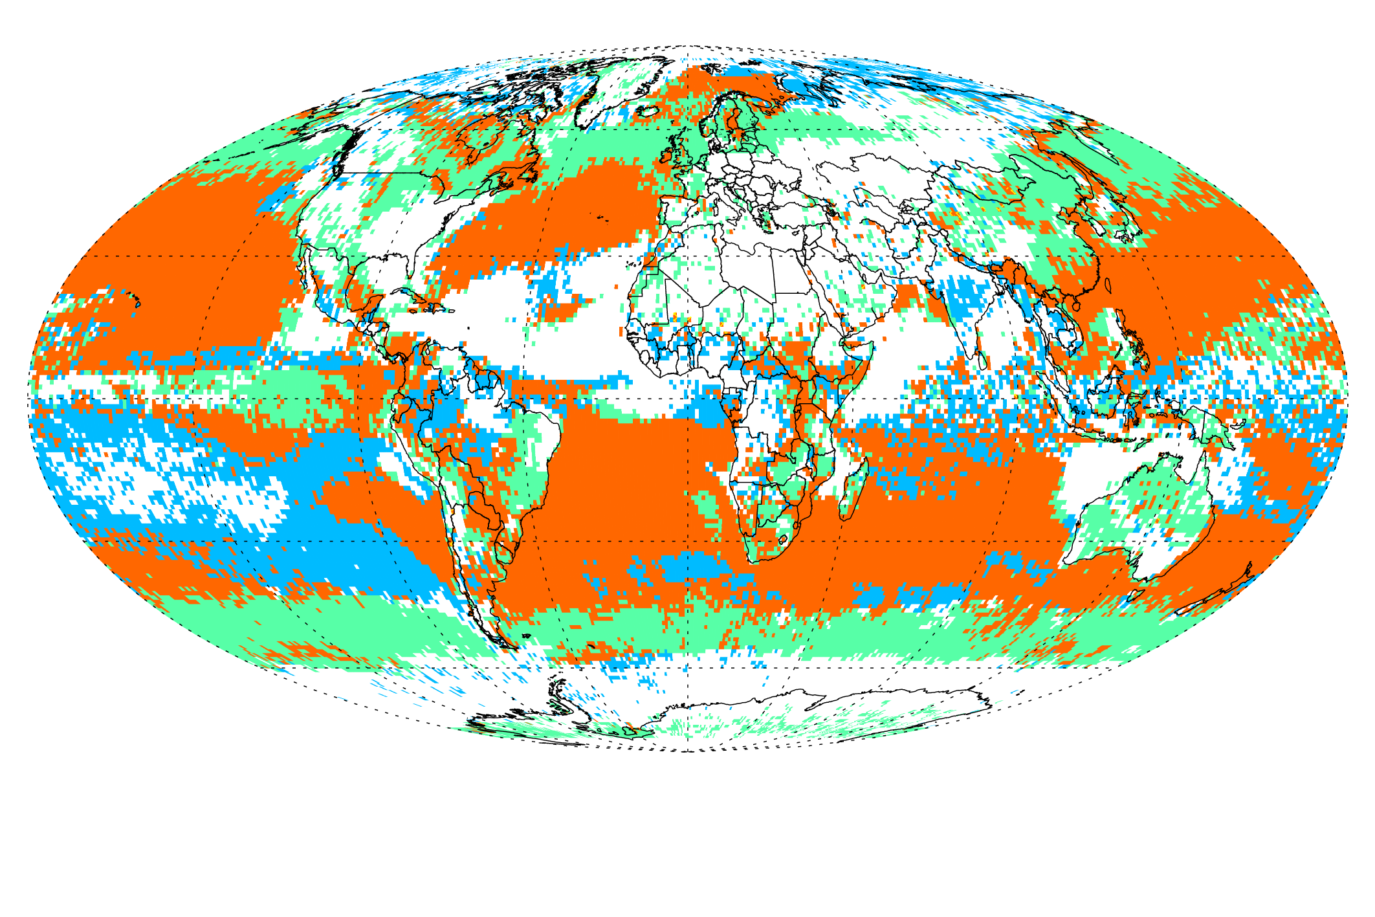
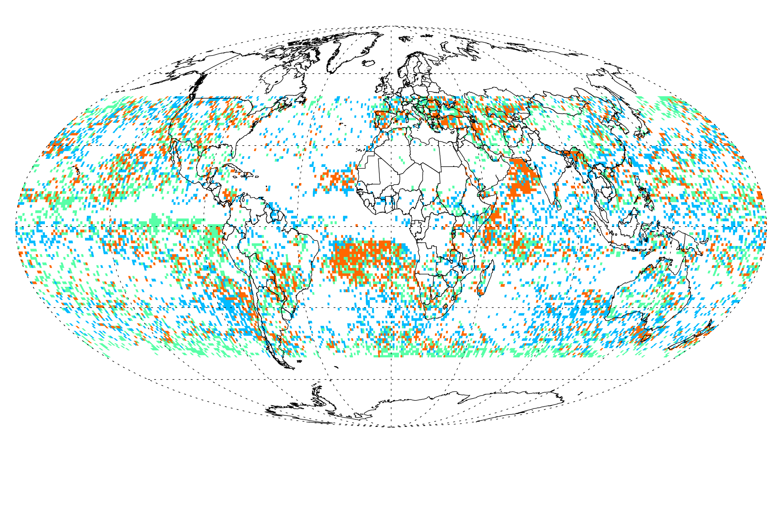
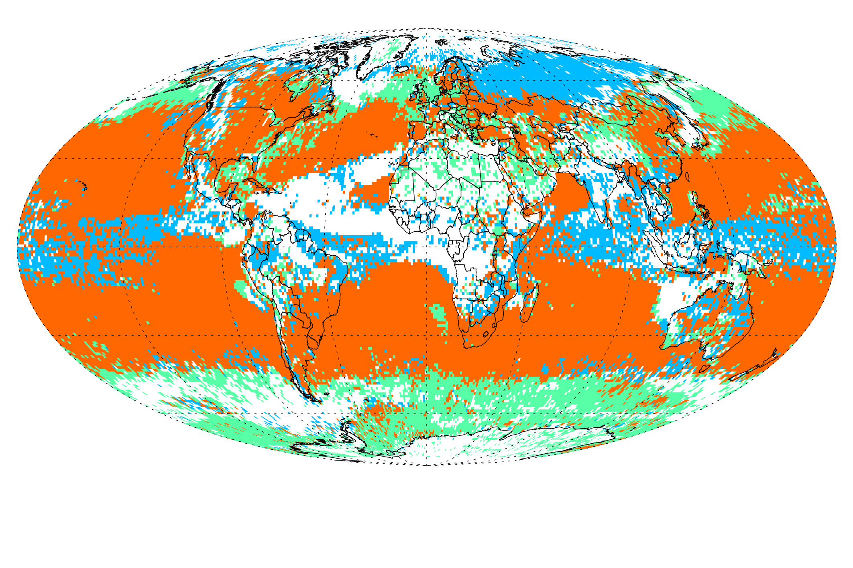
FIE
Liquid CRs
S_{CER} < 0 & S_{COT} > 0 & S_{CRESW} > 0
SIE, no precipitation
SIE
S_{PR} < 0 & S_{CF} > 0 & S_{COT} > 0 & S_{CRE} > 0
S_{CF} > 0 & S_{COT} > 0 & S_{CRE} > 0

Slide 13
Take-home messages
A Regime-based approach is promising for diagnosis of aerosol-cloud-precipitation interactions at global scales
This type of global analysis (most extensive ever?) will not capture nuances and full range of interactions, but will give a robust overall picture
Morning aerosol vs afternoon cloud is possible with Terra-Aqua and MERRA2
  Aerosol sampling limitations due to cloud presence can be overcome with MERRA2
  MERRA2 can also assist with incorporating meteorological influences
  MODIS-MERRA2 result comparison perhaps can tell us about result robustness
Most results consistent with paradigms, especially for liquid CRs
  Precipitation is the most noisy and inconclusive
See Oreopoulos et al. JGR (2017) as a starting point; new paper in preparation.

Slide 14
Questions?

Slide 15
Additional Slides

Slide 16

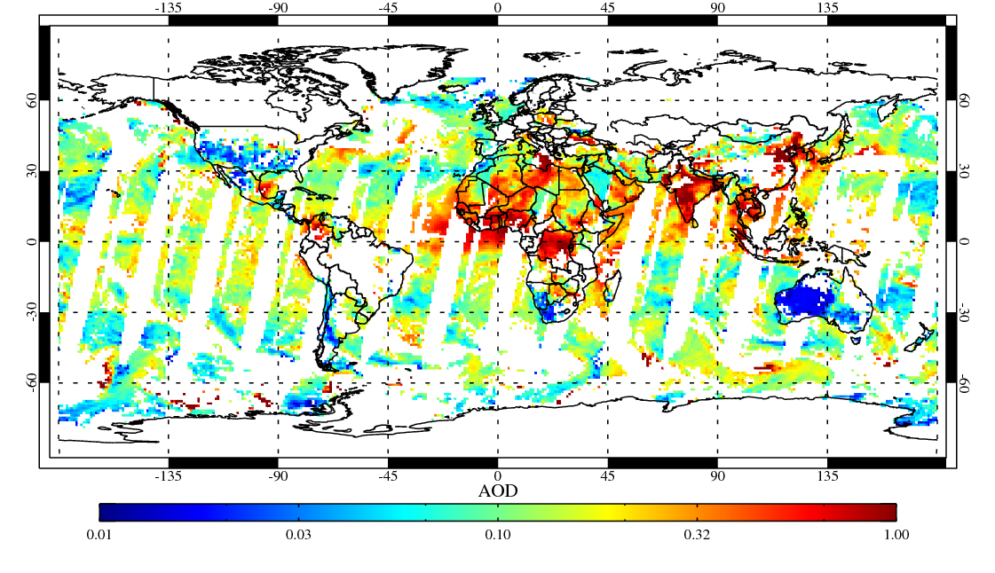
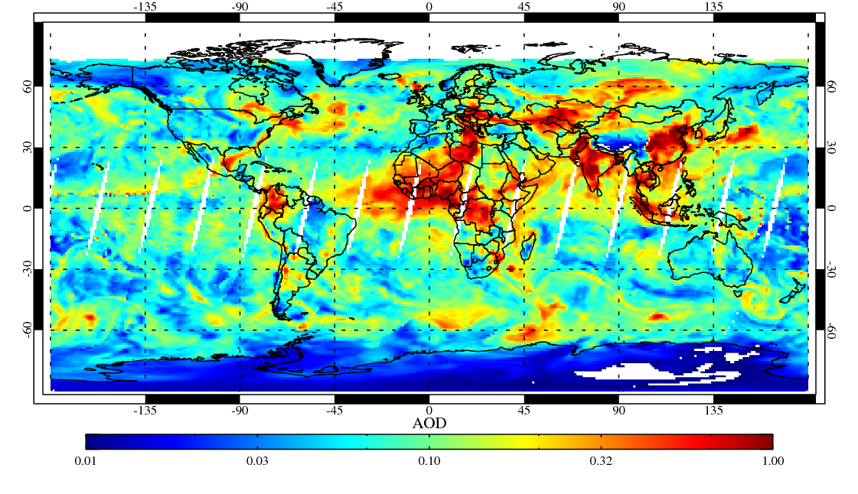
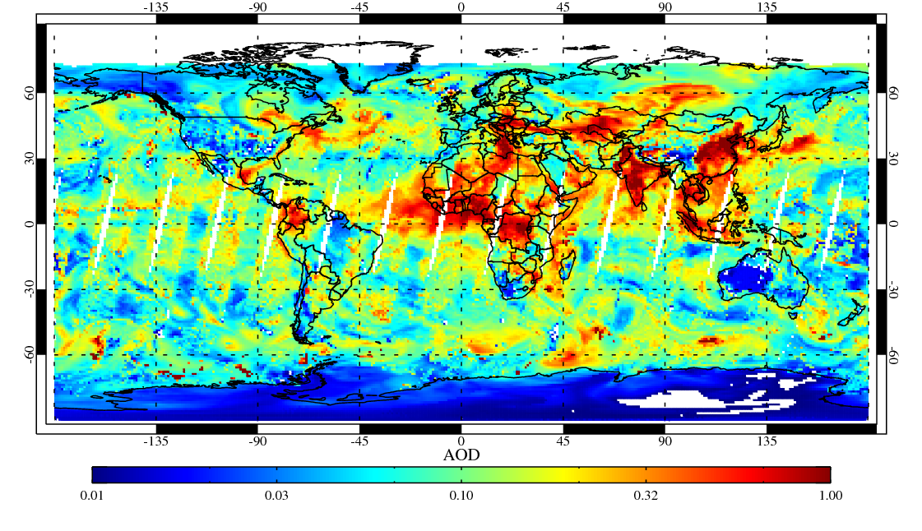
(a) MODIS AOD
(2014.2.21)
Sampling when cloudy
(b) MERRA2 AOD
(a) + (b) MODIS AOD with MERRA2-filled
2014. 2. 21

Slide 17
CRs and large-scale vertical motion
MERRA-2 matched to MODIS

Slide 18
