Slide 1
Inside the Daily Operations at the NOAA
Center for Weather and Climate Prediction (NCWCP)
Edward Strobach
NOAA/NWS/EMC
edward.strobach@noaa.gov

Slide 2
Outline
The different centers at NCWCP
The Environmental Modeling Center (EMC)
The Model Physics Group
Recent model degradation after a radiation fix
Nature of degradation and proposed fixes
Ongoing issues
Student opportunities

Slide 3
Inside NCWCP
National Centers for Environmental Prediction (NCEP)
NCEP Central Operations (NCO)
Manages flow of data and products
Support research and developmental efforts; software dev.
Manages improvements of model suite
Environmental Modeling Center (EMC)
Responsible for transitions-to-operations
Develops and improves components of the model suite
Climate Prediction Center (CPC)
Delivers real-time products that predict/describe climate variations that extend from weeks to years
Ocean Prediction Center (OPC)
Relies on products and the ocean model to produce warnings and and forecasts out to five days
Surge and coastal flood guidance; ocean conditions over shipping routes
Weather Prediction Center (WPC)
Responsible for delivering accurate and reliable forecasts and analyses to the nation
OPC/WPC
NESDIS
CPC
EMC
NCO
Outside NCEP
National Environmental Satellite, Data, and Information Service (NESDIS)
Provides timely access to global environmental data and information

Slide 4
The Environmental Modeling Center (EMC)
EMC
Director: Brian Gross
Deputy Director: Ivanka Stajner
Engineering and Implementation (EIB)
Chief: Arun Chawla
Verification, Post-processing & Product Generation (VPPGB)
Chief: Jason Levit
Modeling & Data Assimilation Branch (MDAB)
Chief: Vijay Tallpragada
EIB maintains model workflow and documentation
VPPGB provides the tools and data needed for verification and data assimilation
MDAB encompasses all functions required for global and regional forecasts
Data Assimilation (DA) & QC
Chief: Russ Treadon
Model Physics
Chief: Jack Kain
Model Dynamics & Coupling

Slide 5
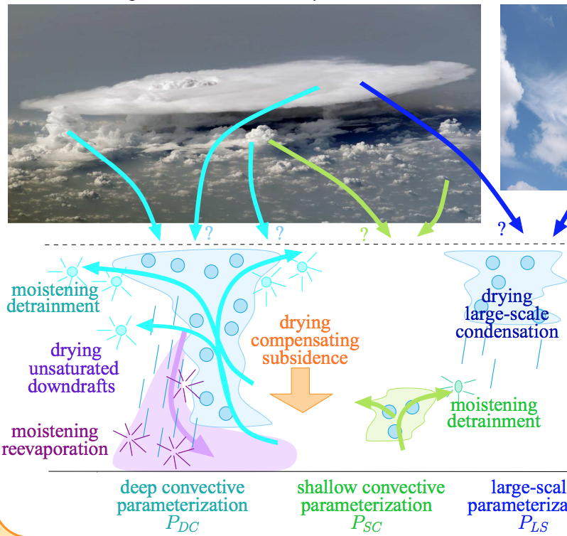
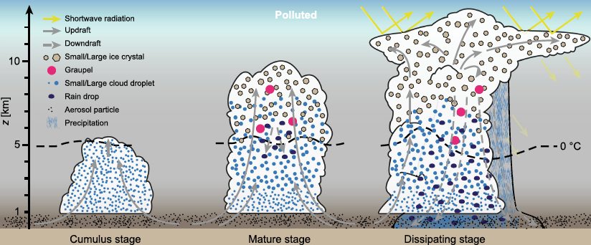
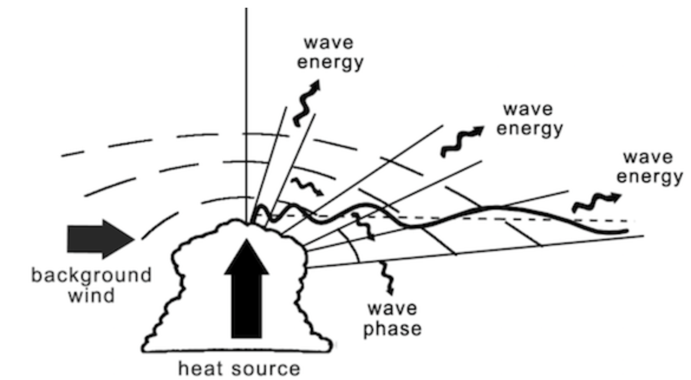
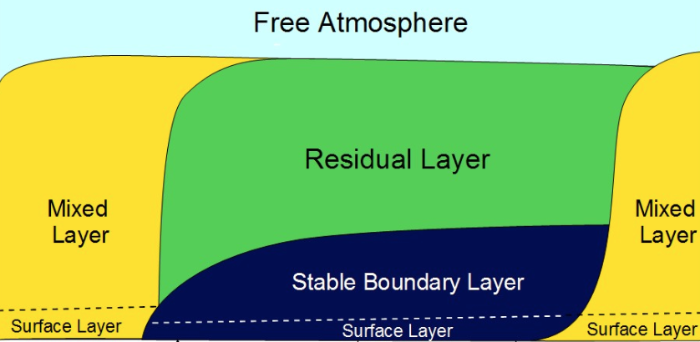
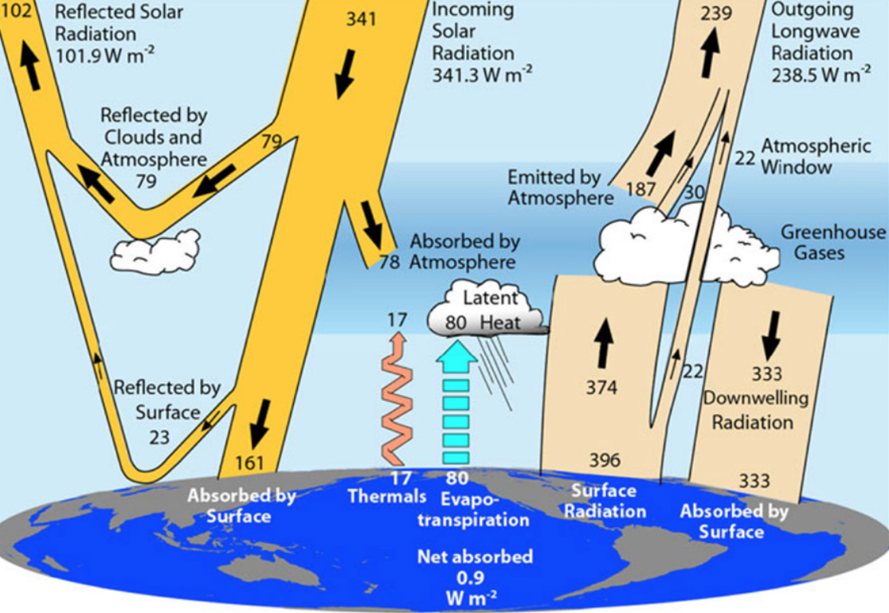
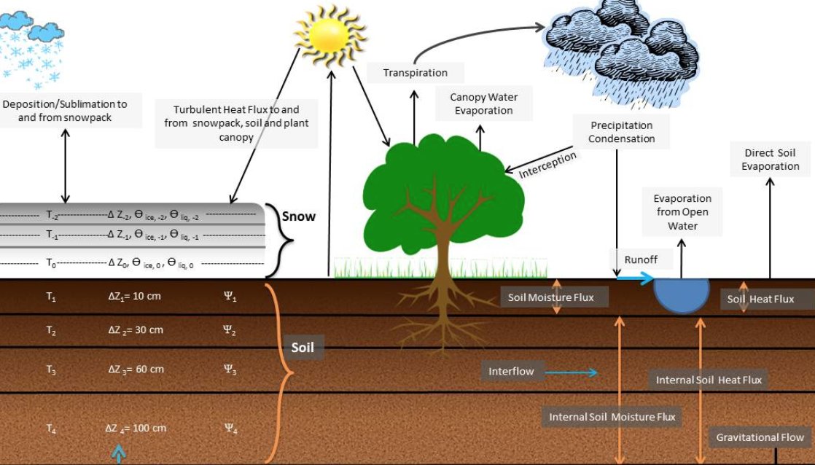
Model Physics
Shallow and Deep Convection
Microphysics
Gravity wave drag
PBL
Radiation
Land Surface

Slide 6
Outline
The different centers at NCWCP
The Environmental Modeling Center (EMC)
The Model Physics Group
Recent model degradation after a radiation fix
Nature of degradation and proposed fixes
Ongoing issues
Student opportunities

Slide 7
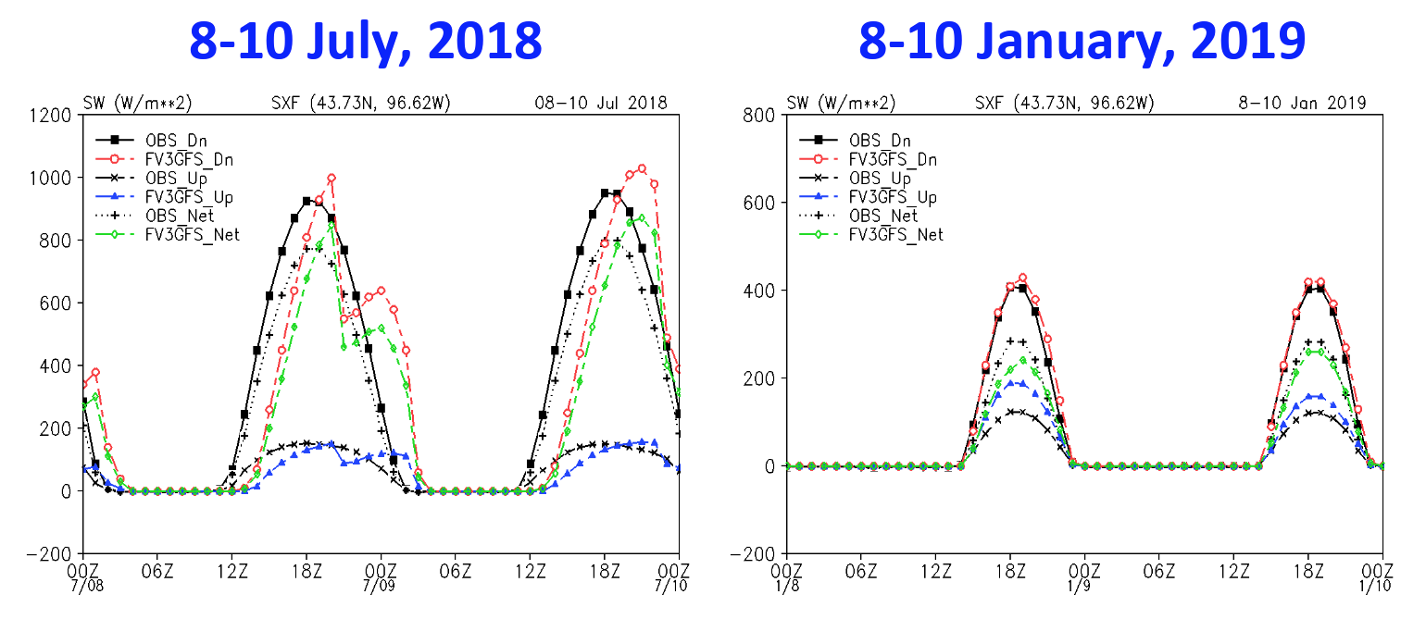
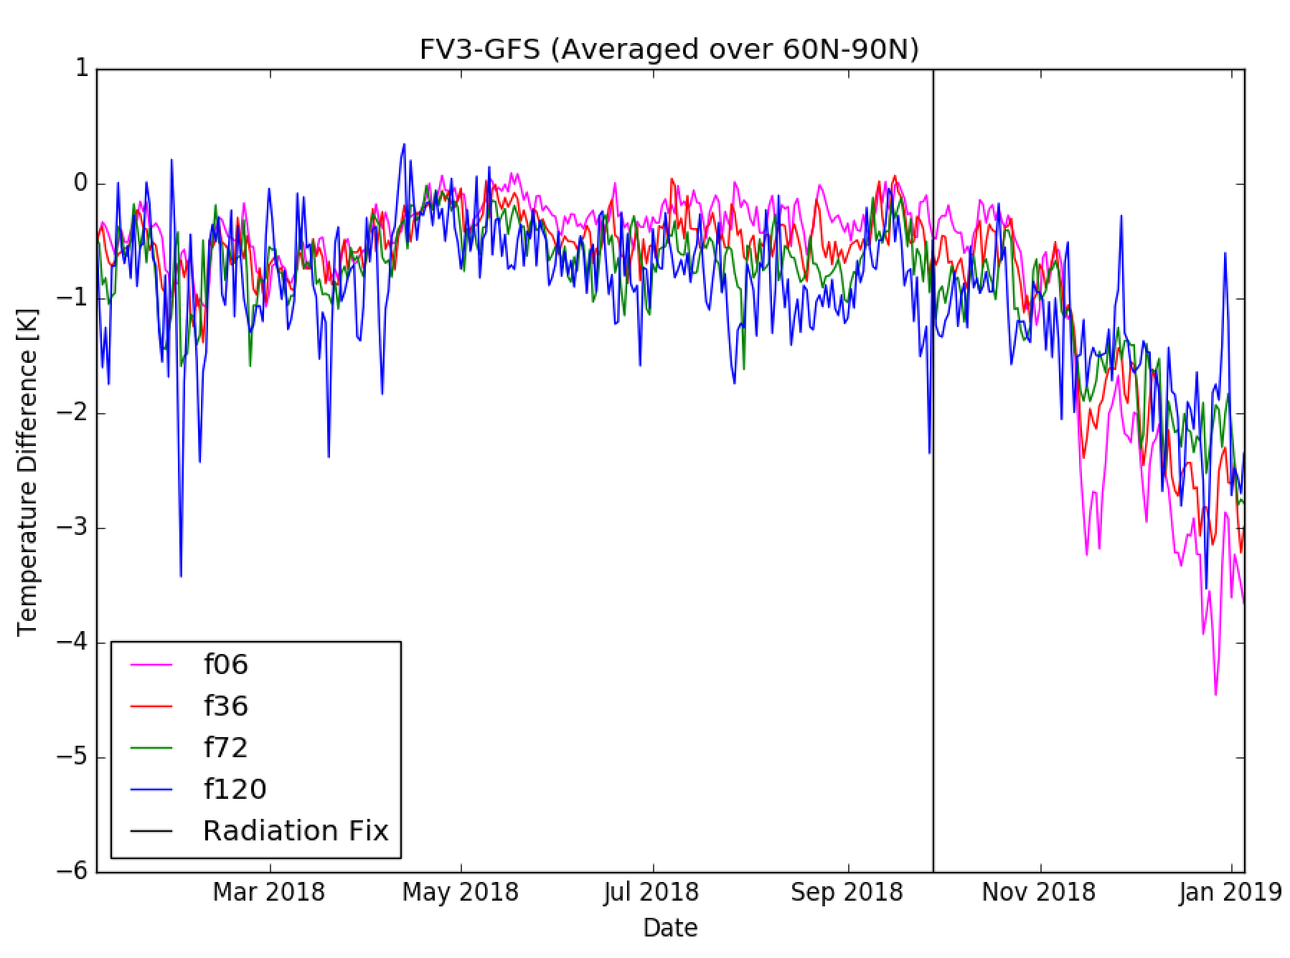
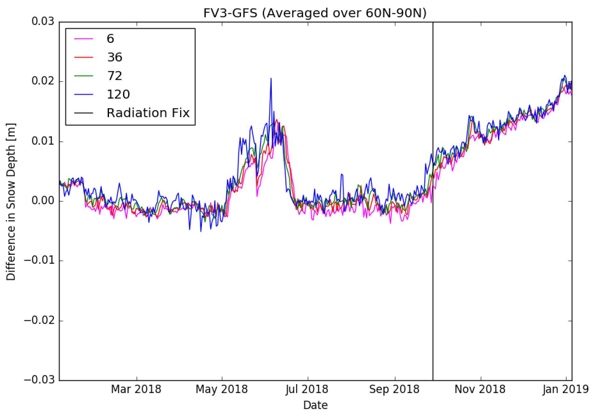
Model Degradation After a Fix in the Radiation Code
Courtesy of Weizhong Zheng
Sept. 2018: A bug was found in the SW calculation related to the zenith angle calculation
Jan/Feb. 2019: Academia, news stations, and private users were complaining about the cold bias and excessive snow over CONUS
Cold bias most obvious across 60N-90N, with some degradation further south, particularly over CONUS
Cold bias worsened into the cold season and appears worst at the beginning of the forecast

Slide 8
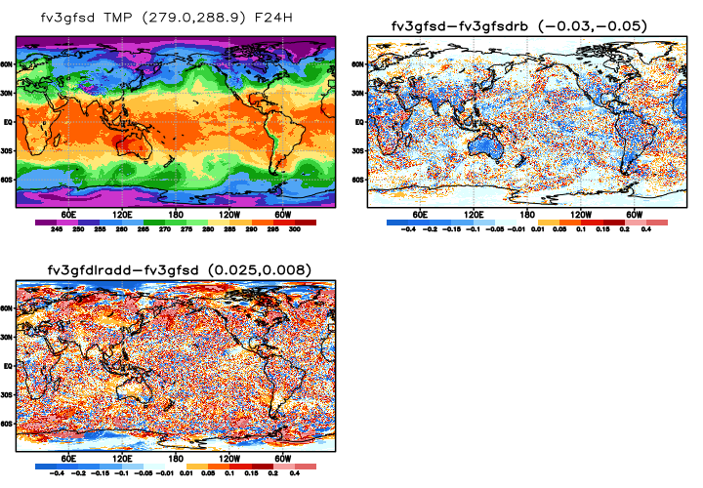
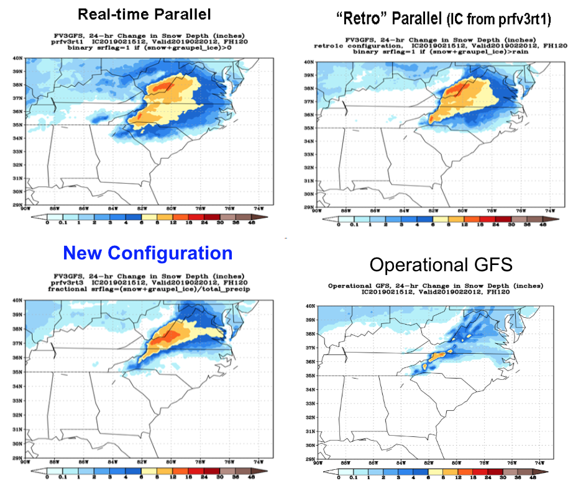
Proposed Fixes to Combat the Cold Bias Issue
Most of the focus was in CONUS
Continuous evaluation of the snow storm over the Carolinas to examine improvement
Proposed fixes:
Lower a parameter called factqmax to adjust the global saturation level in the data assimilation system
Properly partition the falling precipitation by their fractional amounts
Allow radiation to interact with “individual species and corresponding radii”
Went from a semi-empirical temperature dependent function for water and ice with prescribed radii to each specie being fed into the radiation code and their respective radii calculated
20190215 12Z: F24
Analysis at 850-mb
fv3gfsdrb=radiation bug
fv3gfsd = model+radiation fix
fv3gfdlradd = fv3gfsd + new GFDLMP-radiation fix
Improvements in cold biases of about 0.4K
Courtesy of Ruiyu Sun
Courtesy of Fanglin Yang

Slide 9
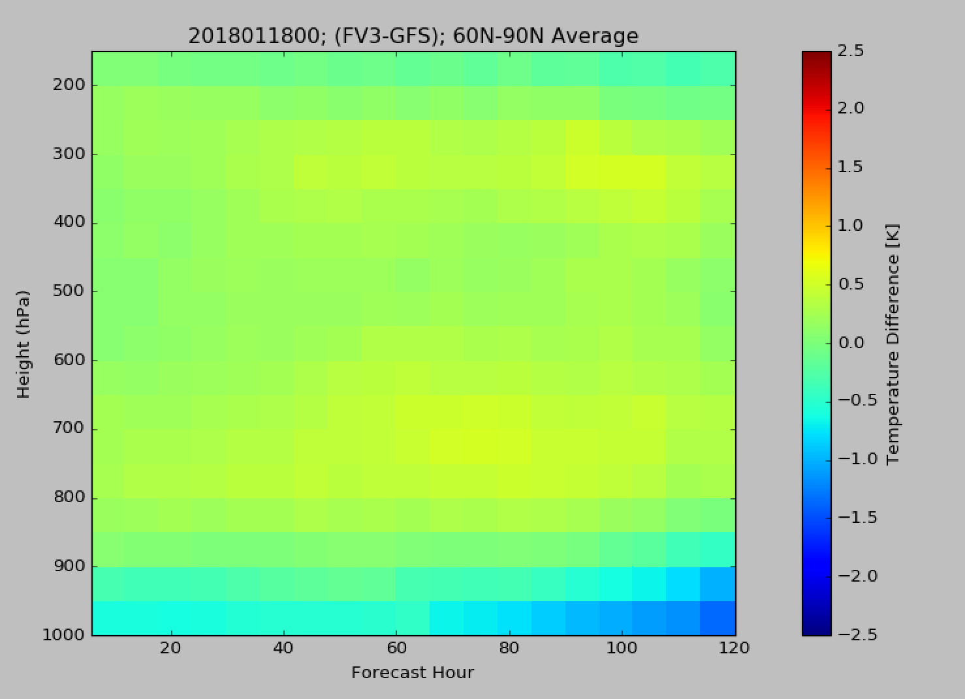
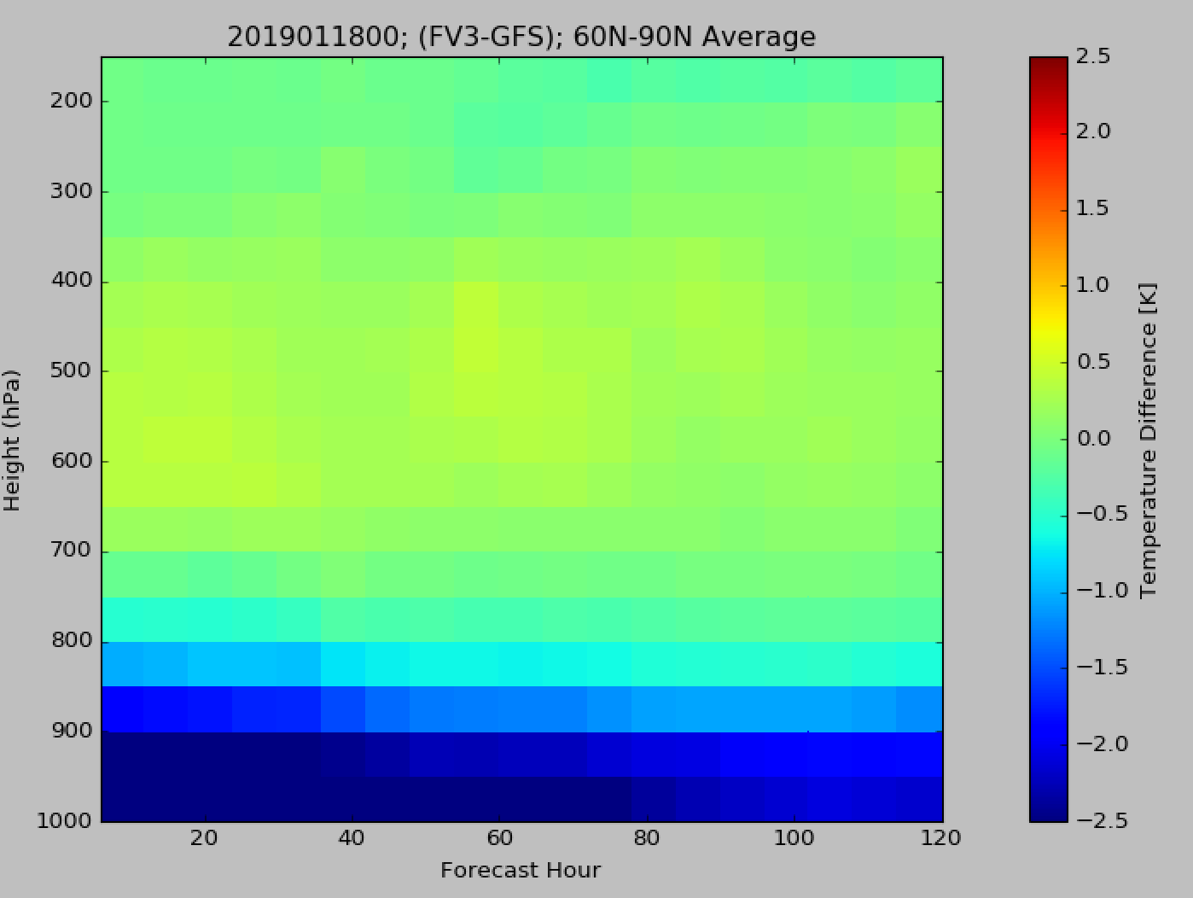
Cold Bias Problem Not Completely Solved…
There was noticeable improvement when including the realistic fixes in precipitation partitioning and how radiation interacted with microphysics
Recent correspondence suggests that there is still excessive snow and cold temperature in the lower troposphere….
Other components worth looking into:
The land surface model
The data assimilation system
High snow amounts and cold temperature present early in the forecast
The cold temperature bias—from surface to 850-mb—appears to reduce with time when compared to the GFS model after the radiation fix
The surface temperature is intimately related to snow depth and fluxes from snow surface

Slide 10
Outline
The different centers at NCWCP
The Environmental Modeling Center (EMC)
The Model Physics Group
Recent model degradation after a radiation fix
Nature of degradation and proposed fixes
Ongoing issues
Student opportunities

Slide 11
Student Opportunities
10 week internship at EMC, CPC, OPC, WPC, or NCO is offered each summer
Students receive hands on experience with model data and learn various numerical techniques for solving the most pressing forecast problems
Students work on a project under an advisor(s) during this period
Excellent professional experience
Good for networking
Possibility of travel to a conference
Info for students:
Students seeking bachelor’s, master’s, or a PhD are eligible.
Resumes, letters of recommendation, personal letter, and transcripts are all required
A stipend of $5,000 is awarded for the 10 weeks of work
Living arrangements are taken care of by the budget office
Highly competitive

