Slide 1

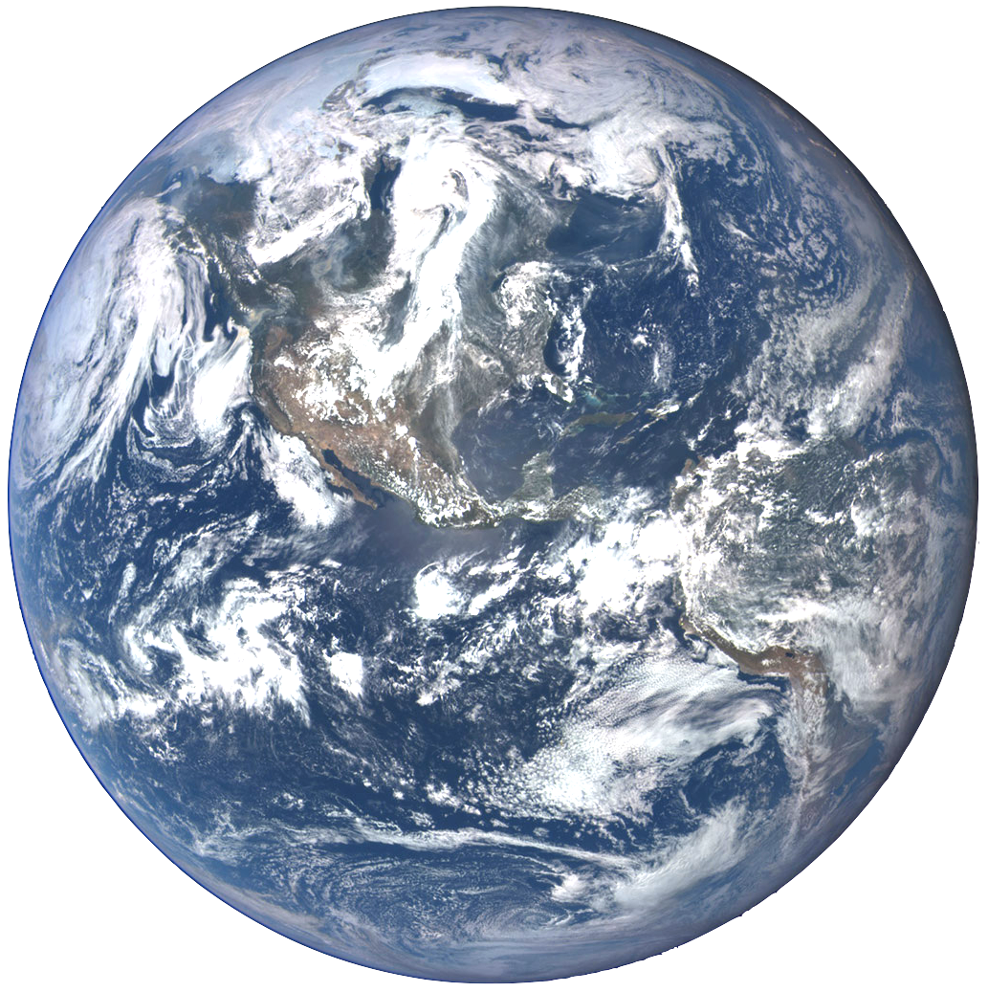
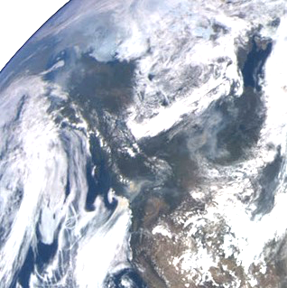
Detecting Aerosol Layer Height from Deep Space
Xiaoguang (Richard) Xu
UMBC/JCET/ESI
Acknowledgements: Jun Wang, Yi Wang, Omar Torres, Steve Miller, Jeff Reid, Alexander Marshak, Yuekui Yang, Vanderlei Martins, and Lorraine Remer
Earth Day Symposium
UMBC 26 April 2019
EPIC “first light” image, acquired on July 6, 2015
Credit: https://epic.gsfc.nasa.gov

Slide 2
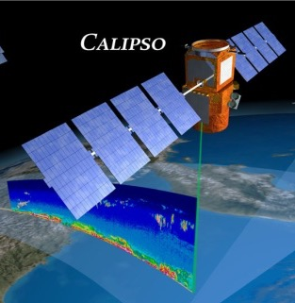
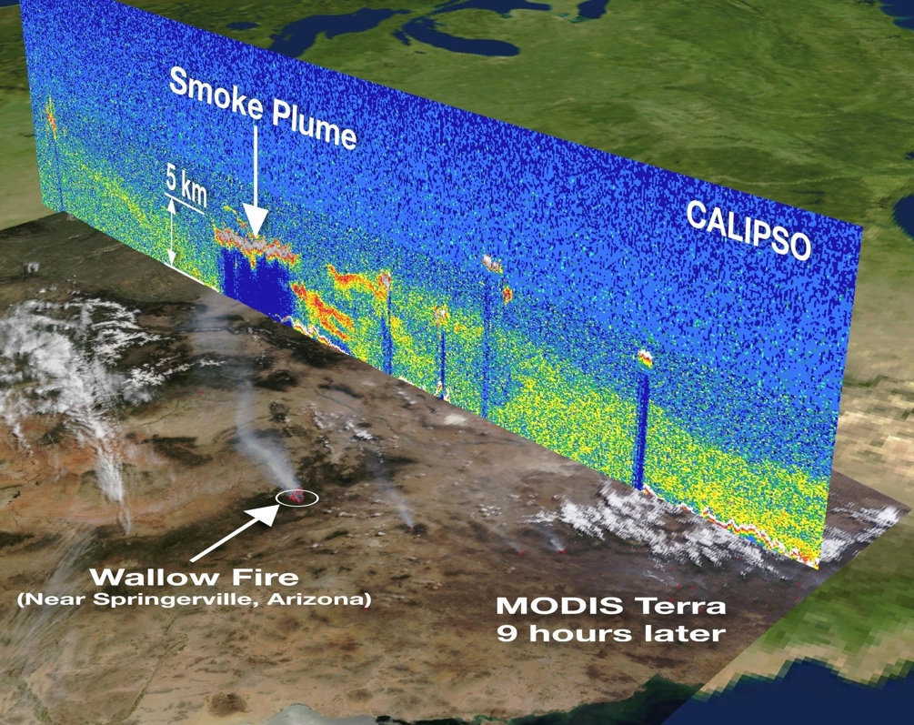
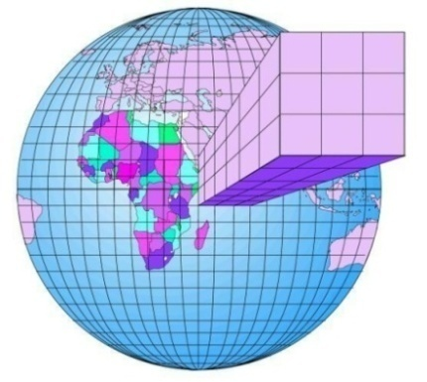
Passive remote sensing of aerosol layer height (ALH) is needed
Aerosol height governs how aerosols affect weather, climate, and air quality.
Regulates how aerosol affects weather and climate
Modeling aerosol transport and lifetime
Helps the remote sensing of surface PM_{2.5}
Spaceborne active lidar, such as CALIOP, has limited spatial coverage.
ALH is also needed for UV aerosol retrievals

Slide 3
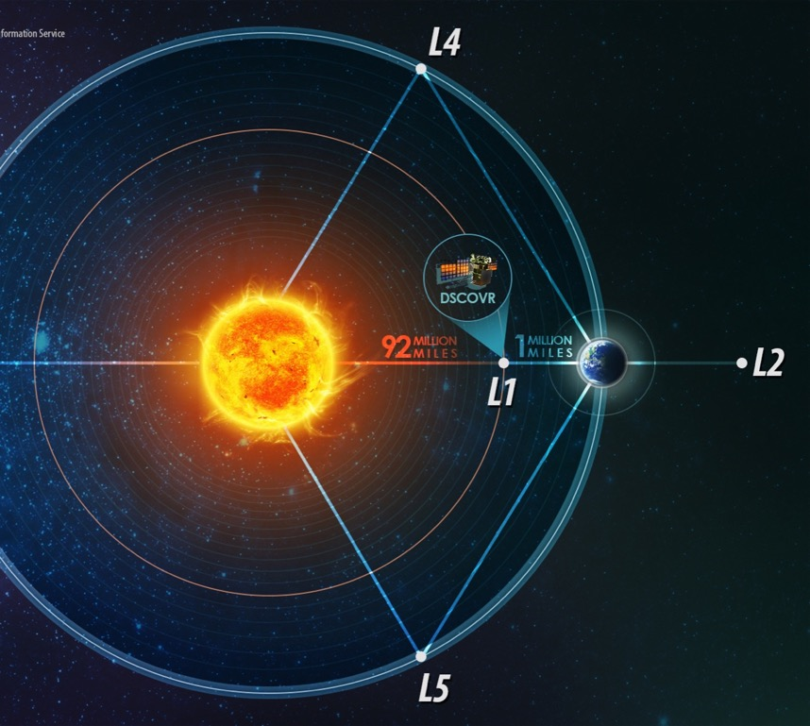
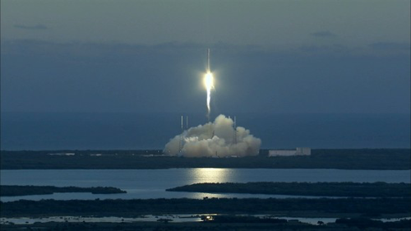
The Deep Space Climate Observatory (DSCOVR)
EPIC shots the entire sun-lit earth every 1 – 2 hours with 10 bands
8km x 8km pixel size at nadir
Parked at Lagrange-1 pint, 1.5 million km from earth.
2048 x 2048
120 days
https://www.nesdis.noaa.gov
https://epic.gsfc.nasa.gov
Launched, Feb. 11, 2015
Notes:
This opportunity came when DSCOVR was launched four years ago. It flied 4 months before reaching its orbit, which is around the fistr Lagrange point. L1 point is 1 million mile from earth, which is over 4 times further than the moon.

Slide 4
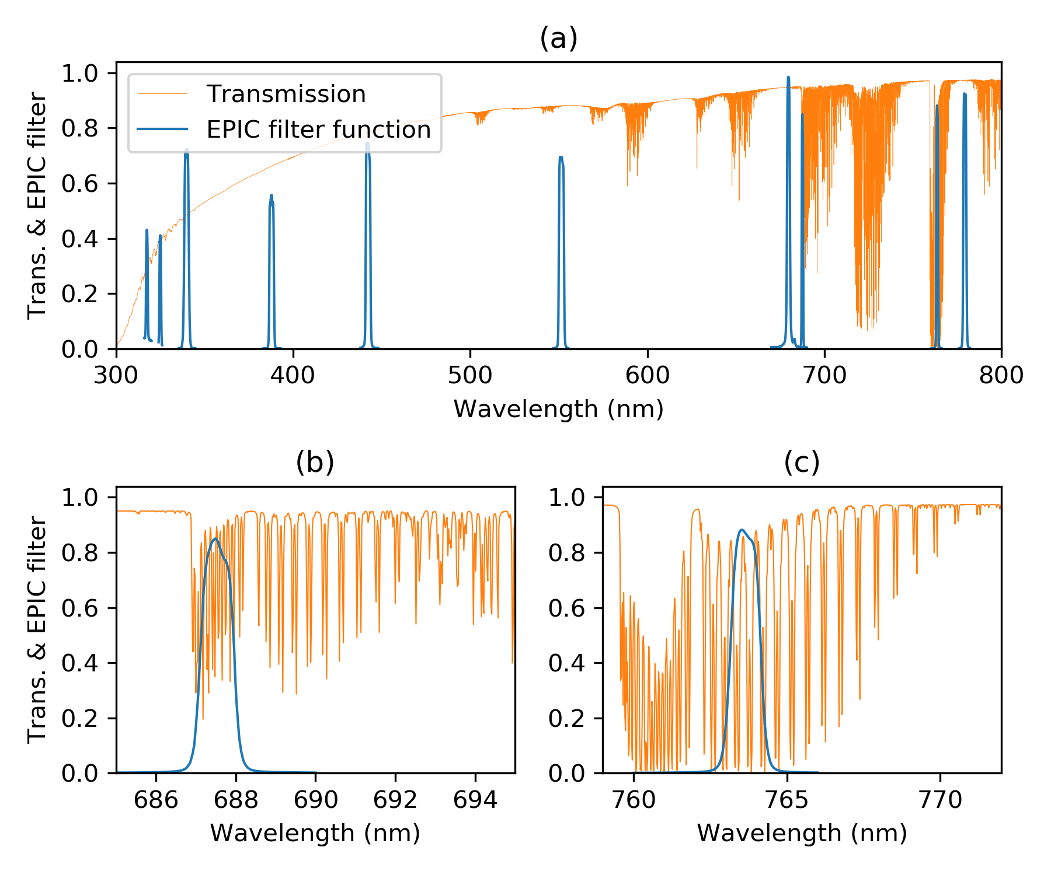
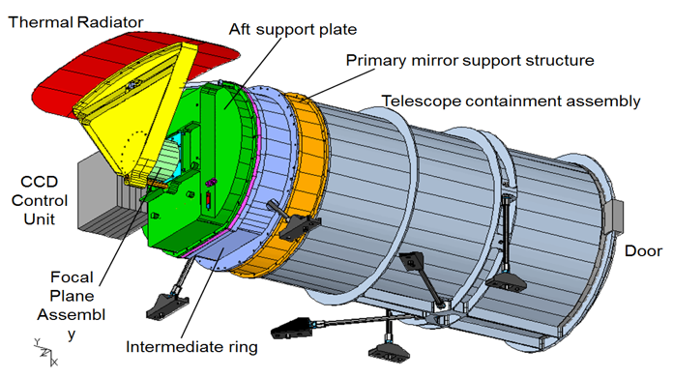
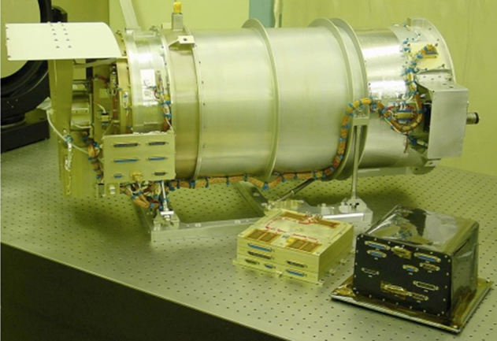
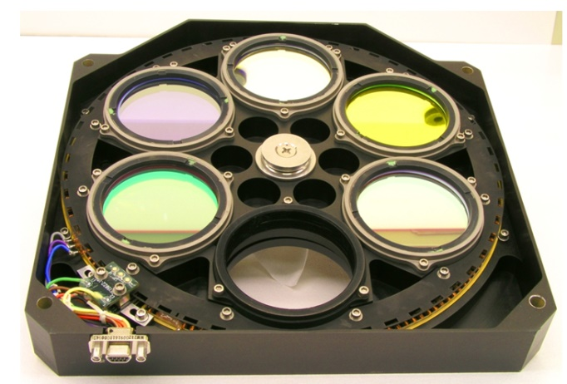
EPIC’s O₂ A and B bands for aerosol/cloud height information
EPIC’s 10 Channels
317
325
340
388
443
551
680
688
764
780
O₂ B Band
O₂ A Band
764 nm
Band width 1.0 nm
688 nm
Band width: 0.8 nm
Xu et al. 2018, AMT submitted

Slide 5
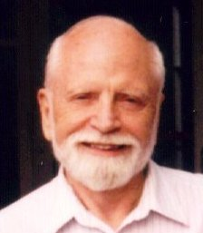
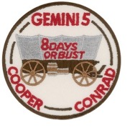
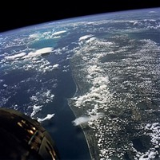
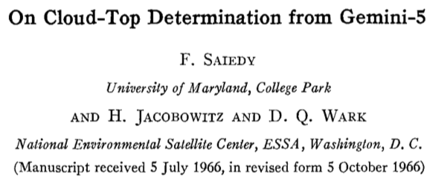
Early concepts of using O₂ bands for cloud height retrieval
JGR 1961
1922-2015
Hanel [1961] proposed to use CO₂ bands (including 2 µm) to detect cloud altitude.
JAS 1967
JGR 1961
Saiedy, Jacobowitz & Wark [1967] proved the feasibility of cloud altitude measurements in the O₂ A band.
Yamamoto & Wark [1961] suggested that O₂ A band would be more suitable than the 2-µm CO₂ band because cloud scattering and O₂ absorption are both stronger at 0.76 µm.
Notes:
The idea of determination of cloud or aerosol height from O2 band is was not new, it dated back to 1961. NASA scientist Rudi Hanal proposed to use CO2 absorption band at 2.0 um for the determination of cloud altitude,
During the Gemini 5 mission, 26 spectrographic observations on various cloud types were obtained using the oxygen A band (7600 A). An example of the types of spectrum and photograph involved represents a cloud in the intertropical convergence zone. Densitometer traces of the spectra of three types of clouds (high, medium, and low) are shown. It was apparent qualitatively that radiation transmission in the oxygen band for a high cloud was much greater than that for a low cloud. The results proved the feasibility of cloud altitude measurements from a spacecraft by this method.

Slide 6
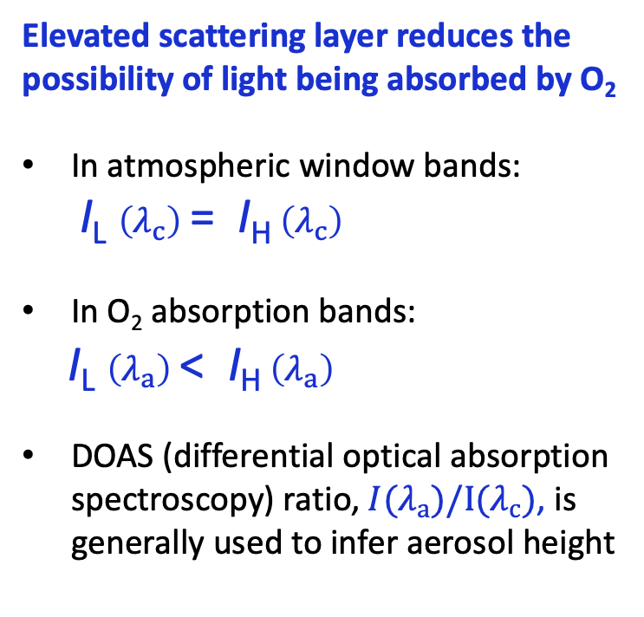
Aerosol height information in the O₂ absorption bands
Elevated scattering layer reduces the possibility of light being absorbed by O₂
In atmospheric window bands:
I_{L} $\left(λ_{c}\right)$ = I_{H} $\left(λ_{c}\right)$
In O₂ absorption bands:
I_{L} $\left(λ_{a}\right)$ < I_{H} $\left(λ_{a}\right)$
DOAS (differential optical absorption spectroscopy) ratio, $I(λ_{a})/I(λ_{c})$, is generally used to infer aerosol height
Xu et al. 2018, AMT submitted
Notes:
In addition to its unique orbit, EPIC also observed a unique band, where oxygen has strong absorption.

Slide 7
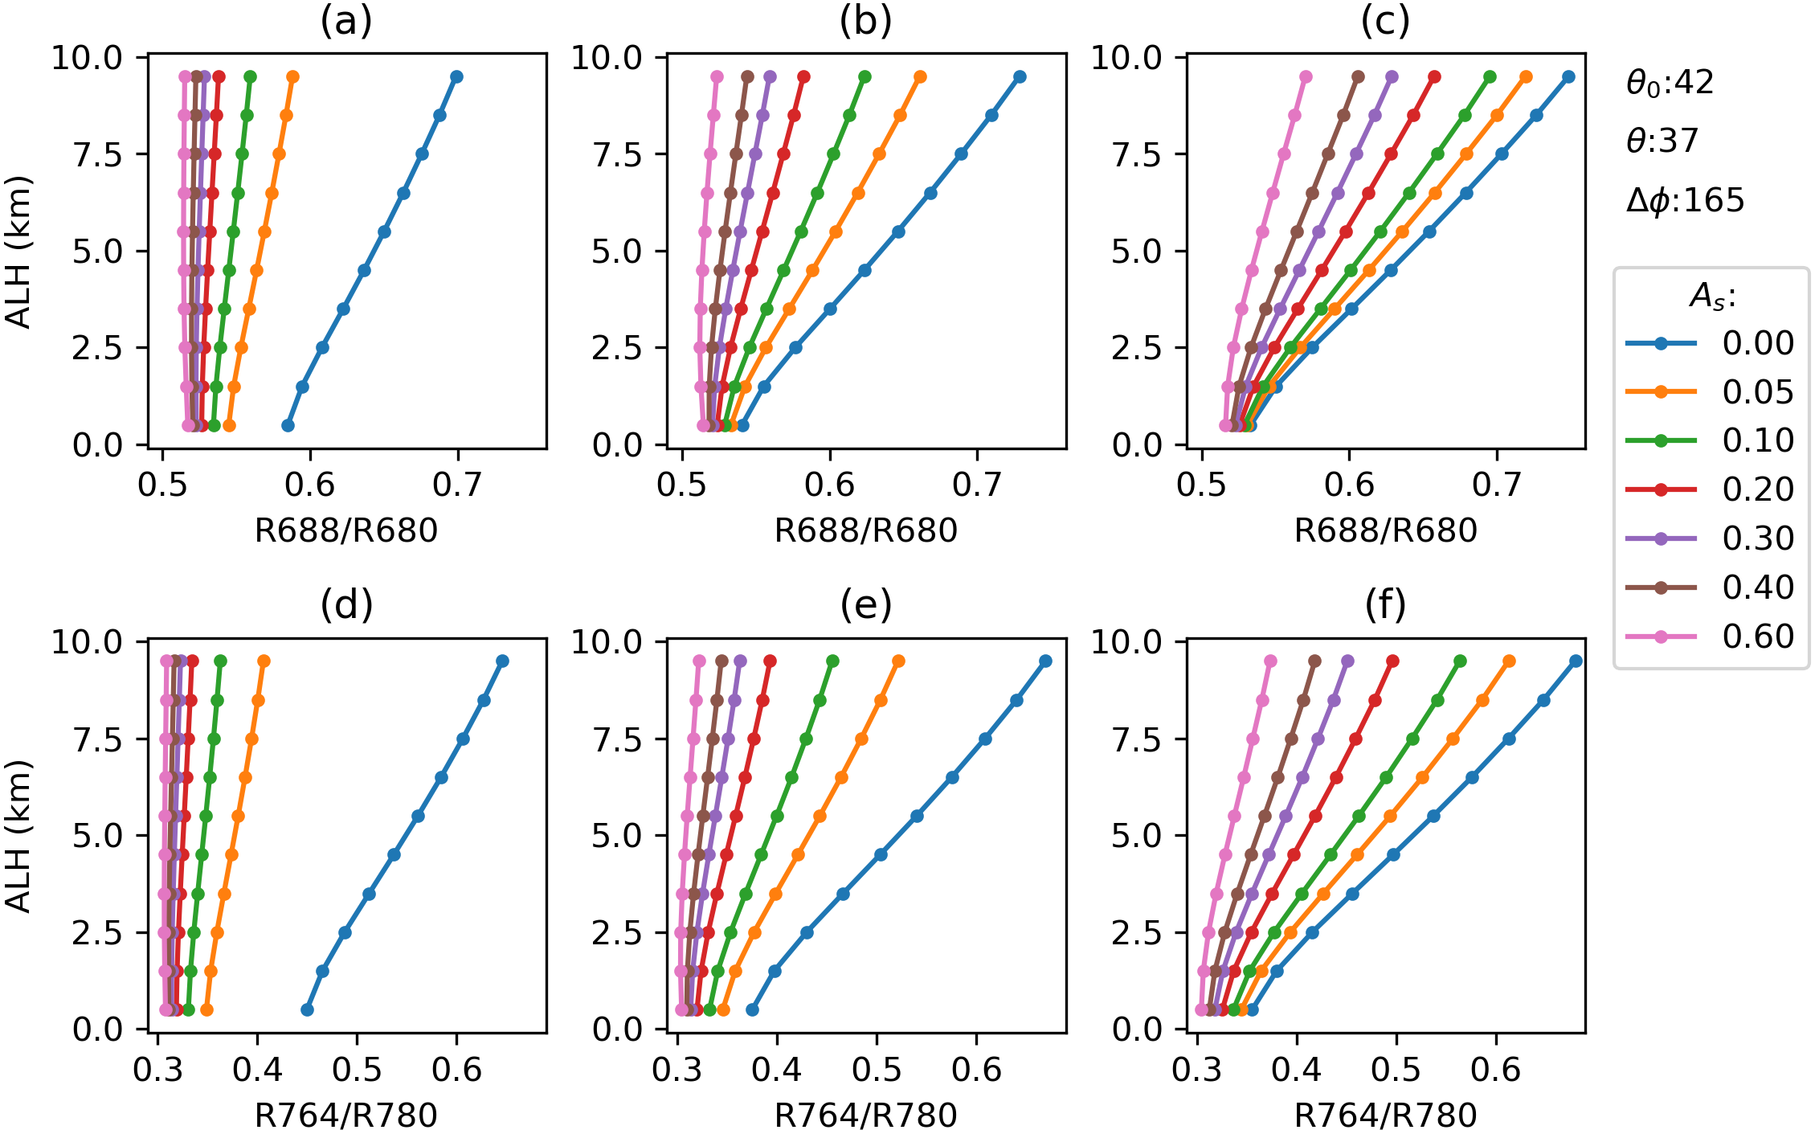
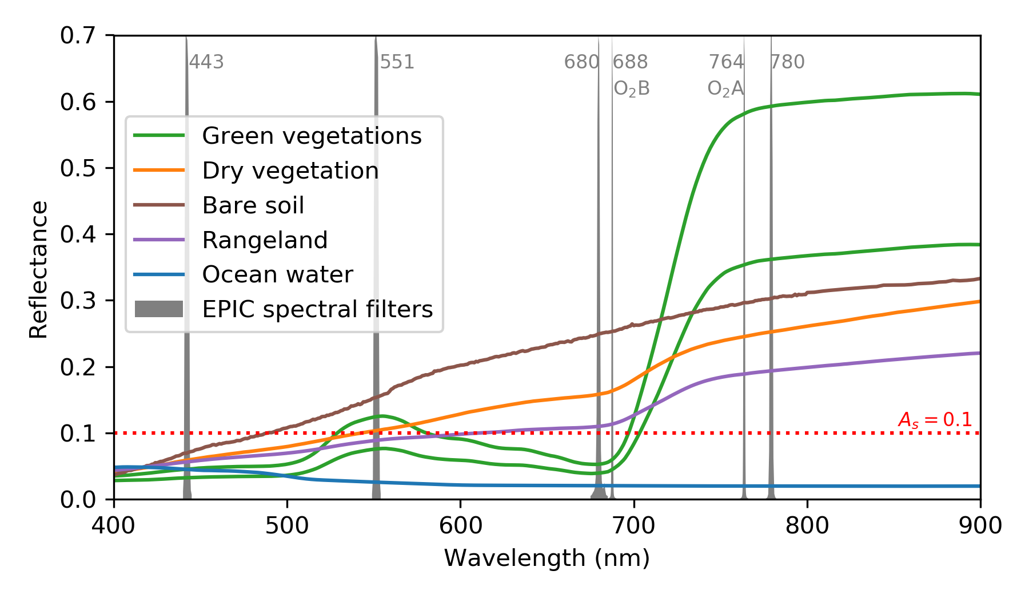
Over what surface types can we get ALH information?
ALH versus DOAS ratios
O2-B band
O2-A band
AOD = 0.1
AOD = 0.4
AOD = 1.0
Reflectance of various surface types
B band
A_{s} <= 0.1
A band
Surface types that meet A_{s} < 0.1:
O2-A band: water
O2-B band: water, green vegetation
So, we only perform ALH retrievals over water and vegetated land surfaces.
Surface reflectance (A_{s}) < 0.1, in order to achieve notable sensitivity in a moderate AOD condition.
Xu et al. 2018, AMT submitted

Slide 8
EPIC ALH retrieval algorithm
Based on Xu et al. [2017] for retrieving dust ALH from EPIC, but with NEW developments:
Implement smoke aerosol model
Determine land surface reflectance from MODIS surface products
3x3 aggregation for retrievals
New strategy of spectral fitting
Acquire
EPIC data
Determine
Surface reflectance
Mask cloud, glint, & bright land
Aggregate
pixels
LUT-EPIC
spectral fitting
Retrievals
Objectives:
Develop an algorithm to retrieve aerosol layer height (ALH) and optical depth (AOD) from EPIC’s radiances in the O2 A and B bands over both land and ocean surfaces
Final goal: global retrieval of ALH for dust, smoke, and volcanic aerosols multiple times a day

Slide 9
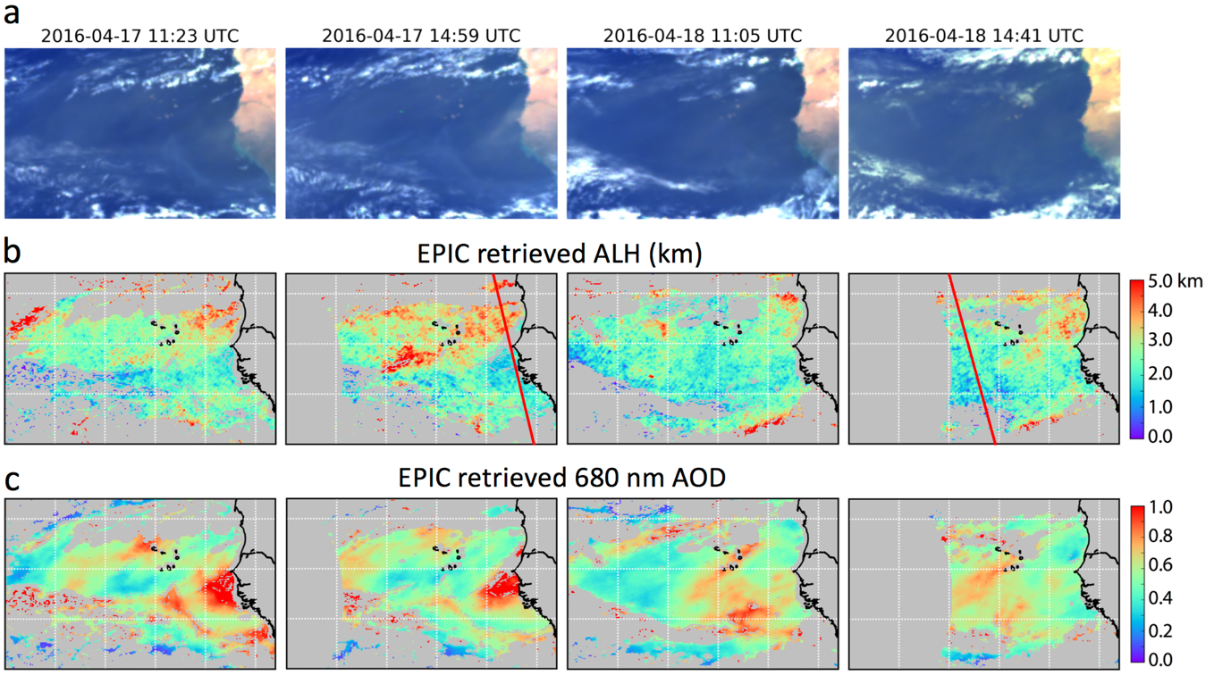
Case 1: Saharan dust over Northern Atlantic Ocean (Retrievals)
Apr-17-2016
Apr-18-2016
Morning afternoon
Morning afternoon
EPIC RBG image
dust
Dust layer height
CALIPSO
Dust AOD
(Xu et al. 2017)

Slide 10
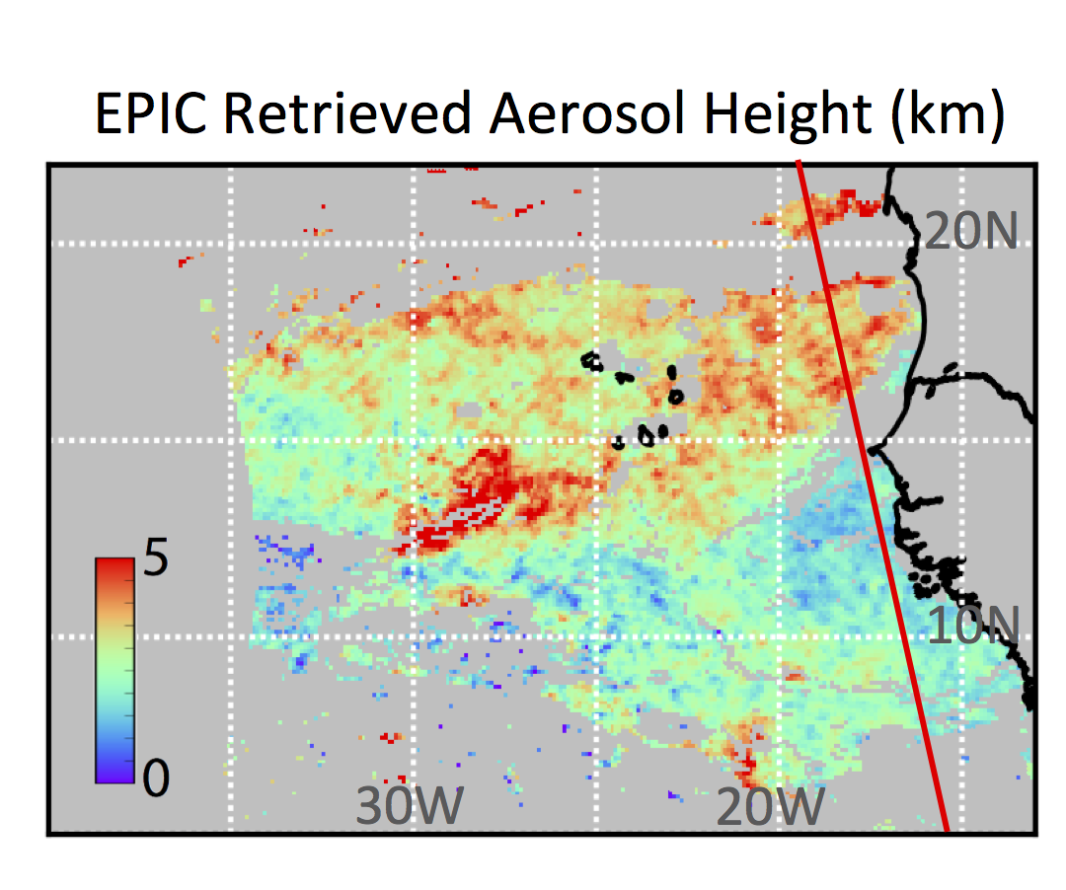
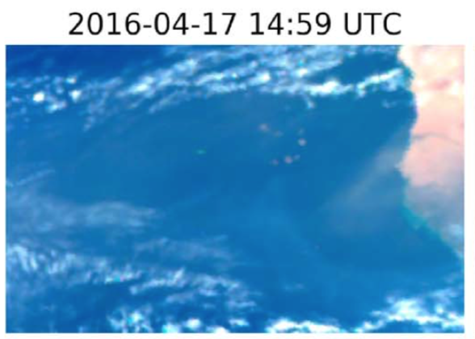
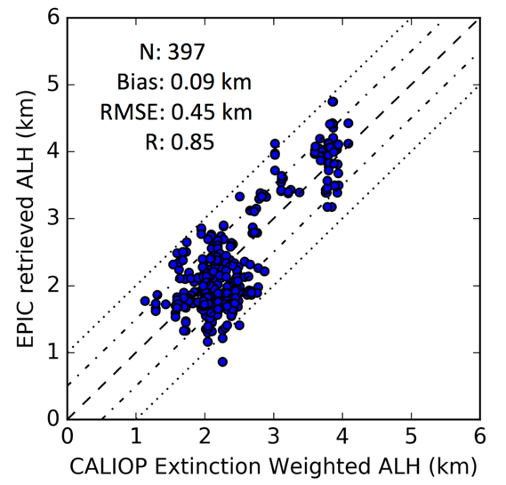
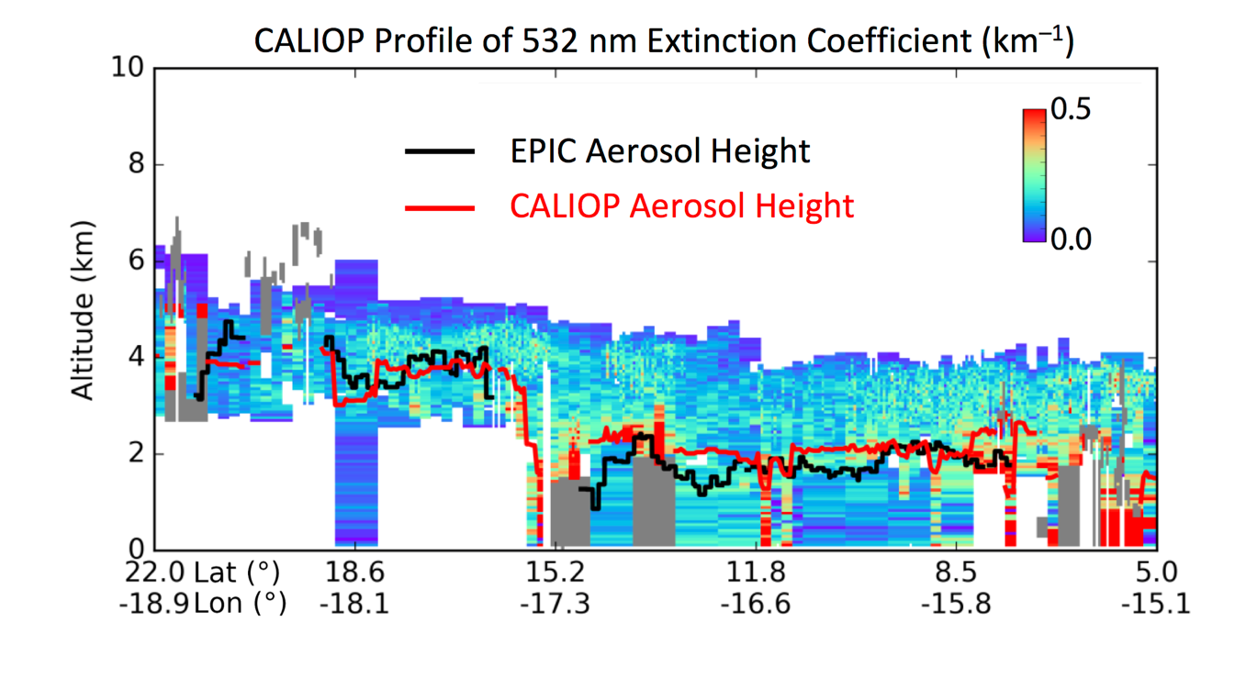
Case 1: Saharan dust over Northern Atlantic Ocean (Validation)
EPIC ALH vs. CALIOP ALH
CALIOP
track
dust
98.7% < ±1km
71.5% < ±0.5km
For the first time, we get dust ALH retrievals over ocean multiple times a day with an accuracy of 0.45 km .
Xu et al. 2017

Slide 11
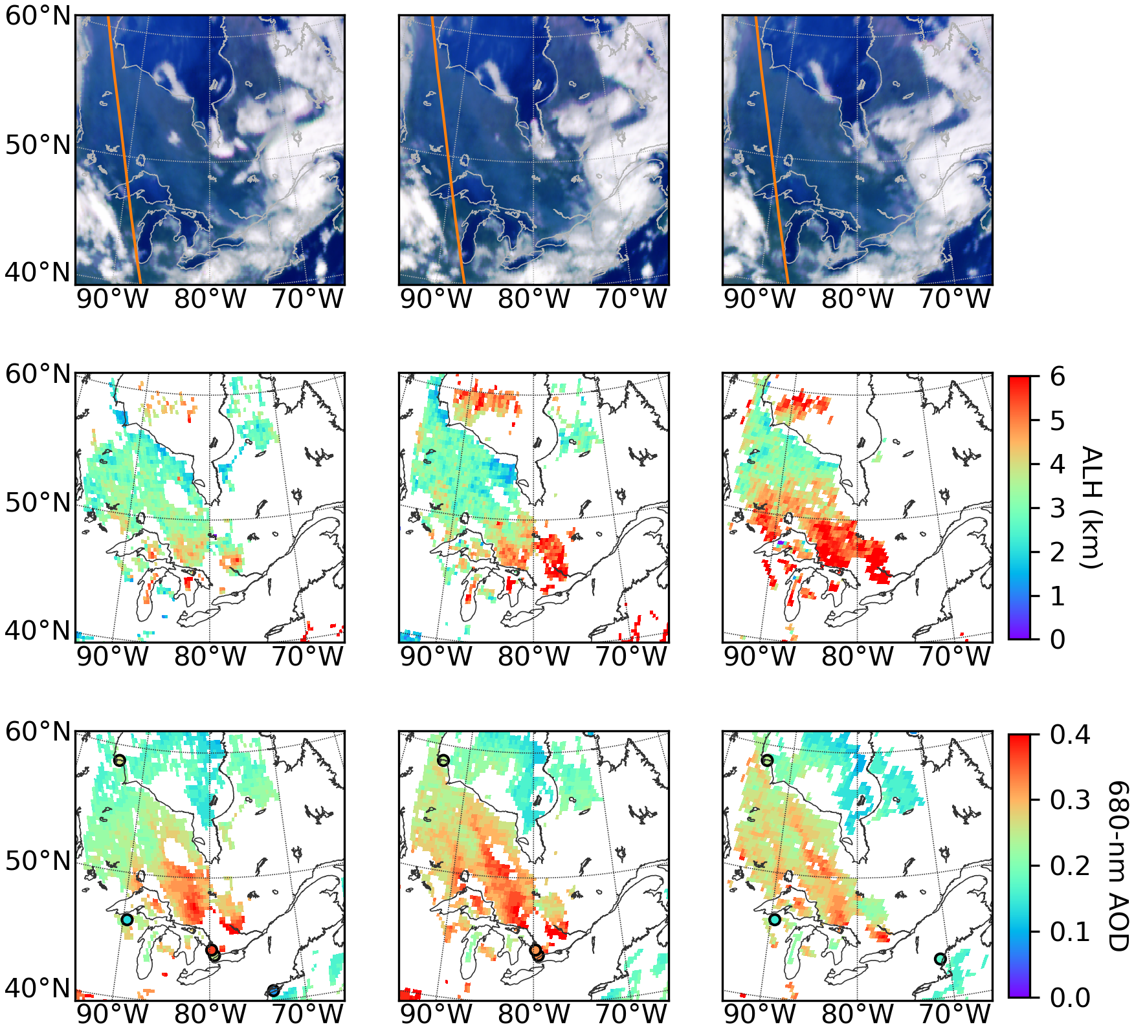
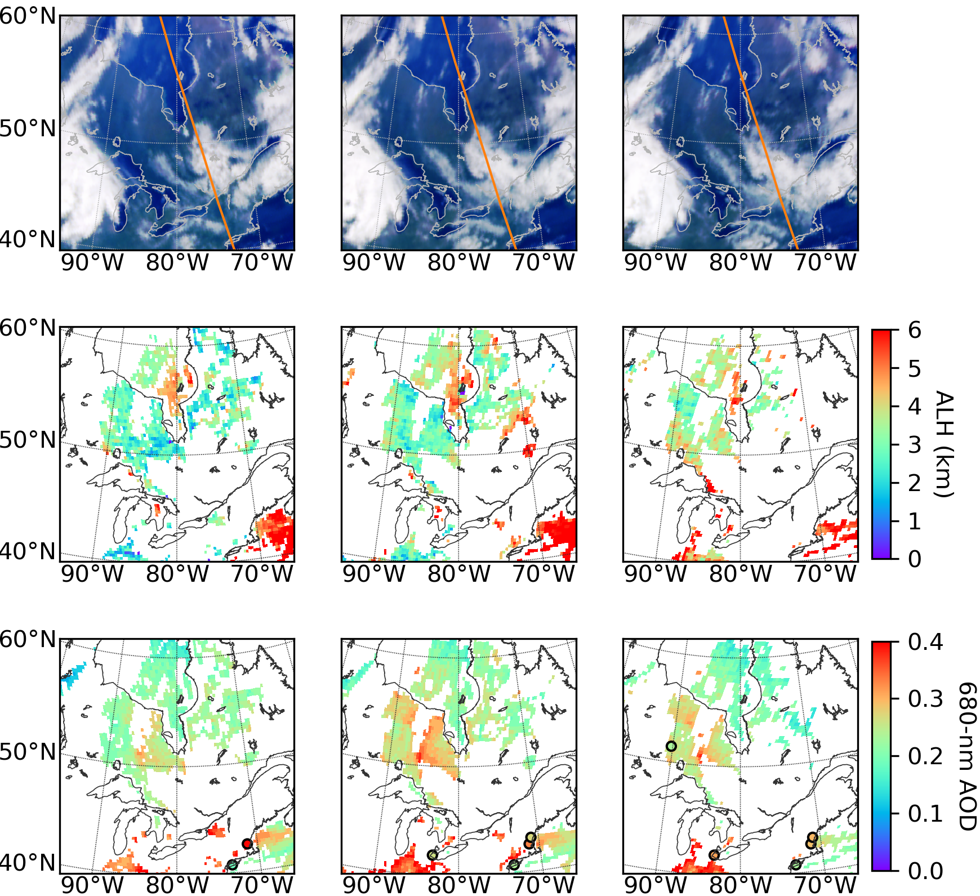
Case 2: Smoke plumes over North America (Retrievals)
Aug-25-2017
(a) EPIC RGB
Aug-26-2017
(a) EPIC RGB
16:10 UTC 17:26 UTC 18:32 UTC
16:11 UTC 17:17 UTC 18:22 UTC
19:05
18:15
(b) EPIC Retrieved ALH (km)
(b) EPIC Retrieved ALH (km)
(c) EPIC Retrieved 680-nm AOD
(c) EPIC Retrieved 680-nm AOD
Xu et al. 2018

Slide 12
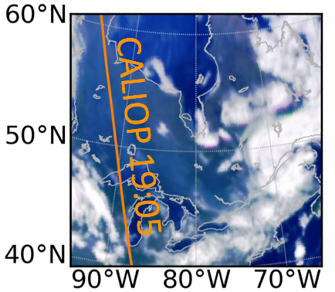
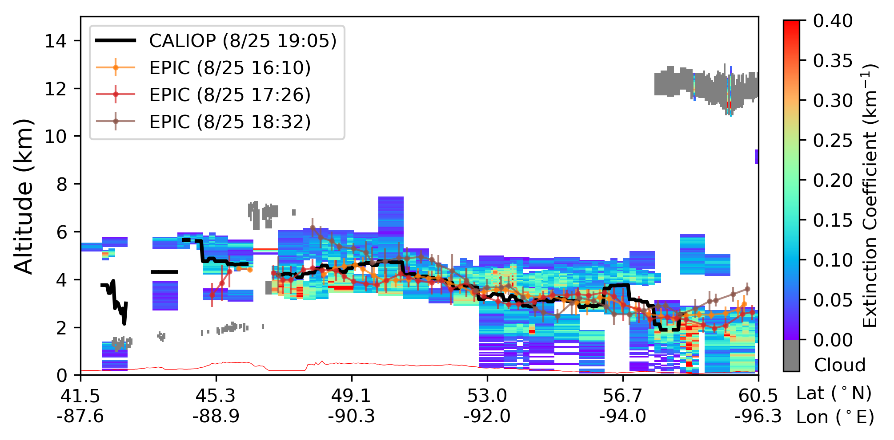
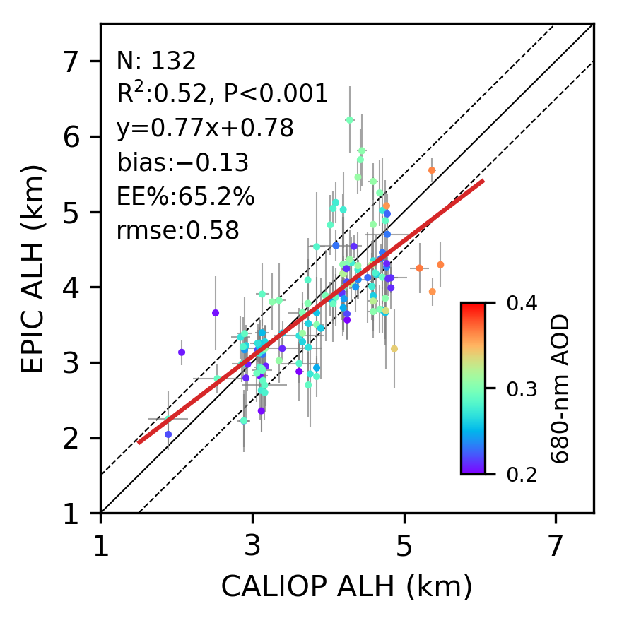
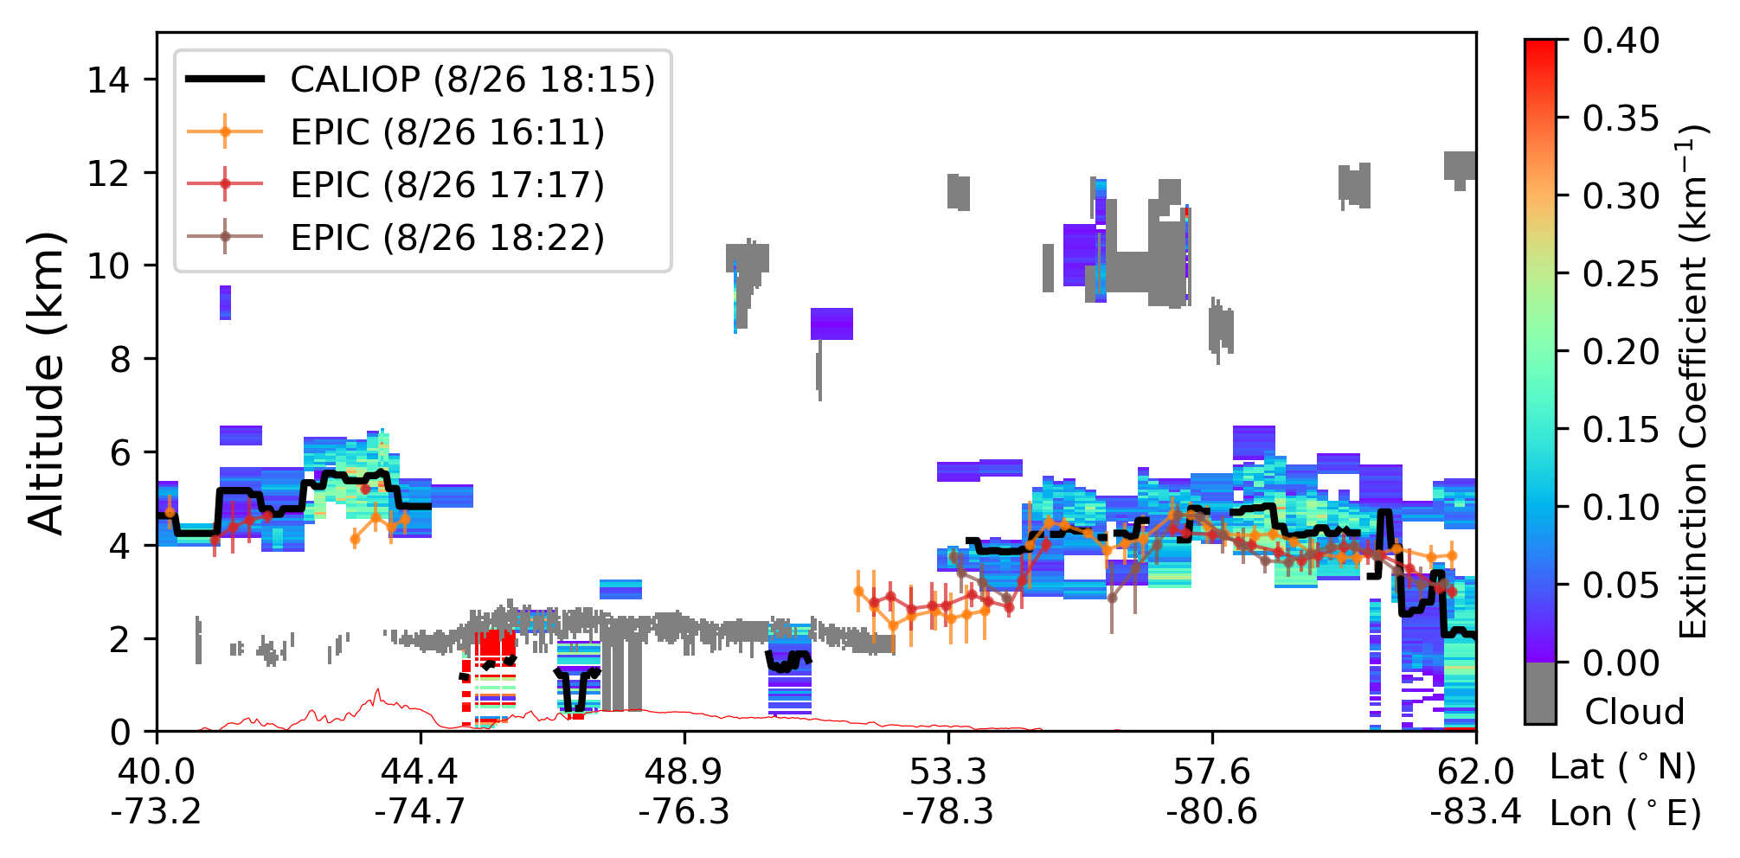
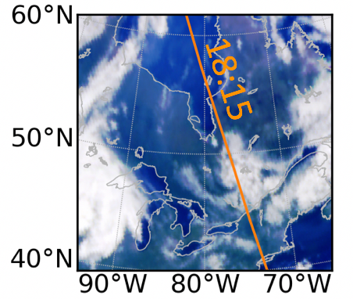
Case 2: Smoke plumes over North America (Validation)
Aug-25-2017
EPIC ALH versus CALIOP ALH
Aug-26-2017
65.2% within ±0.5km
RMSE is 0.58 km
Xu et al. 2018

Slide 13
Summary
EPIC is unique in
  Combining UV-VIS-NIR-O2 A and B band all together.
  Providing sunlit part of Earth surface very 1 – 2 hours
  Offering diurnal variation of AOD and ALH over dark surfaces (ocean and vegetated surfaces)
Our results have shown
  EPIC’s O2 A/B bands are informative for ALH over water and vegetation
  The retrieval accuracy of EPIC ALH is about 0.45 km for dust aerosol over ocean surface, 0.58 km for smoke aerosols over vegetated land surface
The ALH information are valuable for
  Retrieving UV aerosol properties from EPIC
  Constraining injection height and vertical distribution of smoke and dust aerosols in chemistry transport model

Slide 14

Acknowledgements
Thank you for your attention!
Questions?
Data Source and model support:
- NASA/DAAC, NASA GMAO
- HITRAN
- VLIDORT (Robert Spurr)
Computation support:
- U. Iowa HPC
- UMBC HPC
Funding support:
- NASA DSCOVR Science Team
- ONR Multidisciplinary University Research Initiatives (MURI)

Slide 15
Case 1: EPIC AOD vs. MODIS and AERONET AOD
EPIC vs. MODIS AOD
EPIC vs. AERONET AOD
Xu et al. 2017

Slide 16
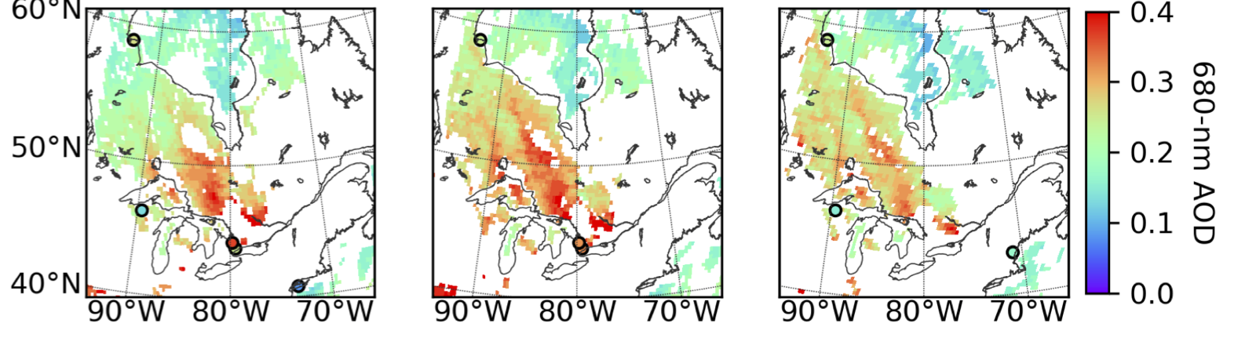
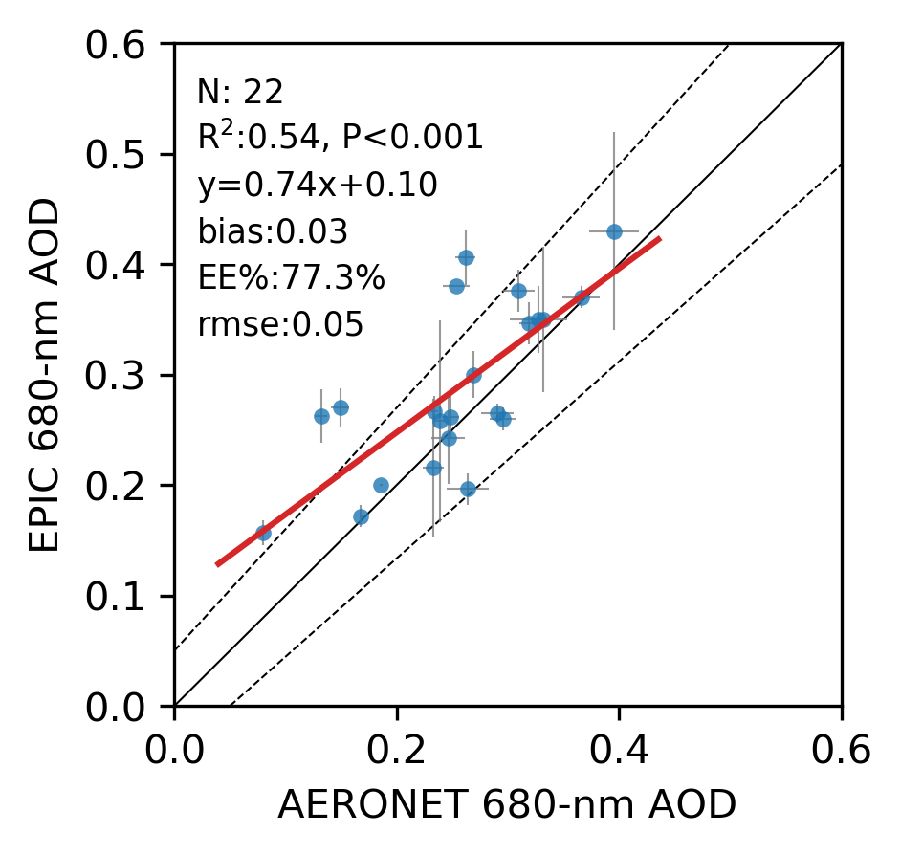
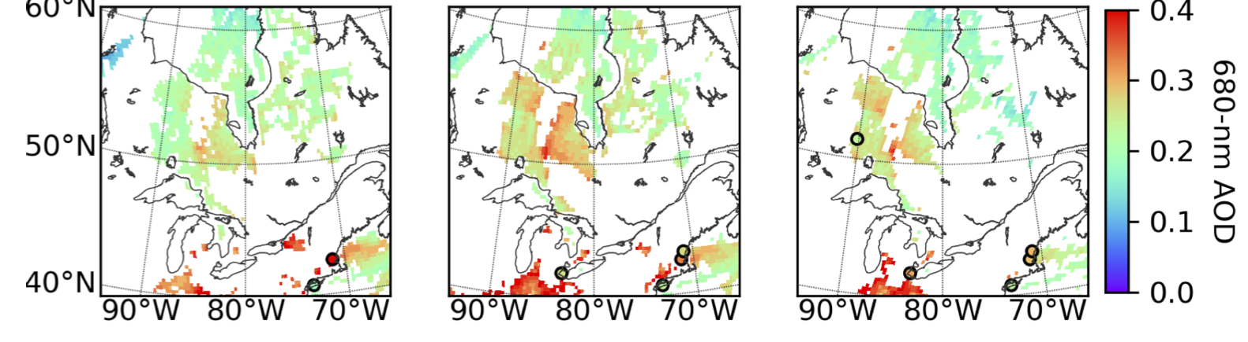
Case 2: Validation of smoke AOD retrievals
EPIC retrieved 560-nm AOD
25 August 2017
EPIC AOD versus AERONET AOD
26 August 2017
77.3% within ± (0.04+10%) difference
RMSE is 0.05
Xu et al. 2018

Slide 17
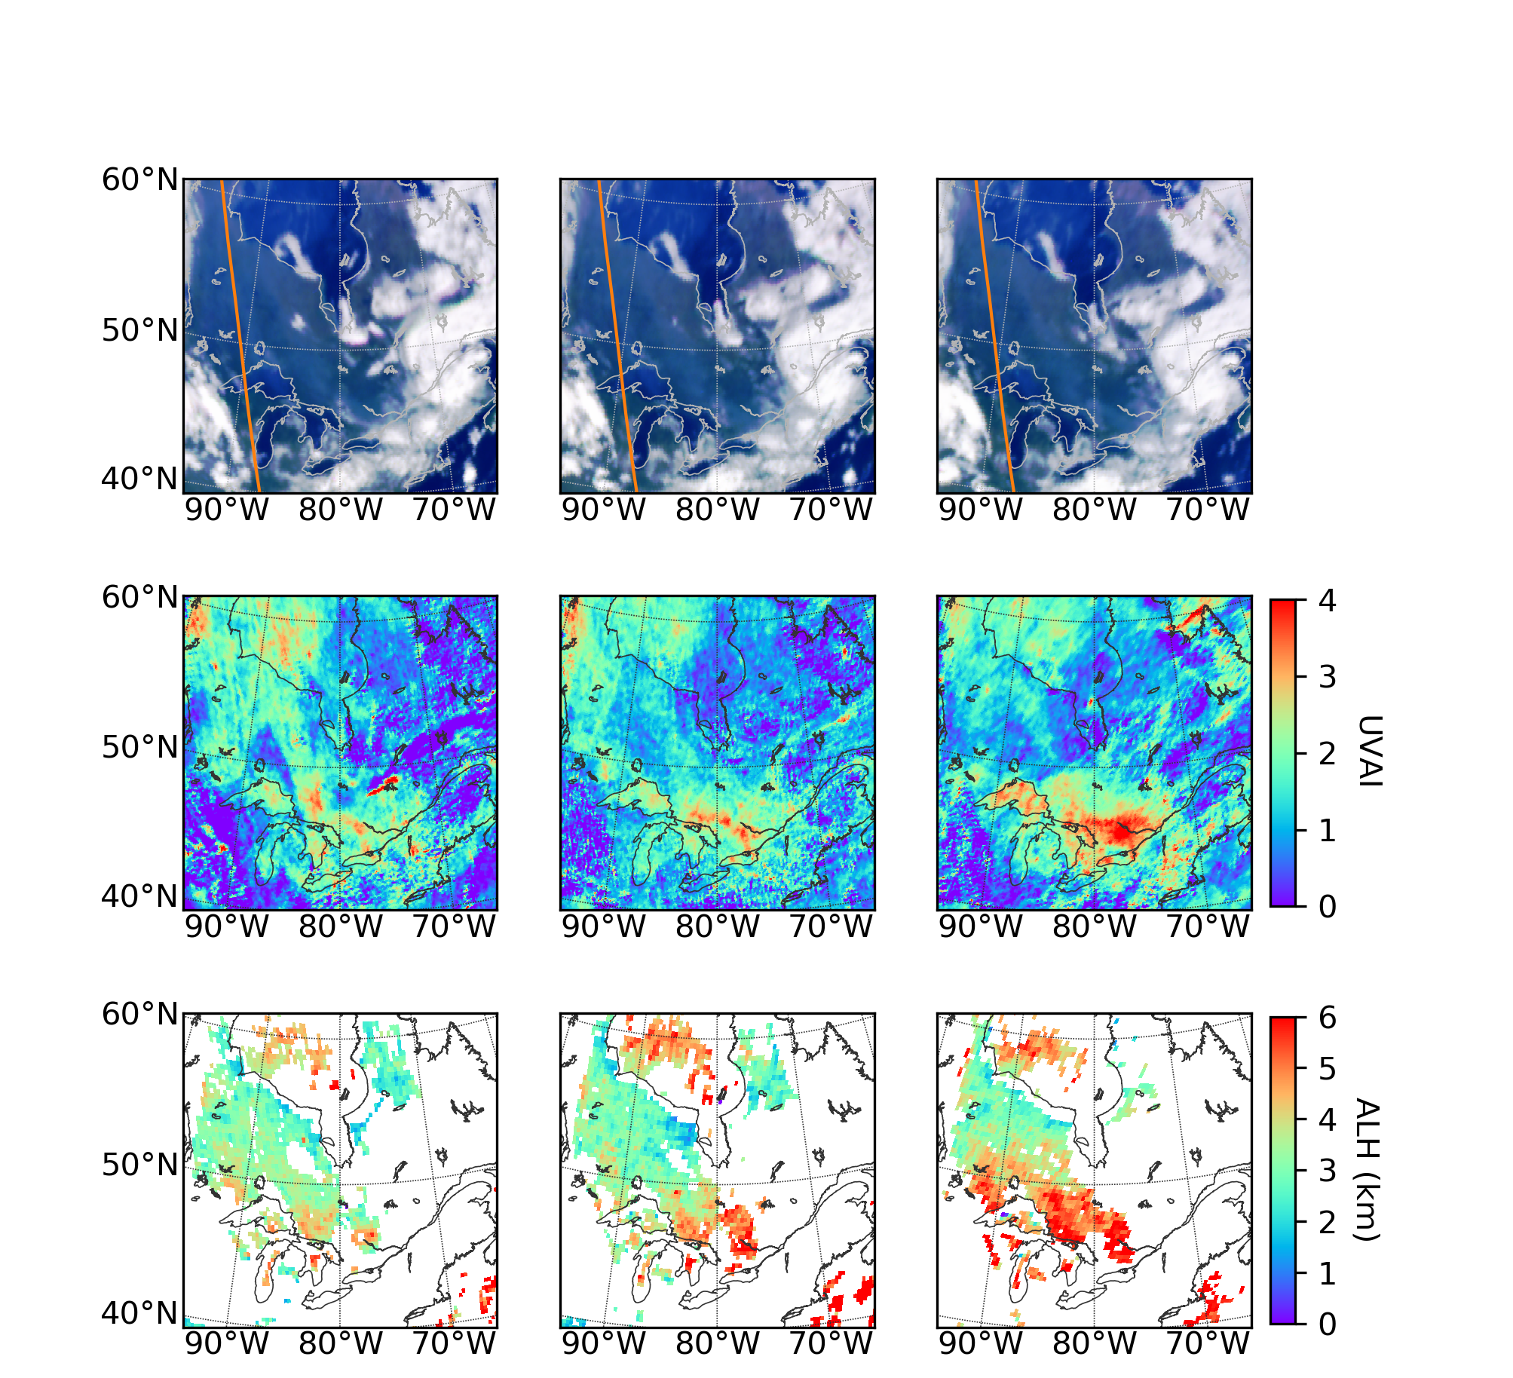
Retrieved ALHs of
smoke plumes over Canada
Case I: Aug-25-2017
Smoke layer is 3 – 5 km high over Hudson Bay
ALHs are 2 – 4 km over land southeast of Hudson bay, increase to 4 – 6 km towards the Great Lakes
Diurnal changes of UVAI and ALH are likely consistent
(a) EPIC RGB
16:10 17:26 18:32
CALIOP 19:05
(b) EPIC UV Aerosol Index (UVAI)
(c) EPIC Retrieved ALH (km)

Slide 18
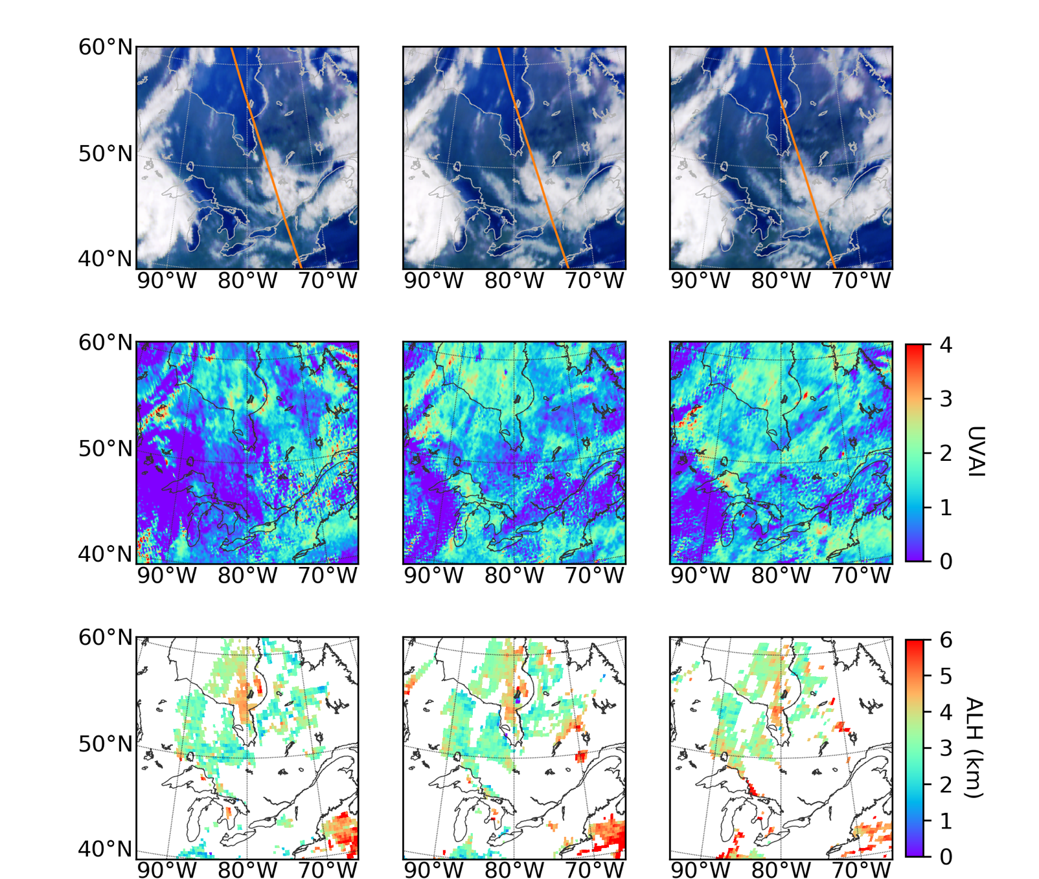
Retrieved ALHs of
smoke plumes over Canada
Case II: Aug-26-2017
ALHs remain 3 – 5 km over Hudson Bay, and 2 – 4 km over land southeast of the bay
Diurnal changes of UVAI and ALH are likely consistent
(a) EPIC RGB
16:11 17:17 18:22
CALIOP 18:15
(b) EPIC UV Aerosol Index (UVAI)
(c) EPIC Retrieved ALH (km)

Slide 19
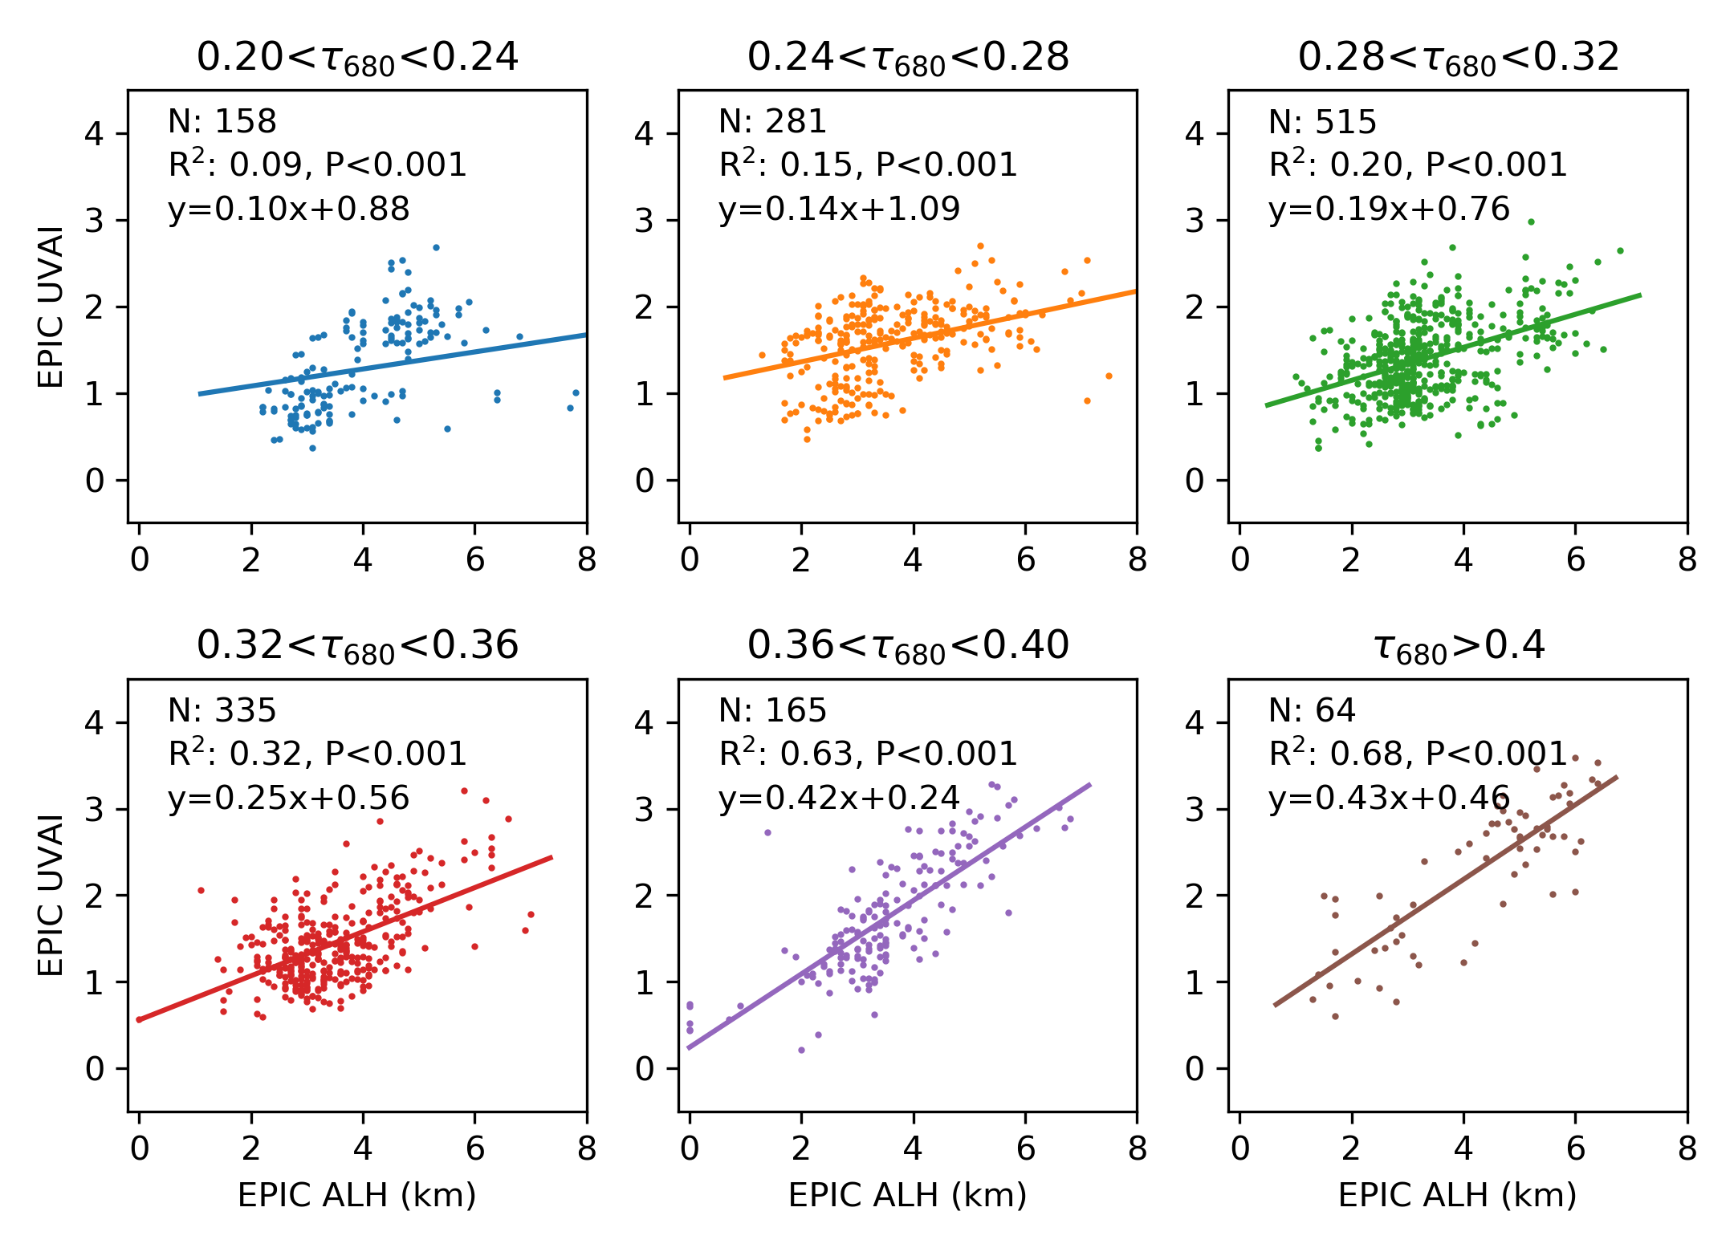
EPIC UVAI versus ALH at different AOD values

Slide 20
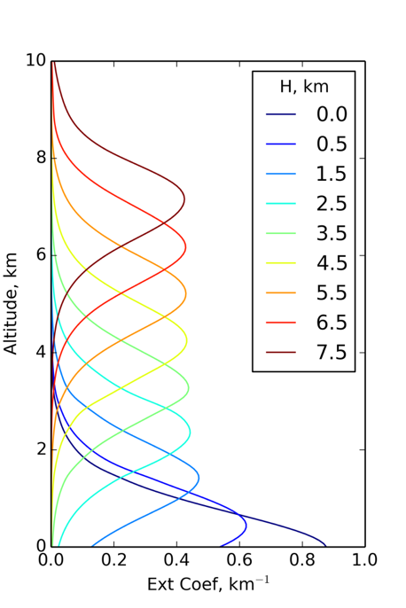


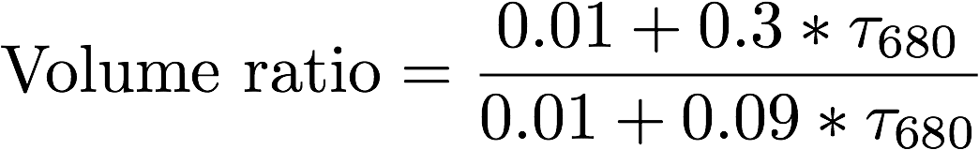
Aerosol profile & smoke optical model
Quasi-Gaussian aerosol extinction profile
Aerosol centroid altitude: H_{peak} , or ALH
Lorenz-Mie calculation for smoke optical properties:
Refractive index: 1.5 – 0.012i for smoke observed in North and South America [Dubovik et al. 2002]
Bi-lognormal particle size distribution, adopted from Dubovik et al. [2002] and Levy et al [2013]:
Small mode:
Large mode:
half-width 𝛾 = 1 km

Slide 21
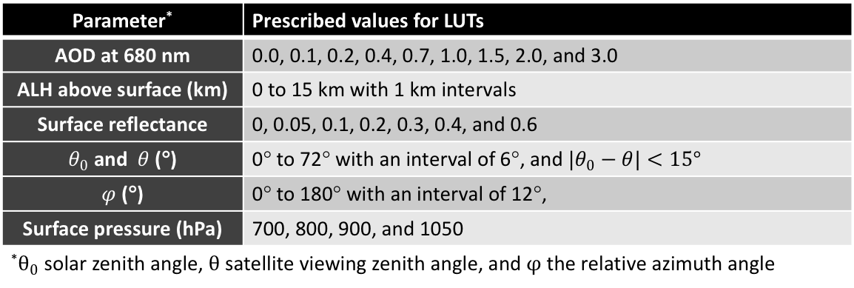
Generating look-up tables (LUTs)
Simulation of EPIC TOA reflectance at 6 bands
EPIC channel (nm) | Spectral range (nm) | Spectral interval (nm) | FWHM (nm)
443 | 440 – 445 | 0.1 | 0.2
551 | 549 – 555 | 0.1 | 0.2
680 | 675 – 685 | 0.1 | 0.2
688 | 685 – 690 | 0.01 | 0.02
764 | 760 – 766 | 0.01 | 0.02
780 | 776 – 782 | 0.1 | 0.2
Structure of the LUTs
Parameter* | Prescribed values for LUTs
AOD at 680 nm | 0.0, 0.1, 0.2, 0.4, 0.7, 1.0, 1.5, 2.0, and 3.0
ALH above surface (km) | 0 to 15 km with 1 km intervals
Surface reflectance | 0, 0.05, 0.1, 0.2, 0.3, 0.4, and 0.6
$θ_{0}$ and $θ$ (°) | 0° to 72° with an interval of 6°, and ${|θ}_{0}−θ|<15°$
$φ$ (°) | 0° to 180° with an interval of 12°,
Surface pressure (hPa) | 700, 800, 900, and 1050
*$θ_{0}$ solar zenith angle, $θ$ satellite viewing zenith angle, and $φ$ the relative azimuth angle

Slide 22
Satellite instruments measuring O₂ A or B bands
 | Year
95 | 96 | 97 | 98 | 99 | 00 | 01 | 02 | 03 | 04 | 05 | 06 | 07 | 08 | 09 | 10 | 11 | 12 | 13 | 14 | 15 | 16 | 17 | →
GOME/ERS-2
POLDER-1
POLDER-2
Spectrometer
MERIS/ENVISAT
Narrowband
SCIAMACHY/ENVISAT
POLDER/PARASOL
GOME-2/METOP
TANSO-FTS/GOSAT
Future instruments:
3MI/METOP-SG,
MAIA
OCI, SpexOne on PACE
OCO-2
EPIC/DSCOVR
CarbonSpec/TanSat
TROPOMI/S-5p

