Slide 1
Ad-Hoc Ceilometer Evaluation Study (ACES): Mixing Layer Heights and Network
Ruben Delgado^{1,2,3}, Vanessa Caicedo^{1,2}, Belay B. Demoz^{1,2,3,5}, Innocent Kironji^{1,5}, Jenna Westfall^{1,2}, Ben Ireland^{1,2} , Daniel Taylor^{1,2}, Brian Carroll^{1,2},
Ricardo Sakai^{4,5}, Micheal Hicks⁶, Dennis Atkinson⁶, James Szykman⁷, M. Woodman⁸, David Krask⁸
¹University of Maryland Baltimore County,
²Joint Center for Earth Systems Technology, ³NOAA Center for Earth System Science and Remote Sensing Technologies, ⁴Howard University, ⁵NOAA Center for Atmospheric Sciences and Meteorology, ⁶National Weather Service, ⁷ US Environmental Protection Agency, ⁸Maryland Department of the Environment
UMBC Earth Day Symposium
April 26, 2019

Slide 2
UMBC Atmospheric Lidar Group
Research Areas
Inversion algorithms, optical, chemical and physical properties of atmospheric aerosols, gases, and clouds.
Boundary Layer Dynamics (Air Quality and Wind Energy)
Continental and intercontinental plume transport to Eastern US.
AOD-PM_{2.5} Estimator Development from Ground, Satellite Observations, NWF and Global Models
New remote sensing technologies for atmospheric observations.
https://alg.umbc.edu
https://lidar.umbc.edu

Slide 3
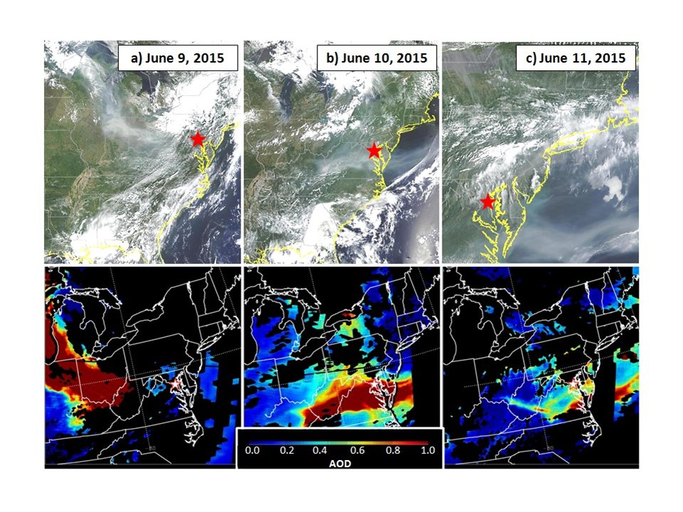
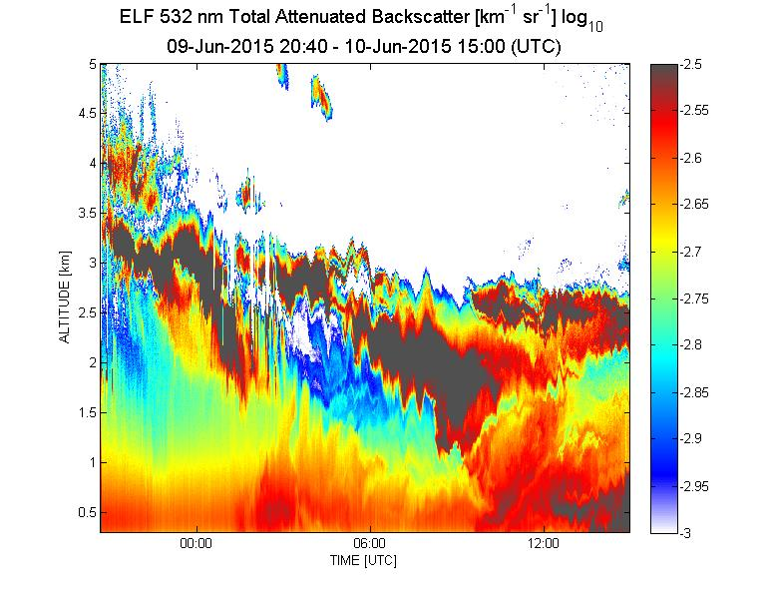
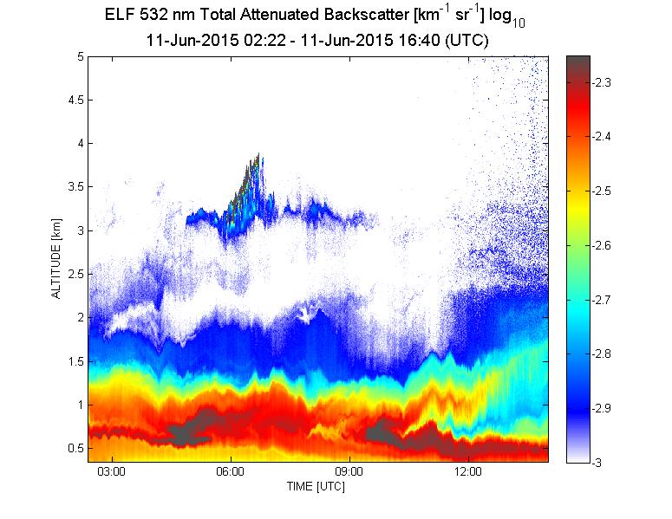
Measuring Our Changing World:
Lidar Remote Sensing
  Observational platform for pursuing societal benefits.
  Intimate engagement between the scientific community and wide range of stakeholders.
  Provide information for managing land, water, air quality, agriculture, energy, disaster response and ecosystems functions.
Dressen et al., “Observations and impacts of transported Canadian wildfire smoke on ozone and aerosol air quality in the Maryland region on June 9–12, 2015”, JAWMA, 2016

Slide 4
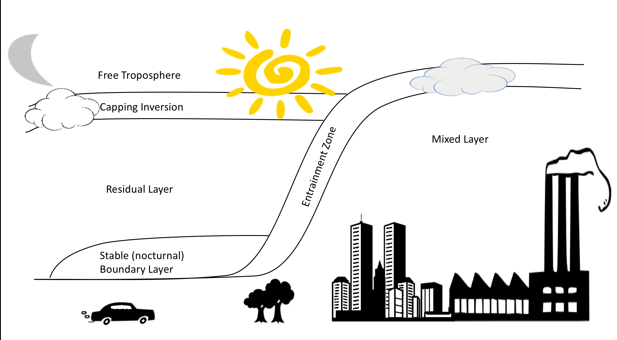
Planetary Boundary Layer (PBL)
The determination of the planetary boundary layer height is vital in air pollution studies as it determines the extent of vertical mixing of pollutants
Mixing Layer
Continuous measurements of the mixed layer height, residual layer and nocturnal stable layers are needed.
Lidars/Ceilometers
Notes:
why

Slide 5
Mixing Layer Height
Diagnostic variable atmospheric transport and dispersion forecasting models.
Without realistic PBL heights models have large errors that result in inadequate public protection against unhealthy air quality.
National Research Council has recommended a “network of networks”¹
  After 60 years of remote sensing research, it is astounding that the PBL is not measured regularly throughout its diurnal cycle
1- NRC. 2009. Observing Weather and Climate from the Ground Up: A Nationwide Network of Networks. Washington, DC: National Academy Press.

Slide 6
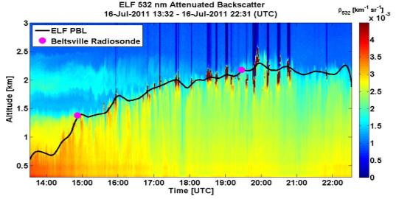
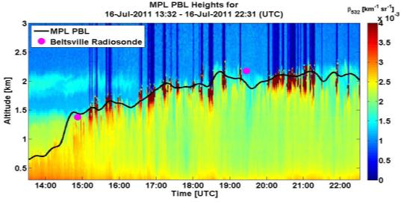
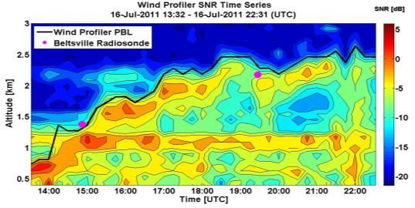
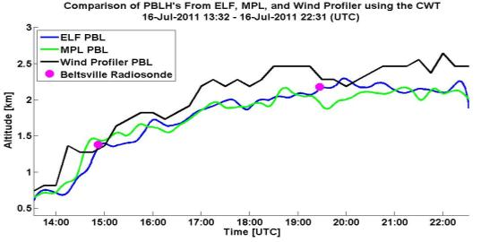
Observations Lead The Way
Ceilometers!!!
NRC
R. Hoff
Observing Weather and Climate from the Ground Up: A Nationwide Network of Networks (2009)
Regional Testbed
NSF
B. Demoz
Thermodynamic Profiling Technology Workshop (2011)
NASEM
R. Delgado
The Future of Atmospheric Boundary Layer Observing, Understanding, and Modeling (2018)
*Compton et al. (2013), J. Atmos. Ocean. Tech., doi:10.1175/JTECHD-12-00116.1
Notes:
6

Slide 7
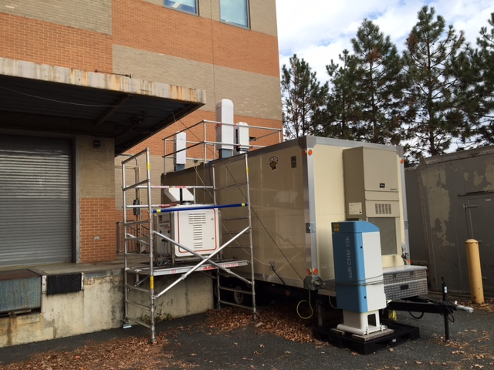
Ad-hoc Ceilometer Evaluation Study (ACES)
Aerosol backscatter from 6 commercial ceilometer/lidars evaluated:
  Campbell Scientific CS135
  Leosphere 200S Windcube
  Lufft: CHM8k and CHM15k
  Vaisala CL31 and CL51
Signals were processed through the firmware unique to each ceilometer to correct background noise, range, and overlap.
  Campbell Scientific CS135: Viewpoint
  Leosphere 200S Windcube: (UMBC Cov. Wavelet Transform)
  Lufft CHM8k and CHM15k: Lufft Viewer
  Vaisala CL 51: BL-View
  Vaisala CL 31 : CL-View
MLHs were derived through three automated methods:
  Covariance Wavelet Transform (Haar Function)
  Second Derivative
  Cluster Analysis
Nov. 15-Dec. 16, 2016 @ UMBC: Automated methods for MLH retrieval were compared to MLHs derived from potential temperature from 55 radiosondes (iMet-1-ABxn 403 MHz GPS and Vaisala Digicora MW41 (RS-41 and RS-92).

Slide 8
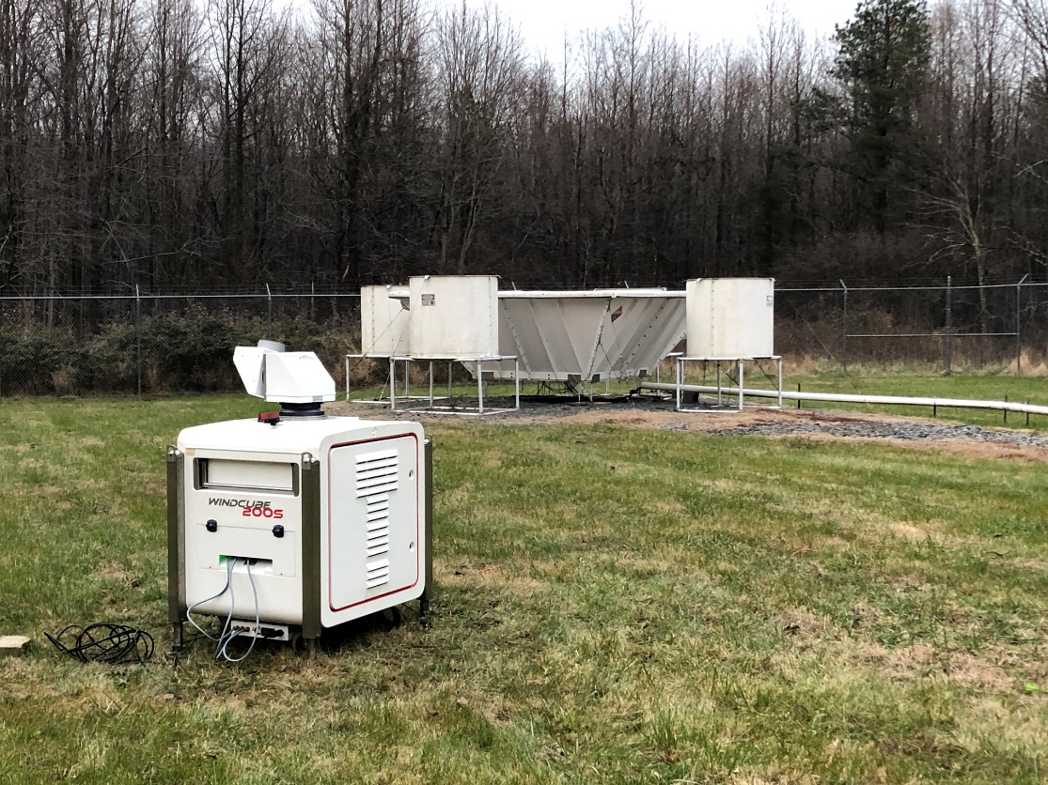
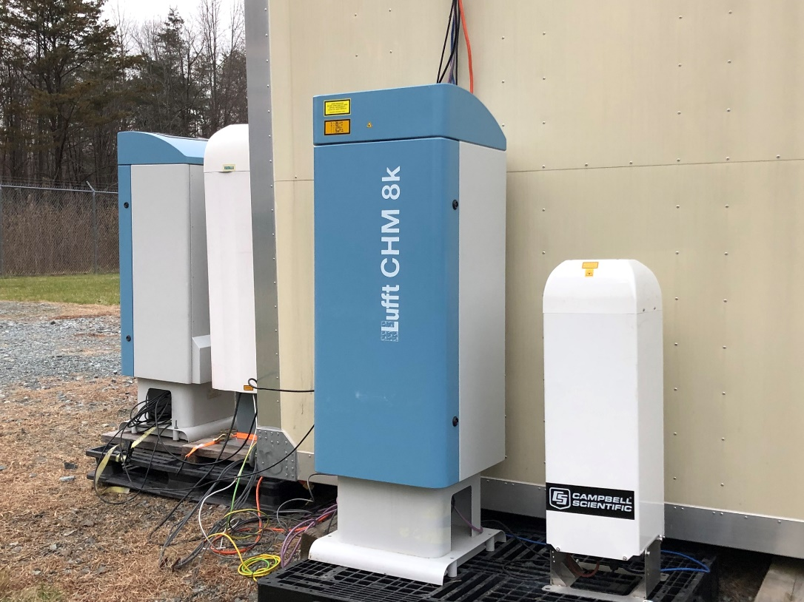
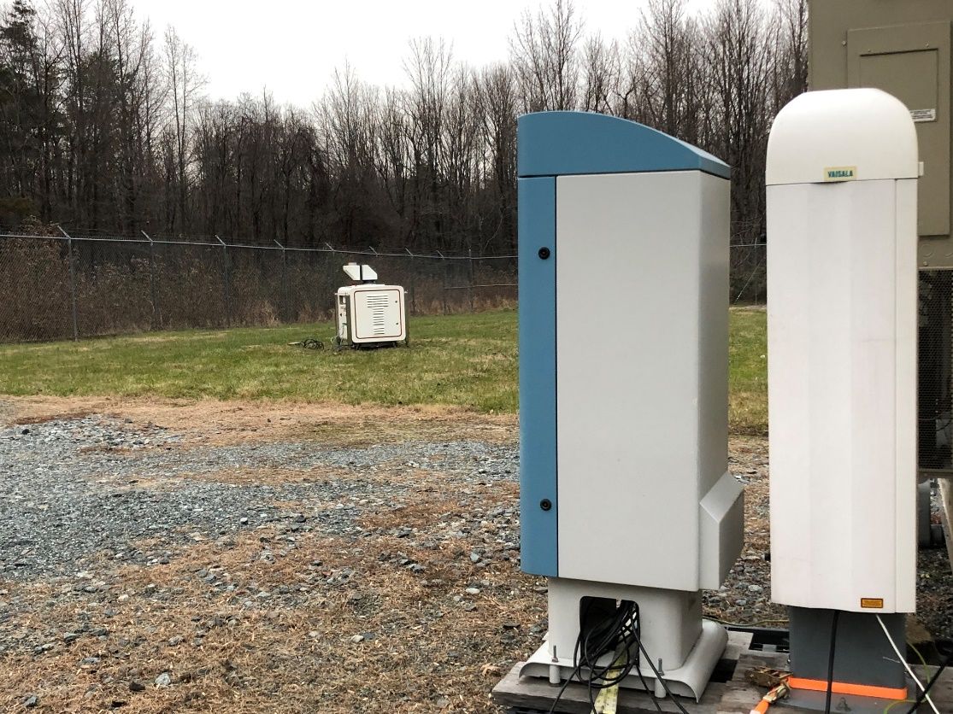
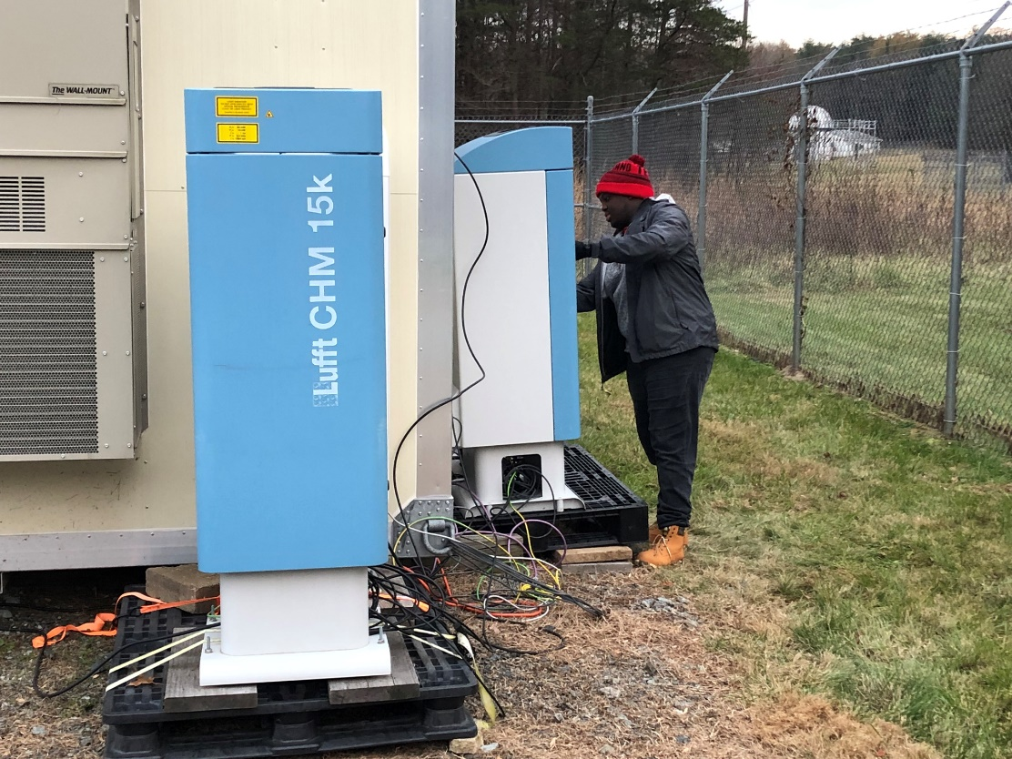
ACES: December 2018-January 2019
MDE HU-Beltsville Monitoring Station
EPA/NWS/UMBC: Measurements to help guide EPA PAMS program implementation for new hourly MLH requirement and supplement current efforts under NWS ceilometer test bed.

Slide 9
Objectives:
  Evaluate aerosol backscatter from commercial ceilometers.
    Aerosol climatology in the Baltimore-Washington metropolitan area:
  PM_{2.5} < 10 (fall) to ≥ 18 (summer) μg/m³ : (clean air to hazy).
    How aerosol load impacts the Signal-to Noise Ratio (SNR) of the ceilometers and the MLH retrieval?
  Assess the daytime mixing layer height determination from commercial remote sensing technology.
    MLH from vendor software and a common algorithm.
    Focus on transition time periods.
What additional information can be gained from remote sensing technology (ceilometer, microwave radiometer, lidar, radar wind profilers, etc), such as elevated layers aloft and entrainment?

Slide 10
Aerosol Backscatter Evaluation
Ceilometer signal evaluation
Signal-to noise ratios
Artifacts
Resolution
Overlap corrections
Software limitations
Notes:
Add Julianna poster

Slide 11
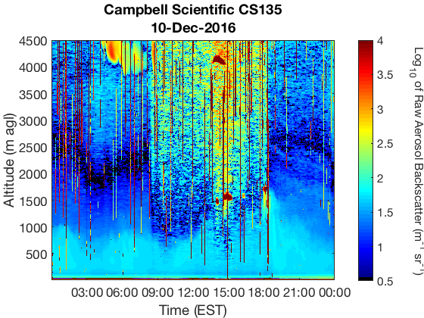
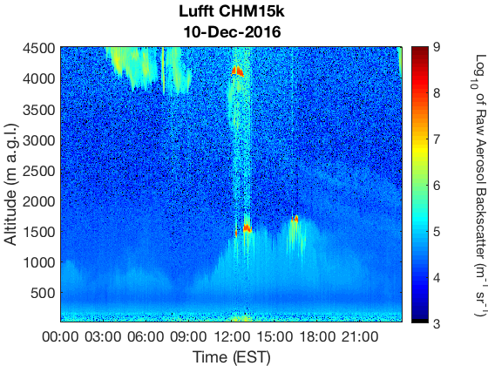
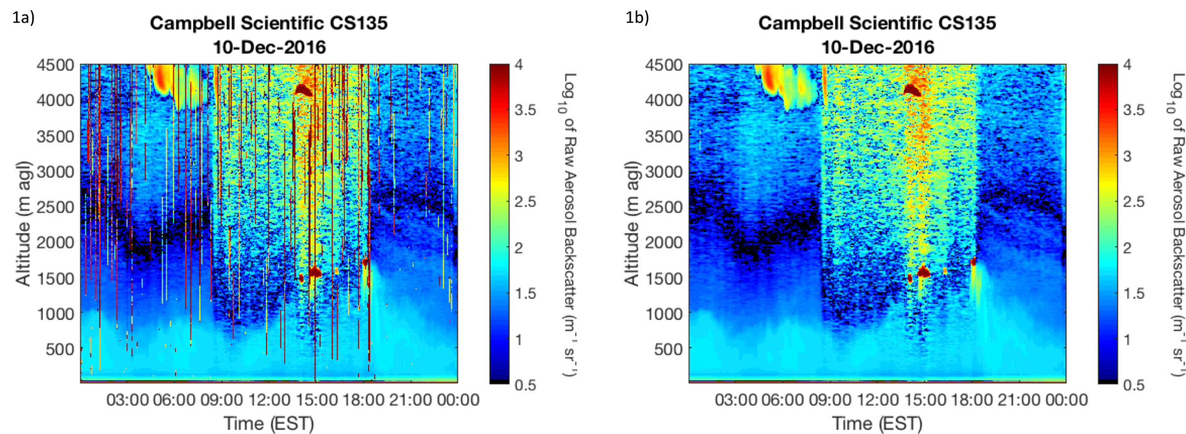
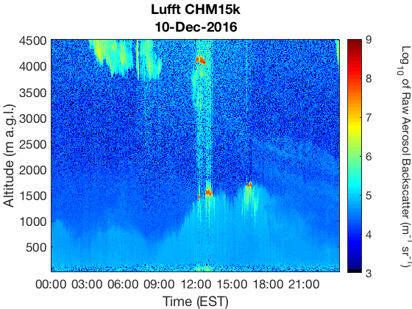
Aerosol Backscatter Evaluation
Artifacts
Overlap Correction
Noise and artifacts must be address by Campbell Scientific, however filtering method able to correct for majority of observed artifacts.
Correction required as it displays a temperature dependency. The Hervo et al. (2016) automated method is suggested.
Notes:
Add Julianna poster

Slide 12
Evaluation and Development of Automated
MLH Algorithms and Methodologies
Results
Software/Firmware retrievals displayed low correlations to radiosonde MLHs and therefore are not recommended for continuous automated MLH retrievals.
A Haar wavelet algorithm including clouds signal identification and removal, continuation parameters, and dual nighttime retrievals is recommended for the consistent automated retrieval of the MLH across varying ceilometer instrumentation.
Additional studies to aid implementation of algorithm constraints to improve diurnal and seasonal retrievals, and retrievals in complex planetary boundary layer environments.

Slide 13
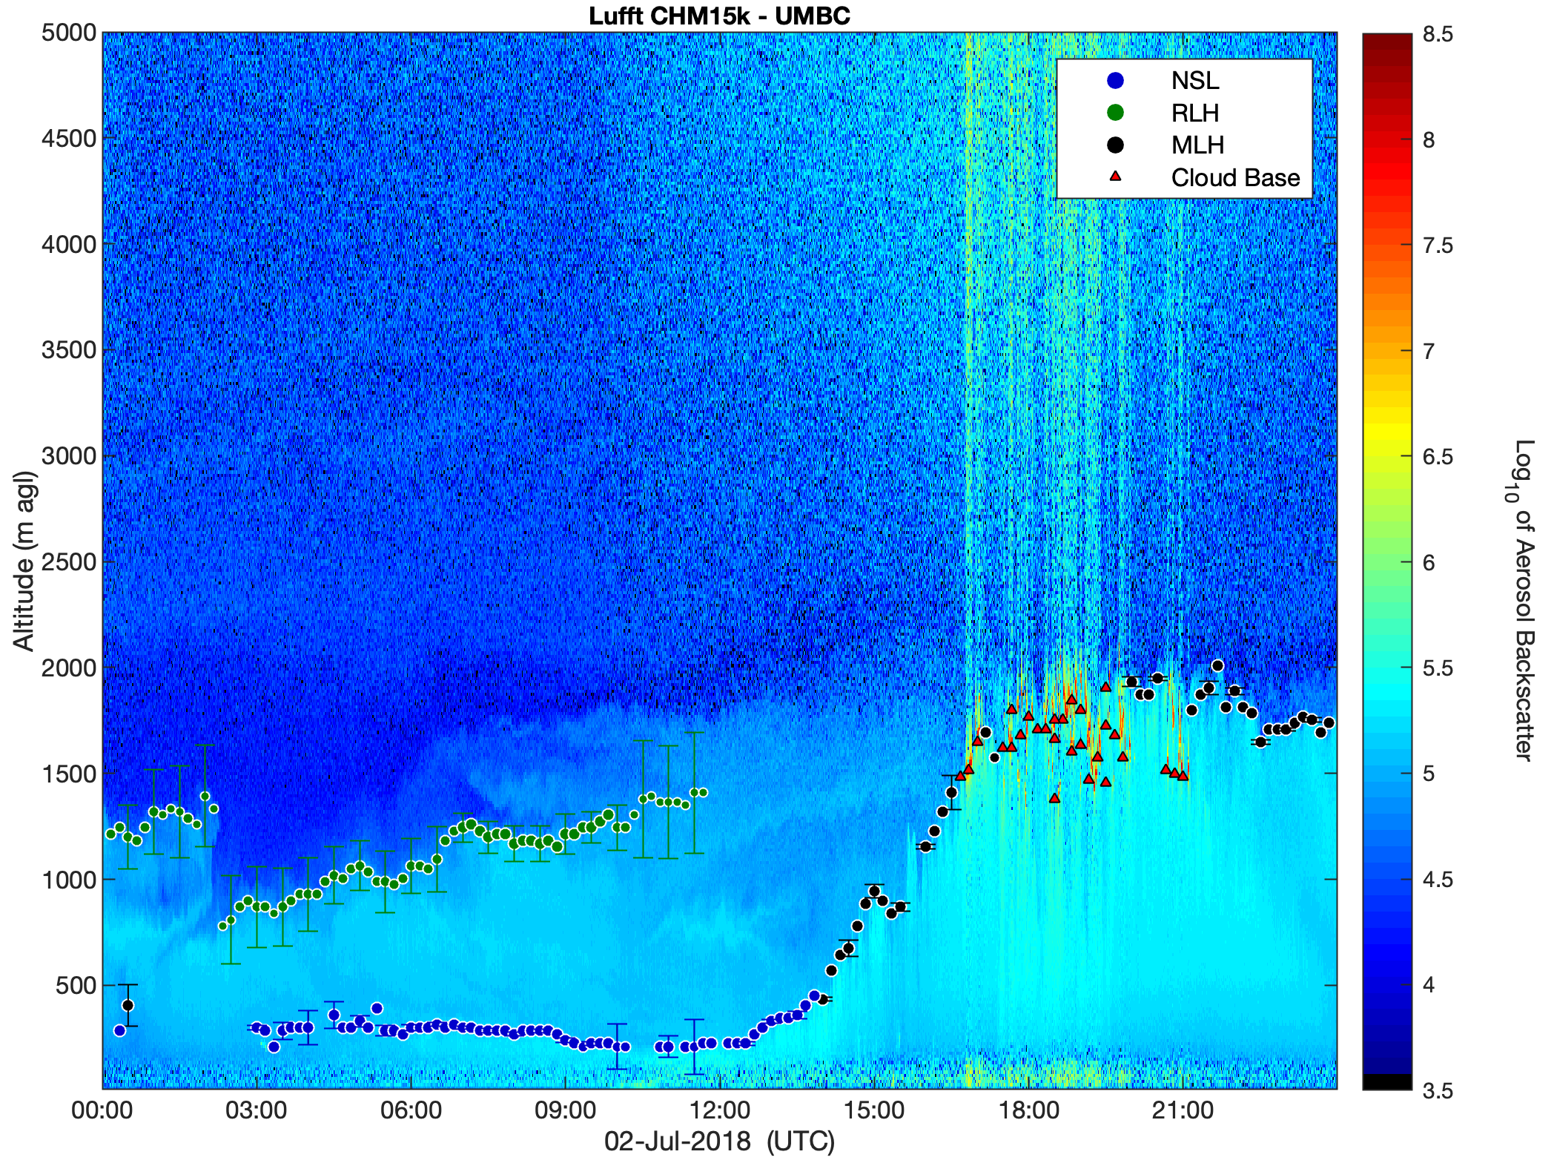
Retrieval Algorithm
Vaisala CL31
Vaisala CL51
Lufft CHM15k
Signal Correction
10-min binning
Haar wavelet transform
Lufft CHM8k
Precipitation Screening
Campbell Sci. CS135
Signal corrections (noise, artifacts, overlap, etc.)
Continuation parameters for layer attribution
Time-tracking height limitations to reduce misidentification of aerosol layers during transition times
Cloud identification independent of commercial cloud retrievals
Range of Haar wavelet transforms to calculate uncertainties in retrievals
Cloud classification in order to include convective cloud-topped boundary layers and cloud cover information
Define dilations and ranges based on uncertainties
QA (Uncertainty/ Precip./ Clouds)
Uncertainty Calculations
PBLH retrievals
Cloud identification
Setting evaluation
Nocturnal Stratification – Shallow ML
Rapid ML growth
Deep convective ML
Calculate cloud base, top, and depth
Caicedo et al., (2017) ; Caicedo et al., (in prep)

Slide 14
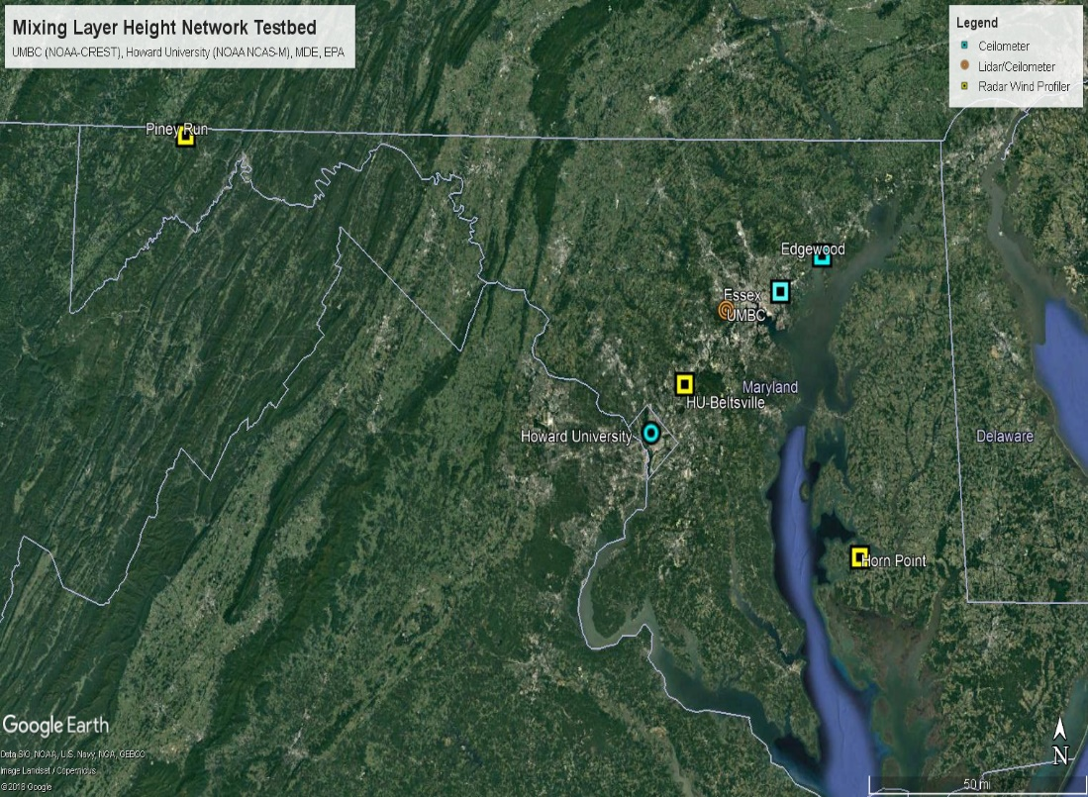

Interdisciplinary Research
Undergraduate and Graduate Students
Atmospheric Physics
Biology
Computer Science and Electrical Engineering
Geography and Environmental Systems
Math and Statistics
Mechanical Engineering
Physics
Mixing Layer Height Network Testbed
Academia
UMBC, City College of New York, Hampton University,
University of Texas, El Paso, Howard University
State and Federal Stakeholders
MDE, EPA, NOAA, NASA

Slide 15
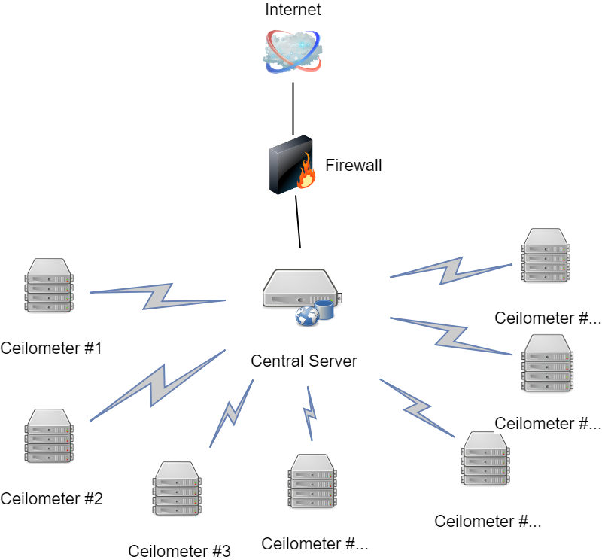
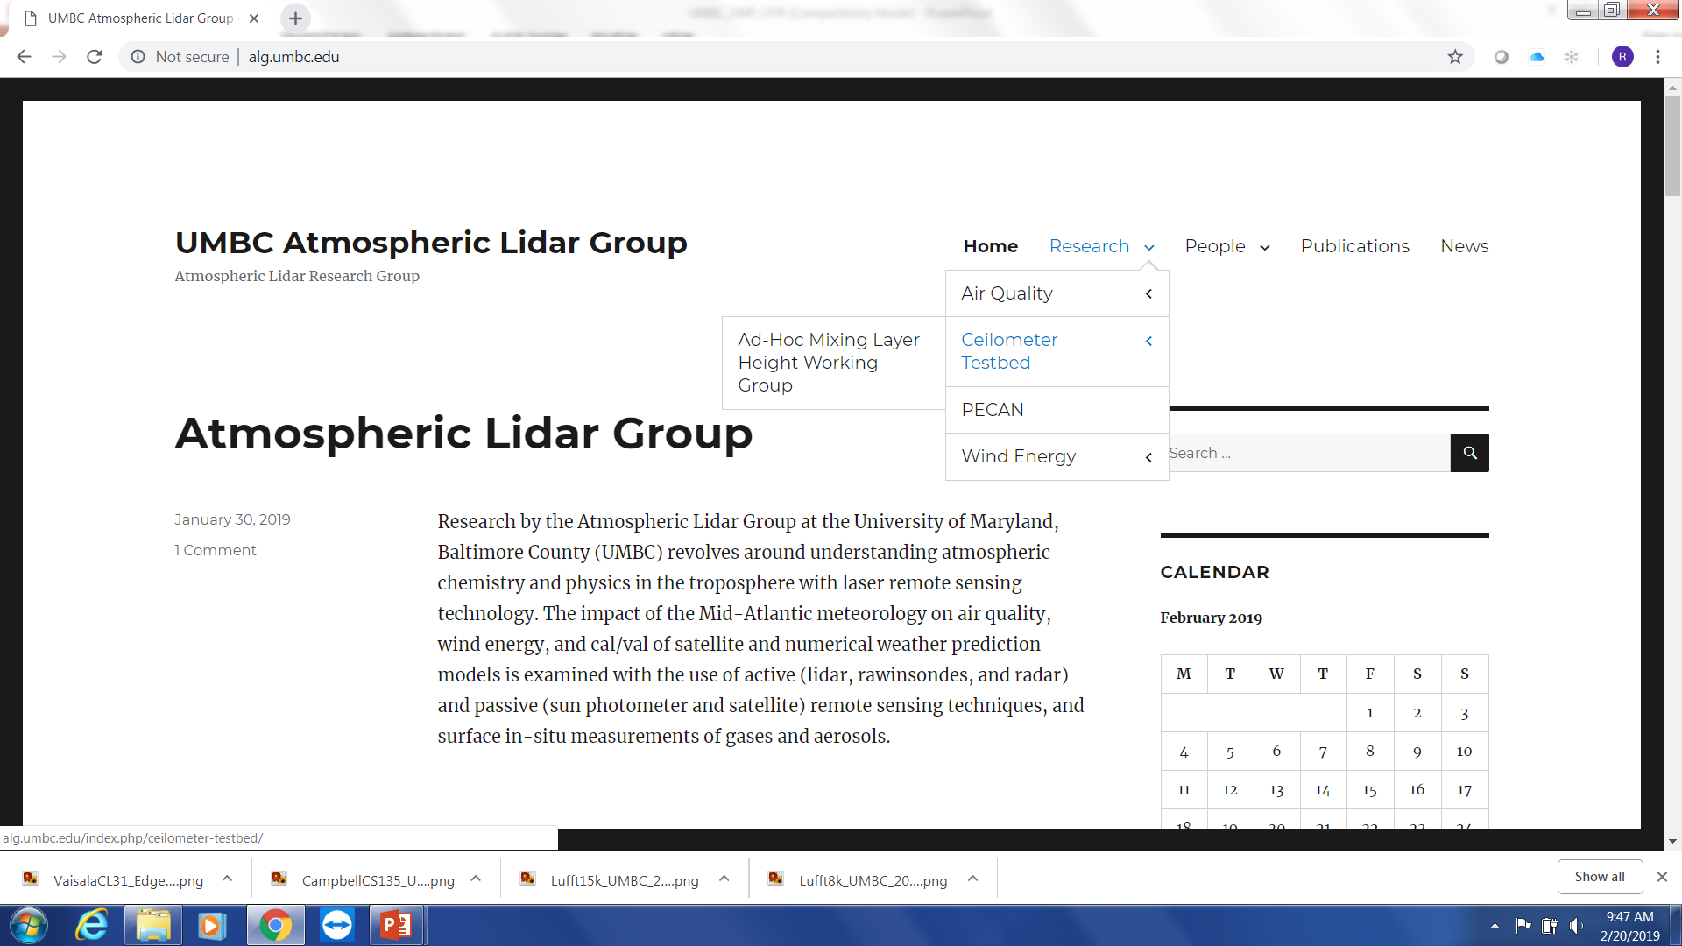
Near Real Time Monitoring Portal
Under Construction
alg.umbc.edu
Distributed Systems & Cyber-Security

Slide 16
Acknowledgements
Maryland Department of the Environment
Environmental Protection Agency
National Weather Service
NOAA Office of Education
Campbell Scientific
Lufft
Vaisala
Leosphere/NRG Systems
Ad-Hoc Mixing Layer Height Working Group
http://lidar.umbc.edu/ad-hoc-mixing-layer-height-working-group/

