Slide 1
Spaceborne observations of sun glint and near-cloud aerosols
Tamás Várnai^{1,2}, Alexander Marshak¹, Guoyong Wen^{1,3}, Weidong Yang^{1,4}, Thomas Eck^{1,4}, Robert Levy¹, Alexander Kostinski⁵
1: NASA GSFC, 2: UMBC JCET, 3: Morgan State Univ., 4: USRA, 5: Michigan Technological University

Slide 2
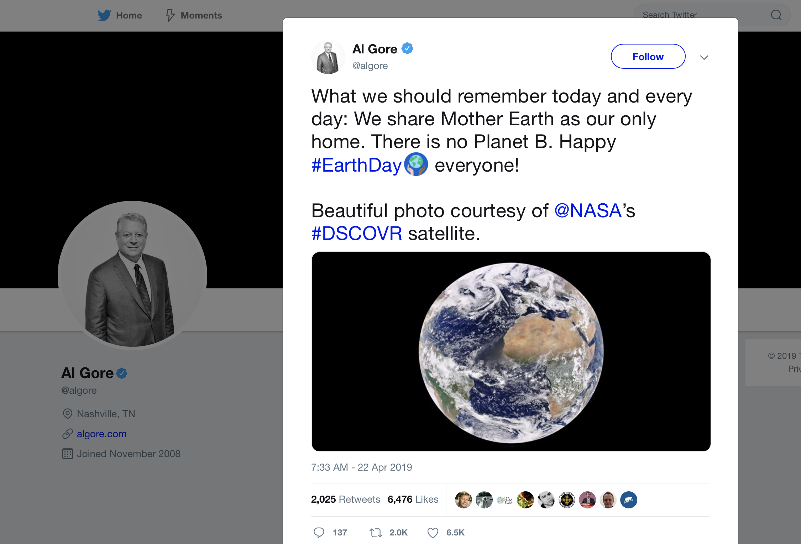
Earth Day tweet from Al Gore

Slide 3
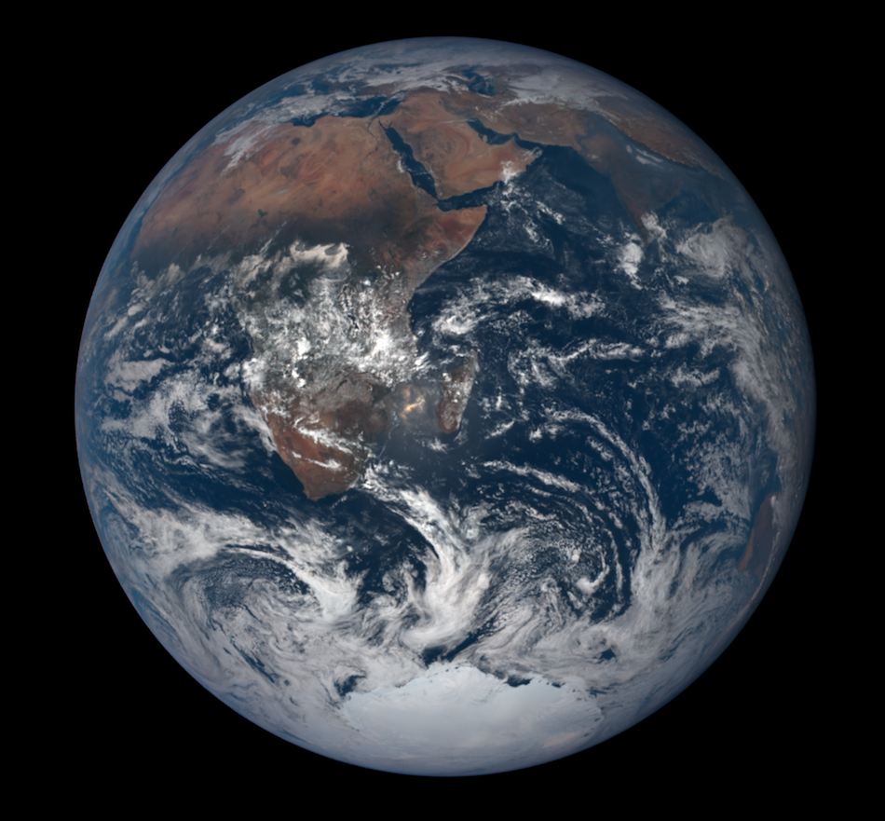
DSCOVR’s EPIC camera: images of Earth’s sunlit side
Apollo 17
Dec 7, 1972
EPIC
Dec 7, 2016
44 years later

Slide 4
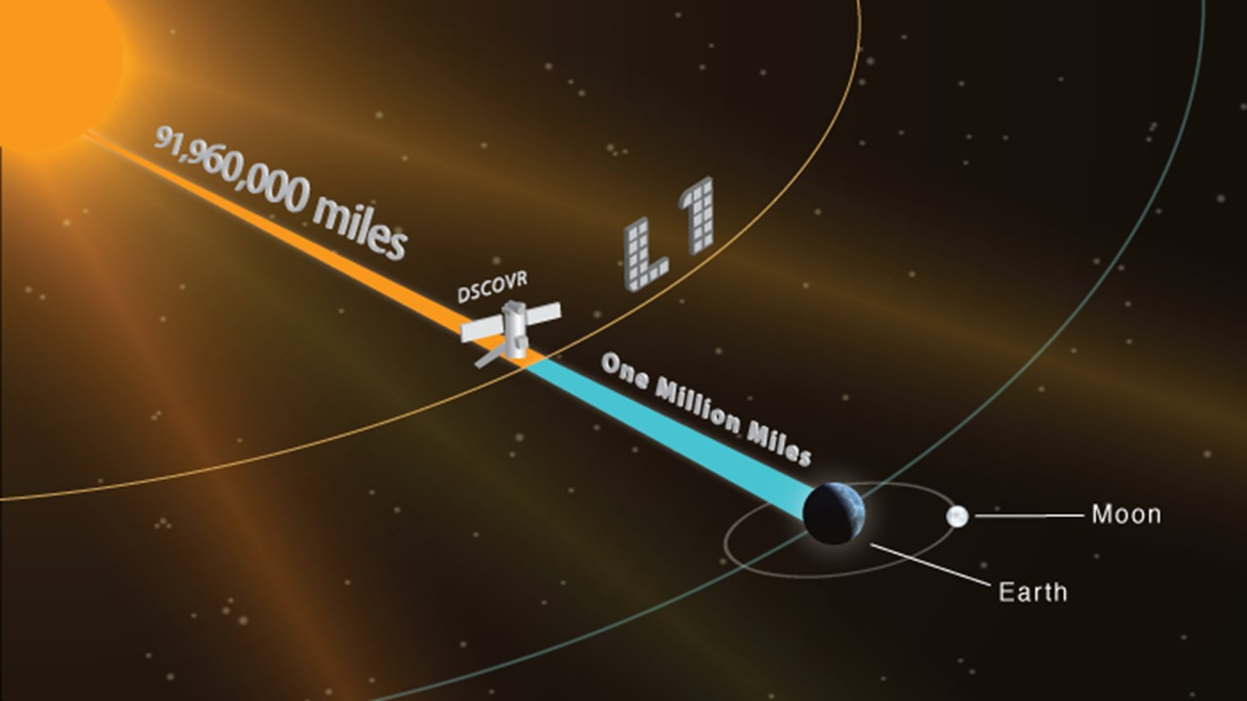
The DSCOVR spacecraft is at the L1 Lagrangian point

Slide 5
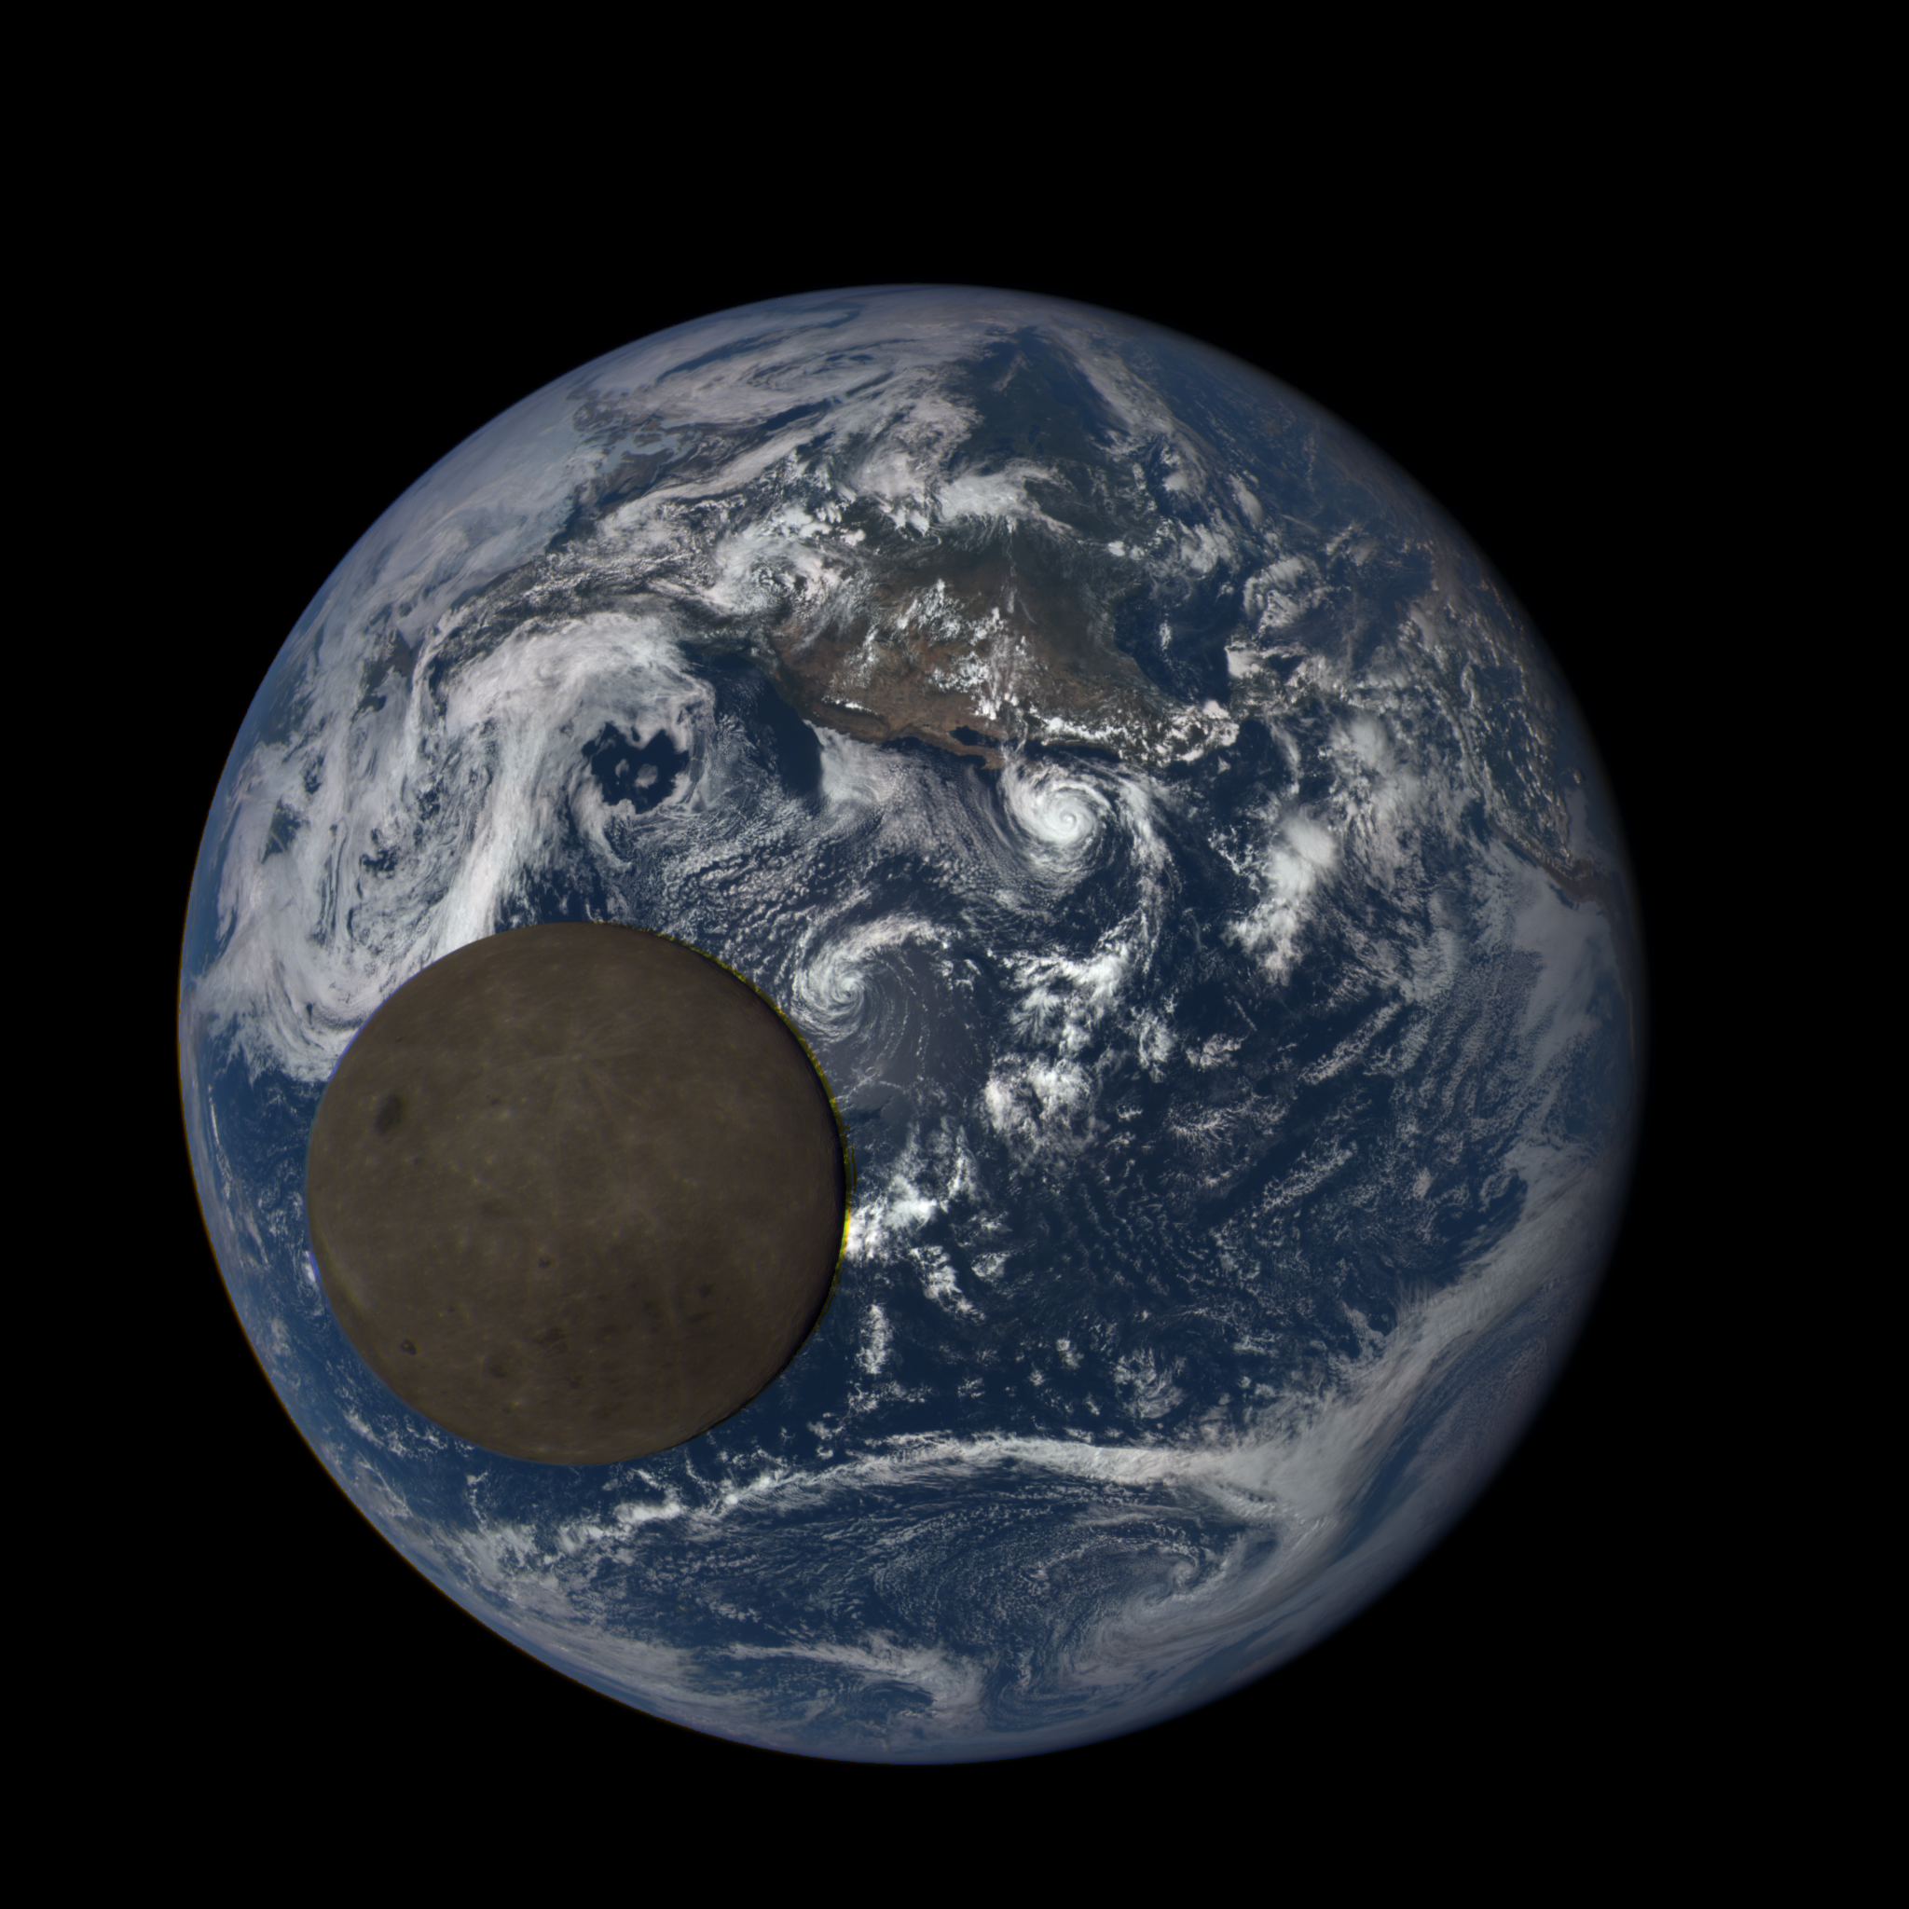
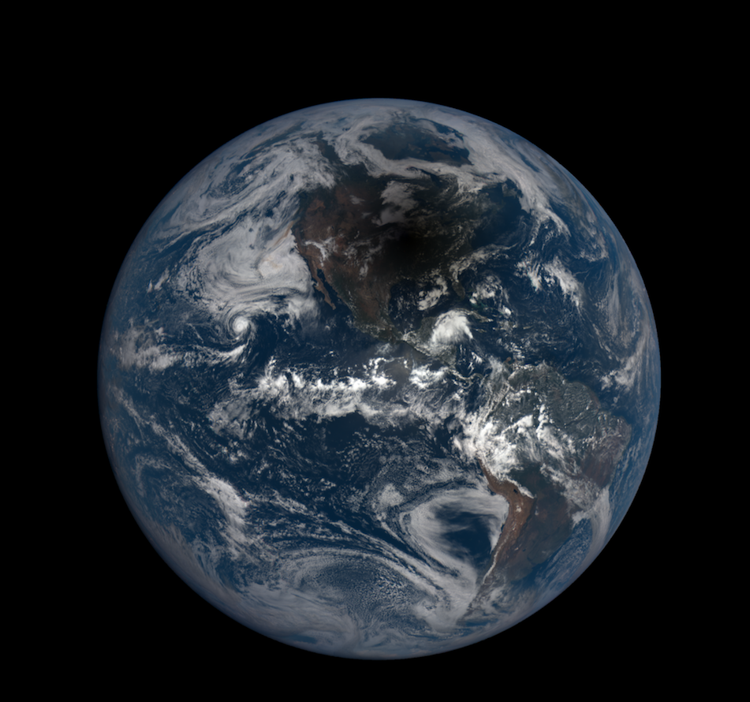
In 2018, Epic.gsfc.nasa.gov was the 9th most popular NASA website
July 16, 2015
August 21, 2017

Slide 6
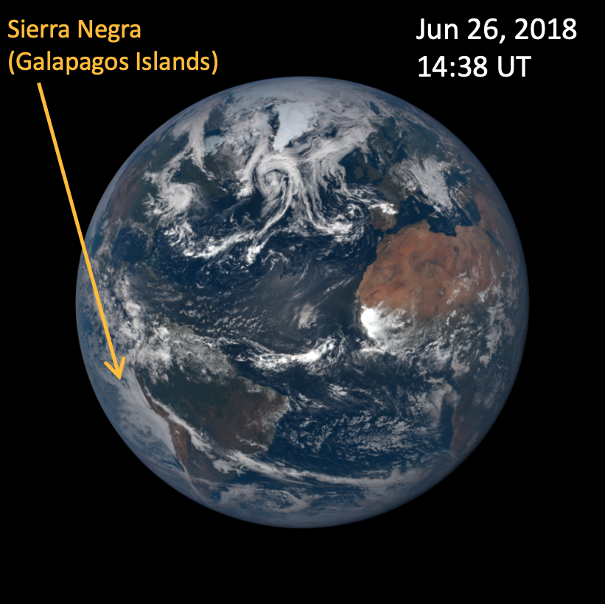
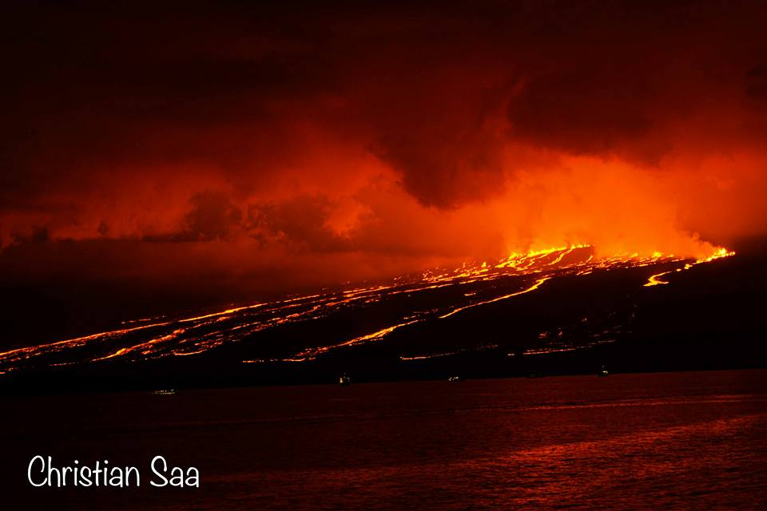
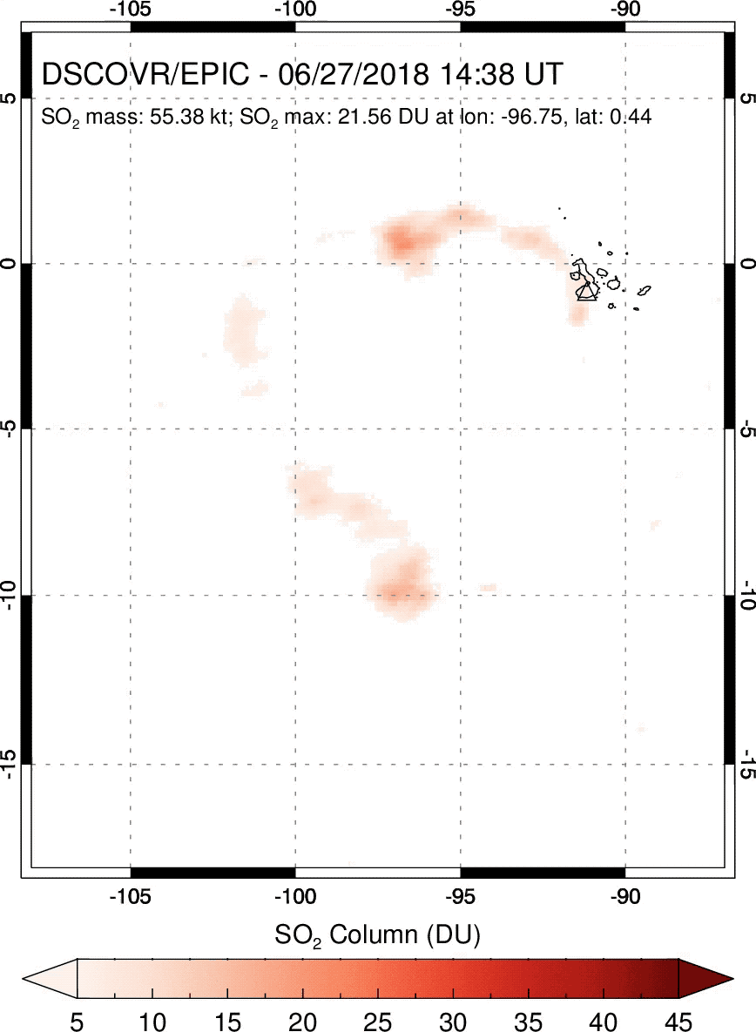
Many DSCOVR science products are available
Ozone
Volcanic SO₂
UV aerosol
Clouds
Atmospheric correction
Vegetation
Eruption captured in 8-9 consecutive, hourly EPIC images
First observations of volcanic eruption clouds from the L1 Earth-Sun Lagrange point by DSCOVR/EPIC
S. A. Carn¹, N. A. Krotkov², B.L. Fisher^{2,3}, C. Li^{2,4}, and A.J. Prata⁵
¹Michigan Technological University, ²NASA GSFC, ³SSAI, ⁴ESSIC, ⁵AIRES Pty Ltd.
GRL, 2018

Slide 7
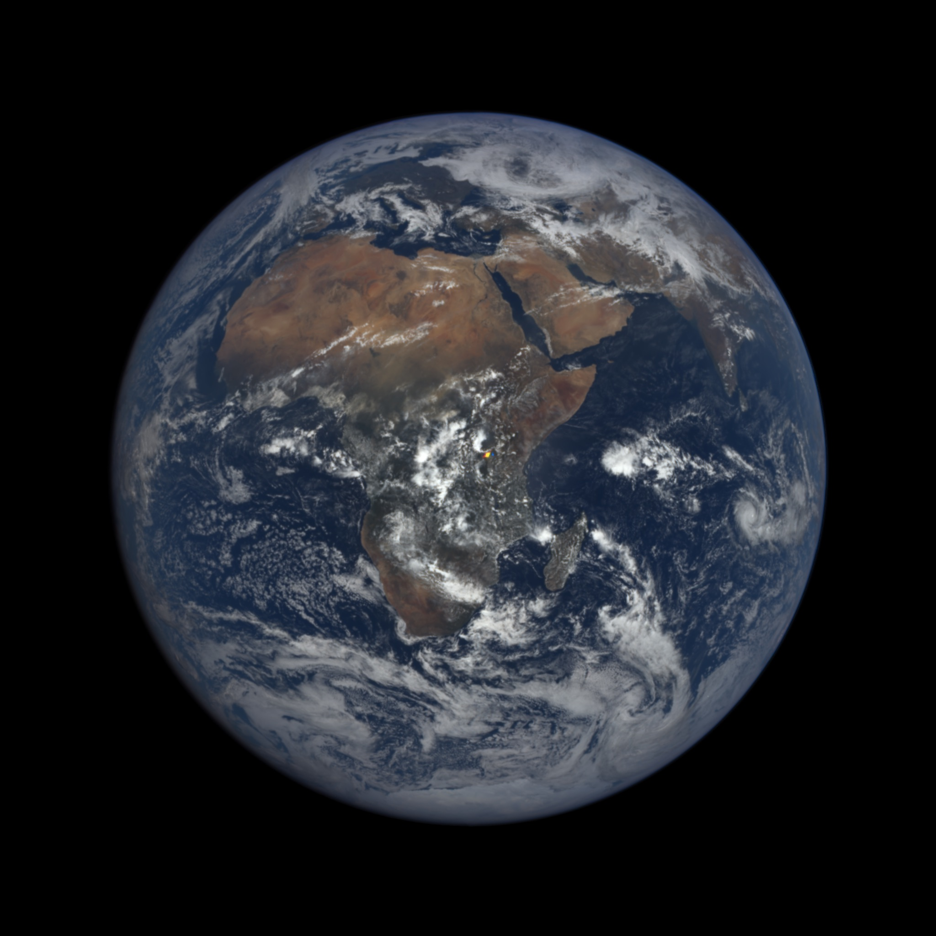
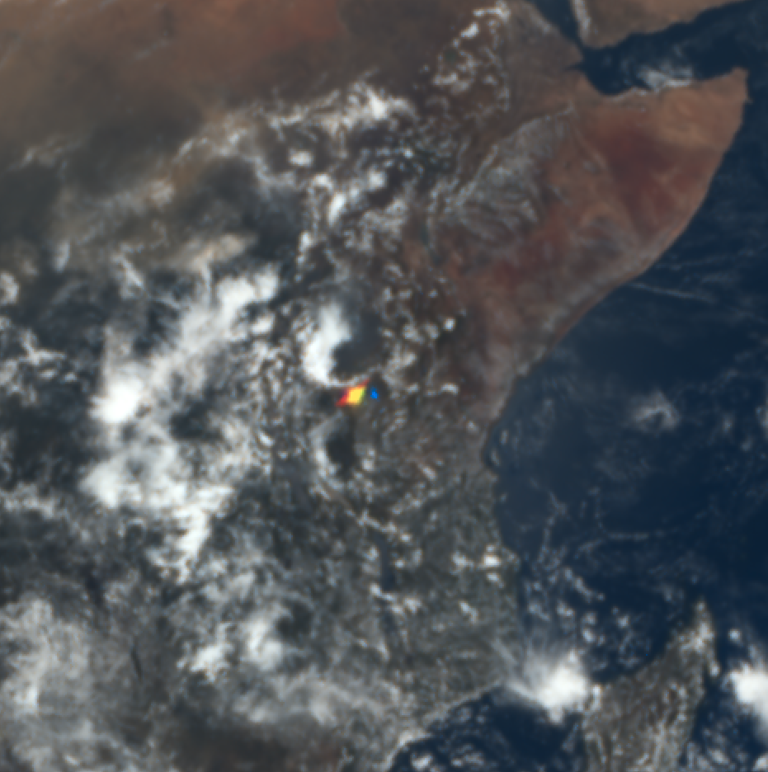
EPIC images often contain colorful bright spots
2016 03 17, 09:46 UTC

Slide 8
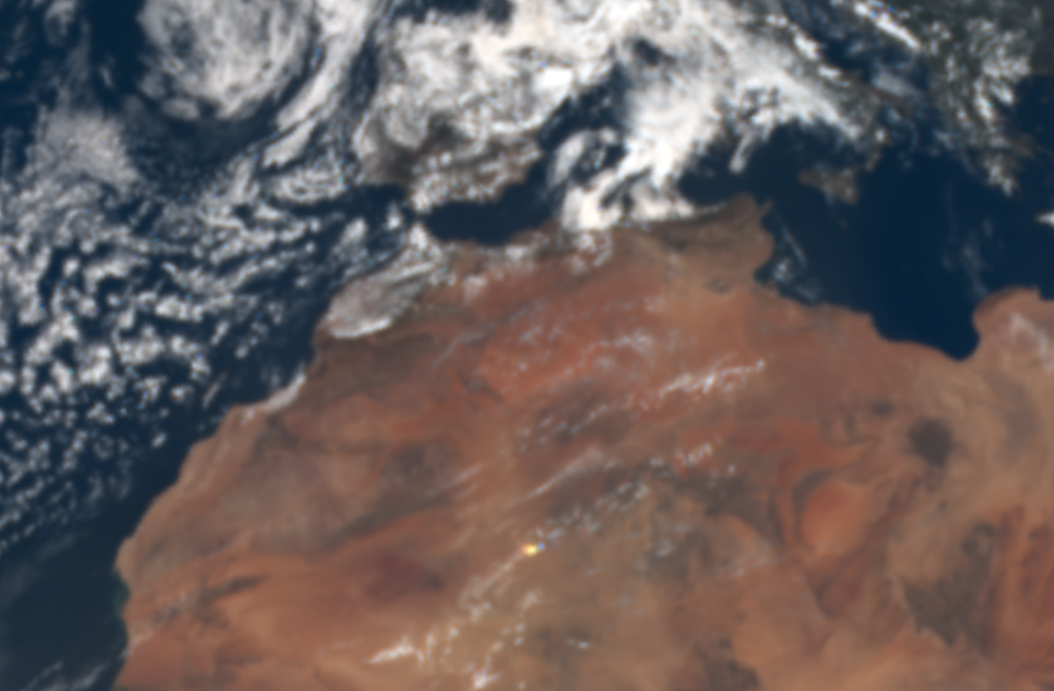
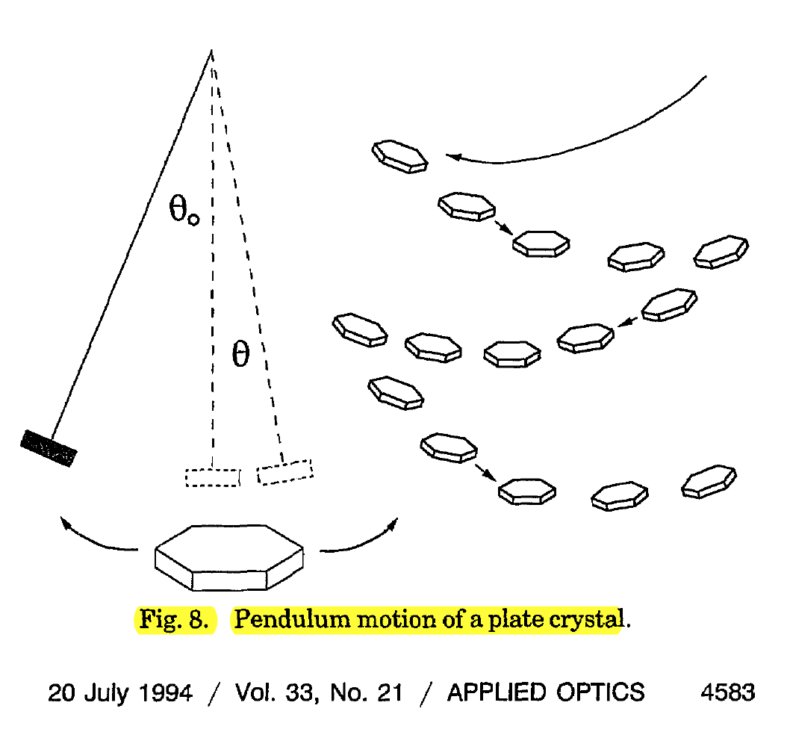
Likely cause of such spots: ice crystals in clouds
2018-05-28

Slide 9
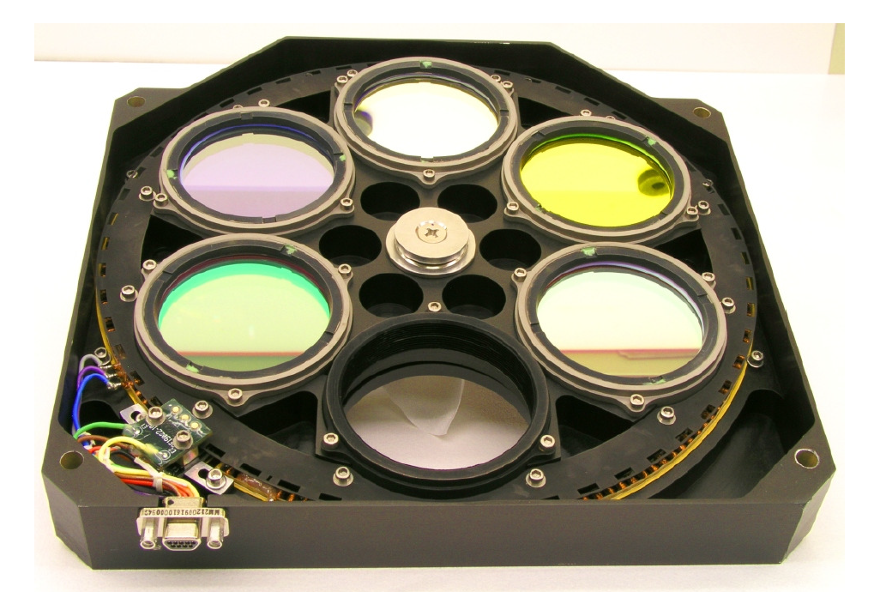
Glint form horizontal ice crystals in clouds (subsun)
Photo from aircraft
EPIC image
EPIC filter wheel
Können (2017, BAMS)
2016 03 17, 09:46 UTC

Slide 10
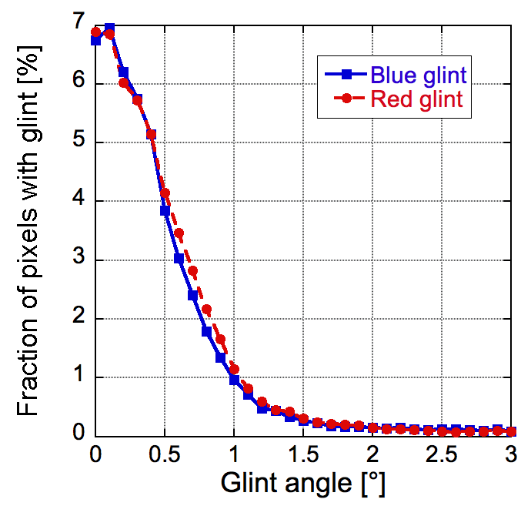
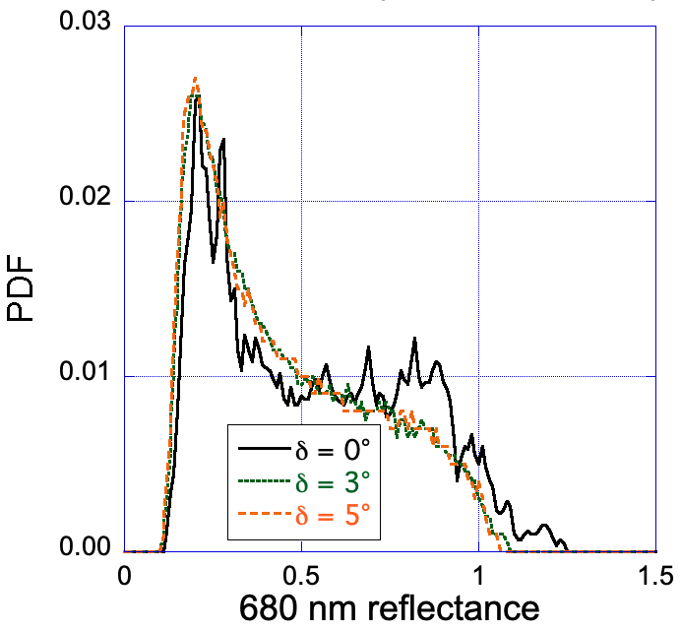
EPIC can be used as quasi multi-angle instrument
Statistically, how bright and wide are glints at various wavelengths?
DSCOVR
All oceans, 1 year
Glint angle
What are the prevalence, size, and tilt of horizontally oriented ice crystals, and how do these crystals affect cloud albedo?

Slide 11
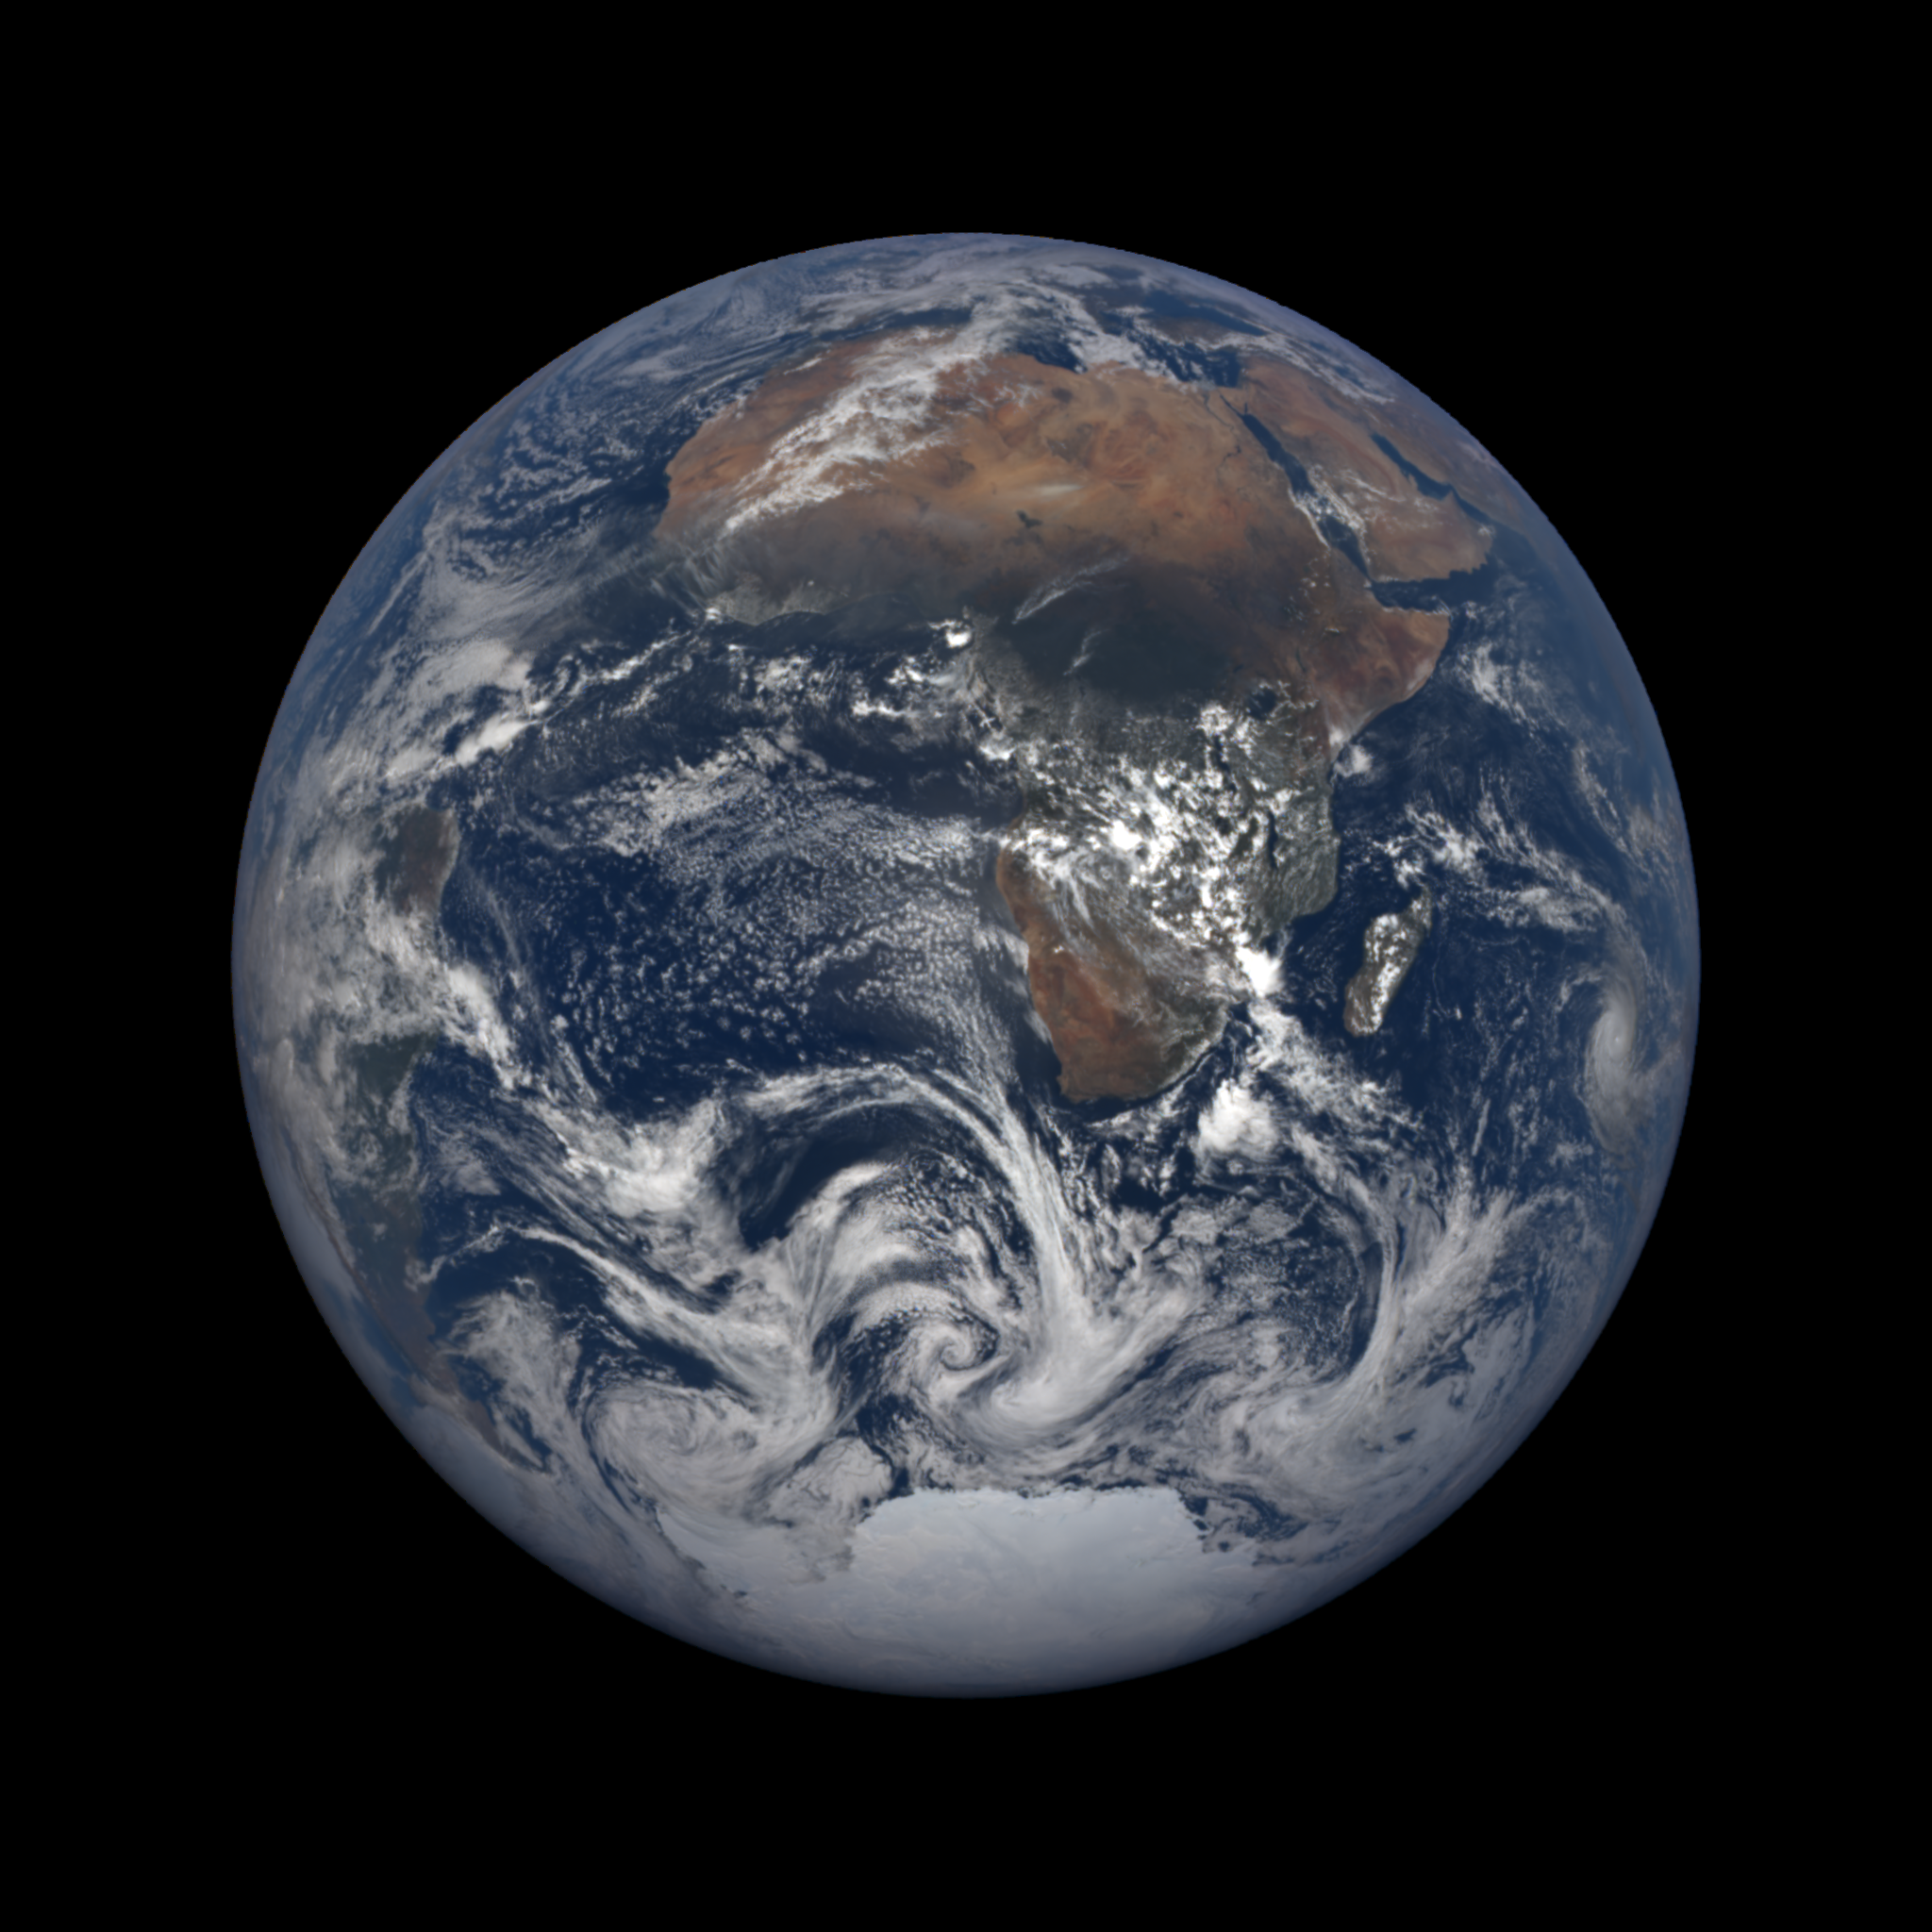
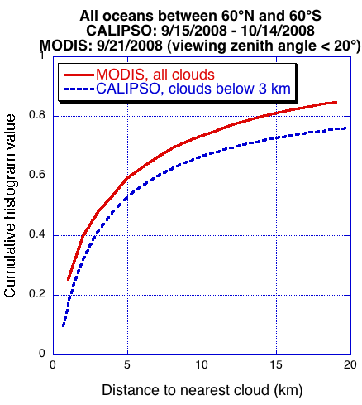
Most clear areas are not too far from clouds
February 1, 2018

Slide 12
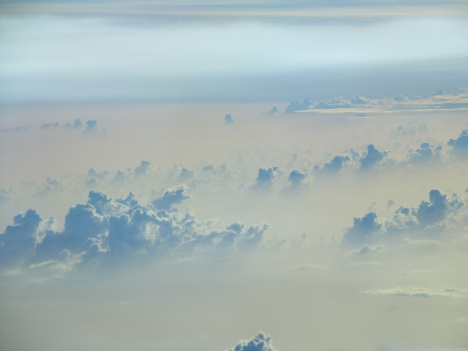
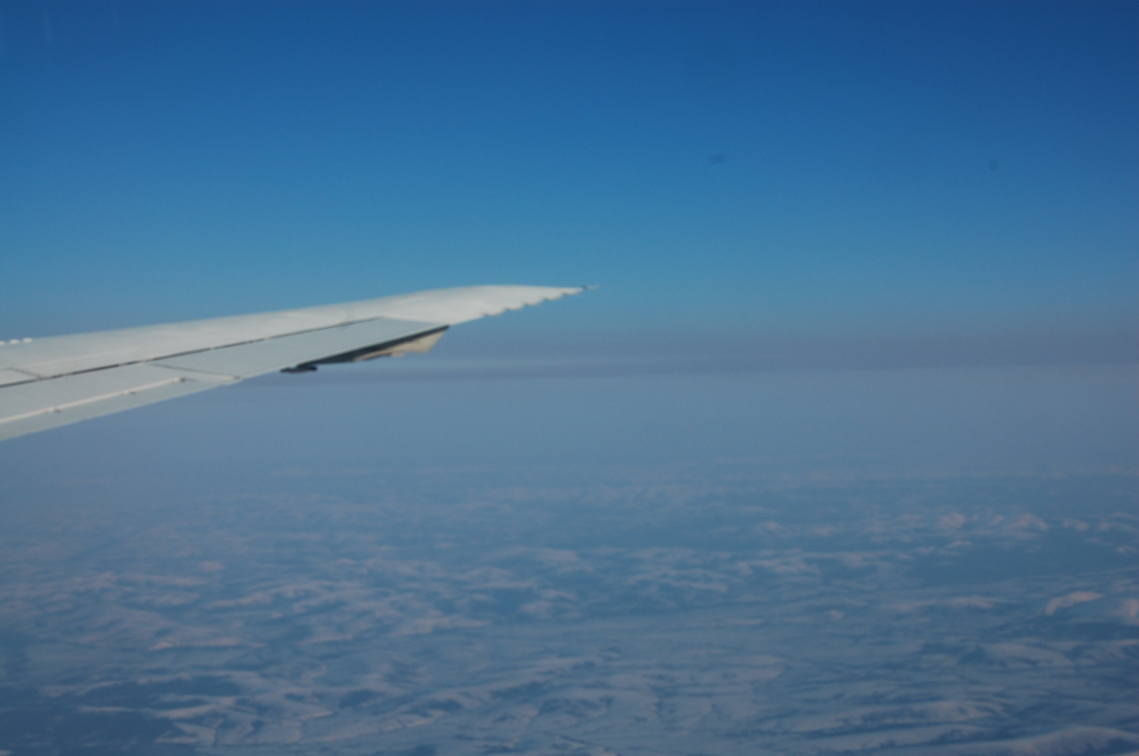
Aerosol remote sensing is especially difficult near clouds
Saharan dust & clouds
Arctic haze
View from G-IV, J. Dunion, NOAA
View from DC-8; A. Wisthaler, NOAA

Slide 13
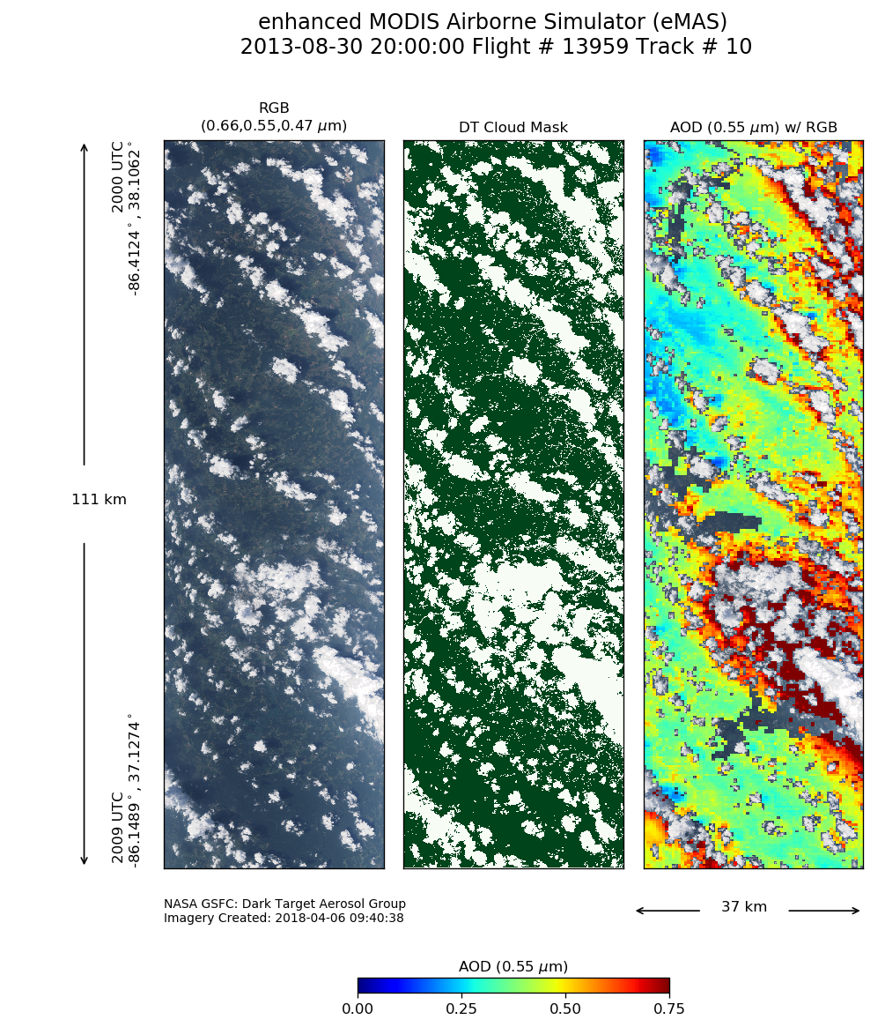
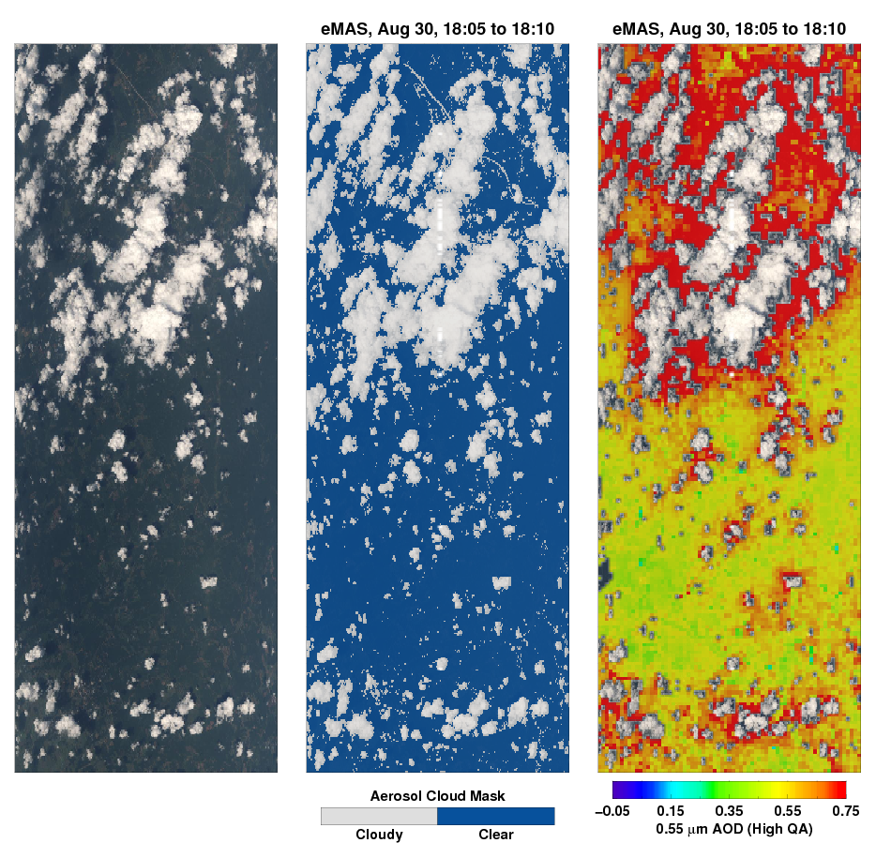
Aerosols are different near clouds; ignoring this would underestimate aerosol direct and indirect radiative effects
RGB image
Cloud mask
AOD
RGB image
Cloud mask
AOD
37 km
37 km
NASA ER-2 eMAS, SEAC4RS, Kentucky & Alabama, August 30, 2013

Slide 14
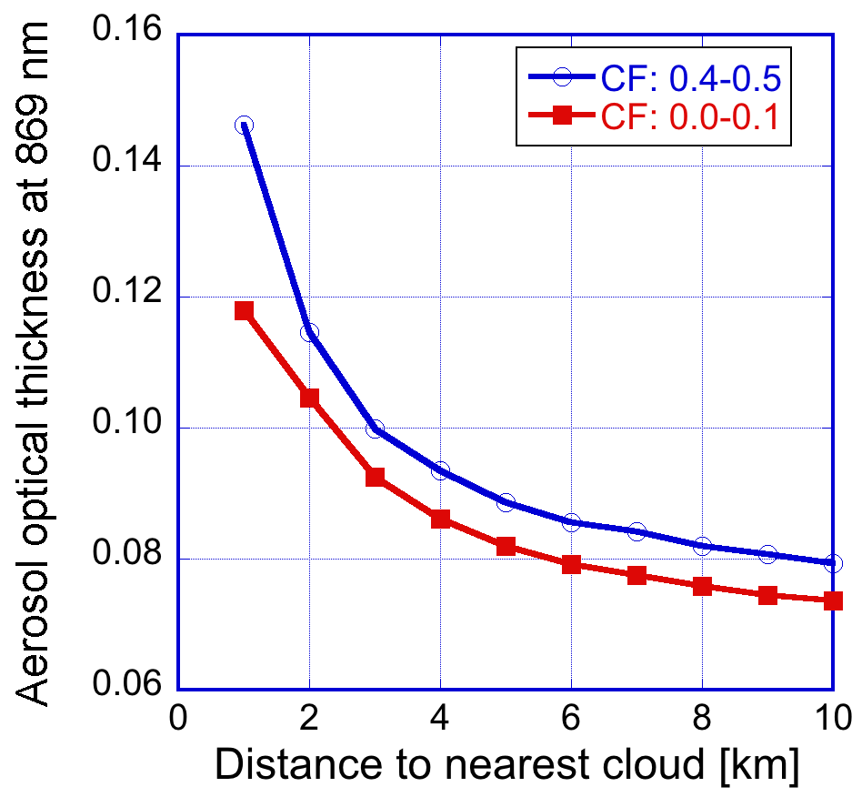
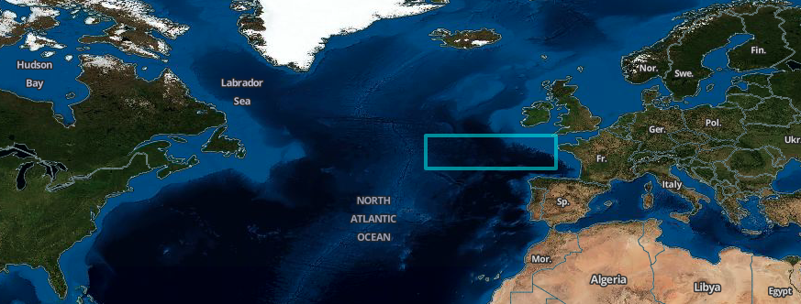
AOD increases near clouds
Retrieved 0.55 µm AOD is 50% higher in the half of data that is closer to clouds
Sept. 14-29, 2002-2011

Slide 15
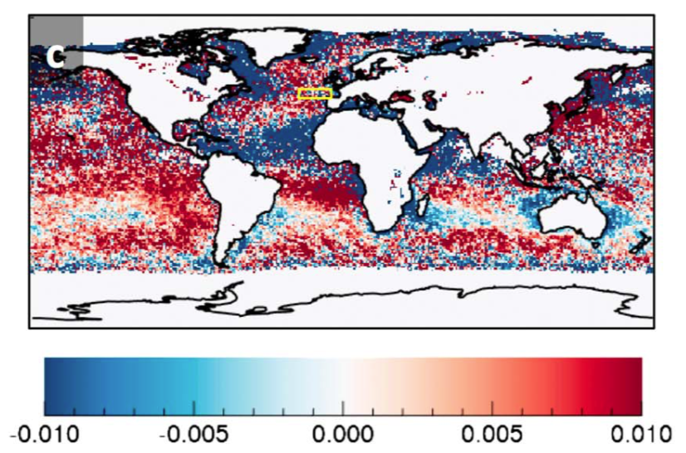
Cloud effects on size distributions are more complex
AOD increases more with CF for
Coarse mode Small mode
MODIS Aqua, JJA 2012-2014

Slide 16
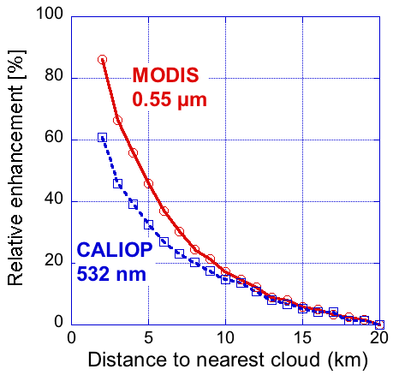
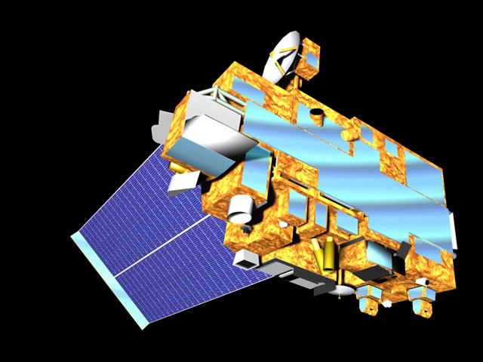
Several processes contribute to near-cloud enhancements
MODIS CALIOP
Both MODIS & CALIOP observe:
Aerosol swelling
Cloud processing
Cloud contamination
MODIS data also affected by:
3D enhancement
Instrument blurring
Relative enhancement
in particle scattering [%]
Distance to nearest cloud [km]
Global oceans, 60°N – 60°S, Nov. 2006 - Oct. 2007

Slide 17
Online 3D radiative transfer simulator is available
Quick 1D & 3D Monte Carlo simulations through web interface (15 sec - 4 min)
Goal: help initial exploration of ideas, class projects
Part of the Intercomparison of 3D Radiation Codes (I3RC) project: i3rcsimulator.umbc.edu
Sample input LES fields

Slide 18
Summary
We explore using EPIC data to constrain the prevalence and size of horizontally oriented ice crystals and their impact on Earth’s albedo.
Clouds and cloud-related processes affect a large portion of aerosols; we seek to help better characterize the affected aerosols and their radiative impacts.

